Slide 1
Pharmacists are healthcare professionals
Key facts

Slide 2
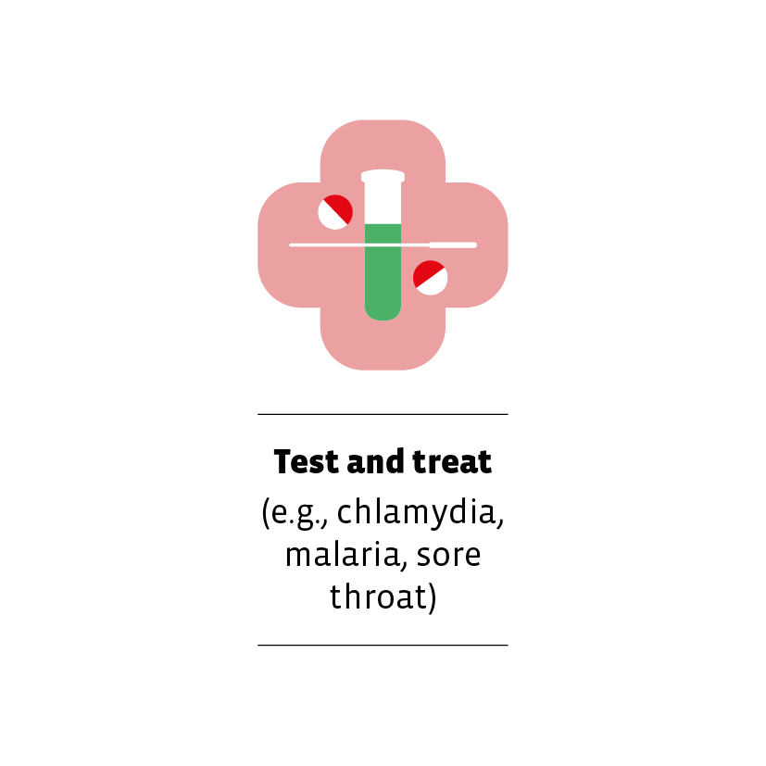
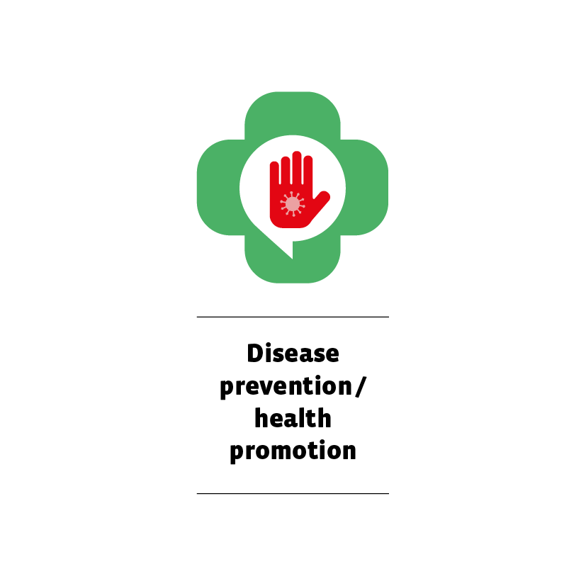
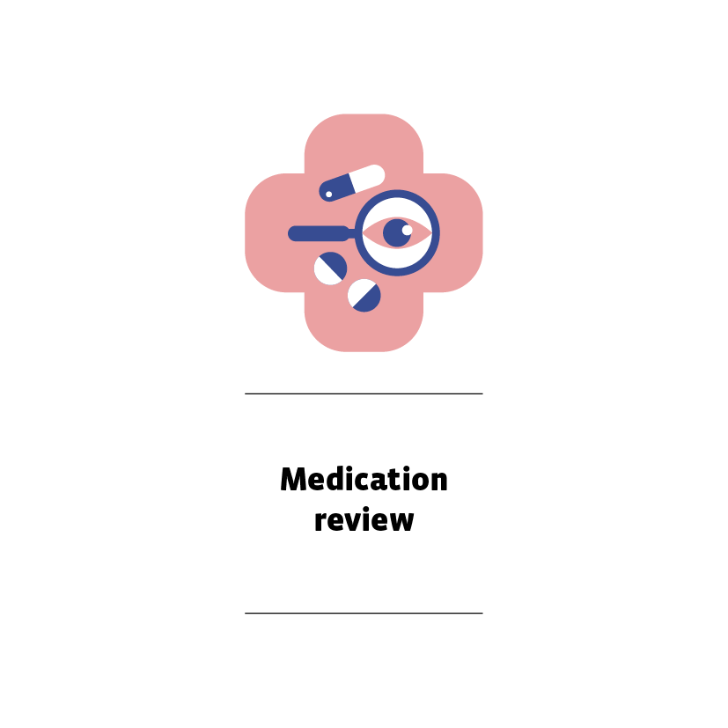
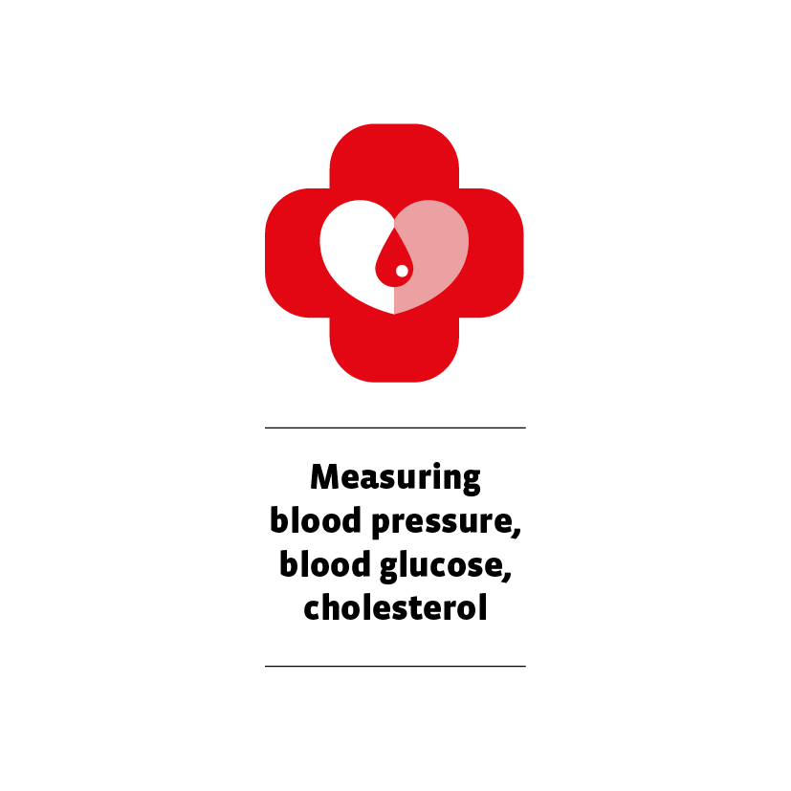
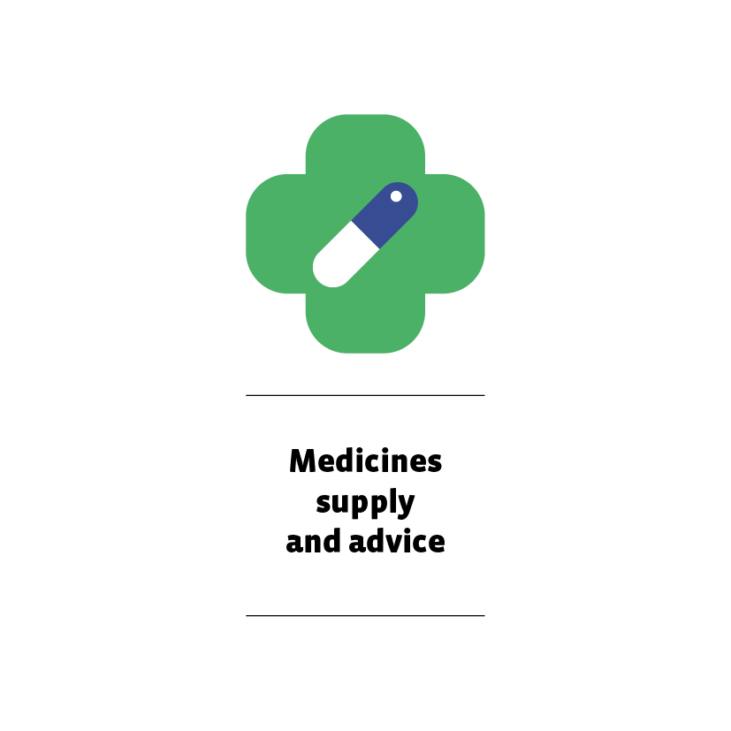
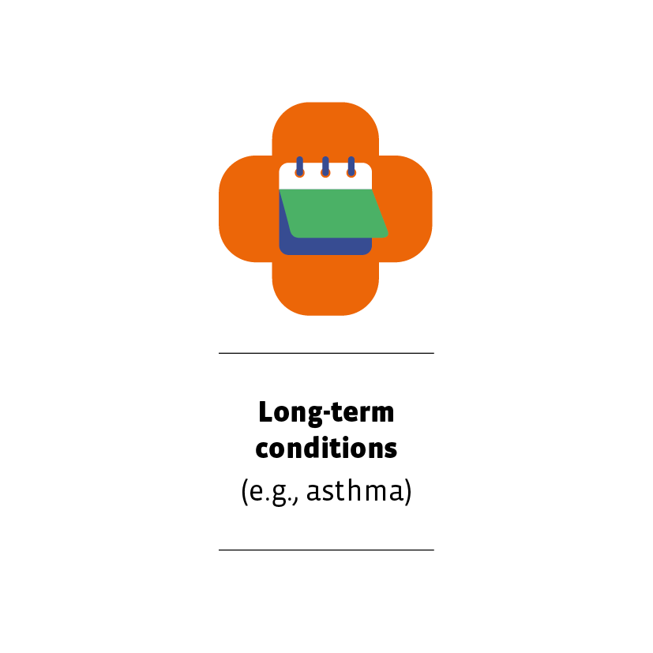
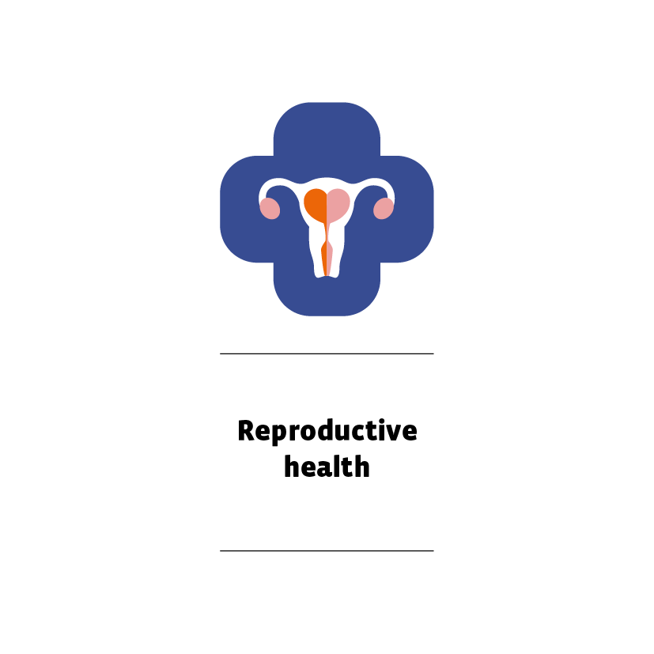
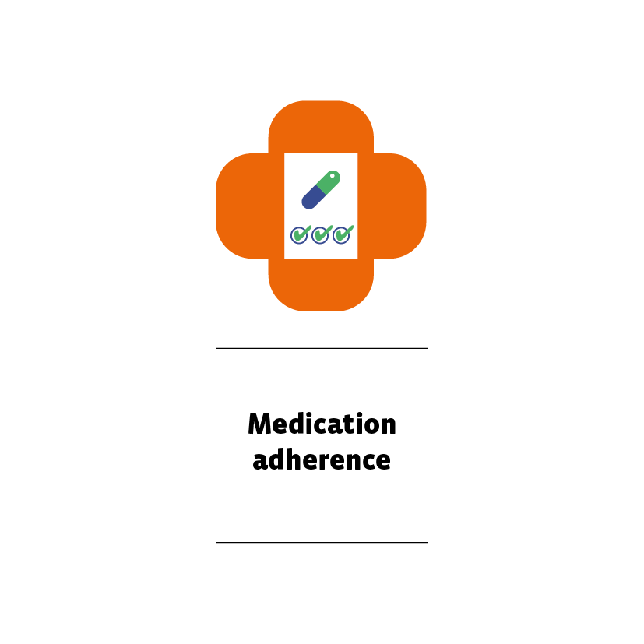
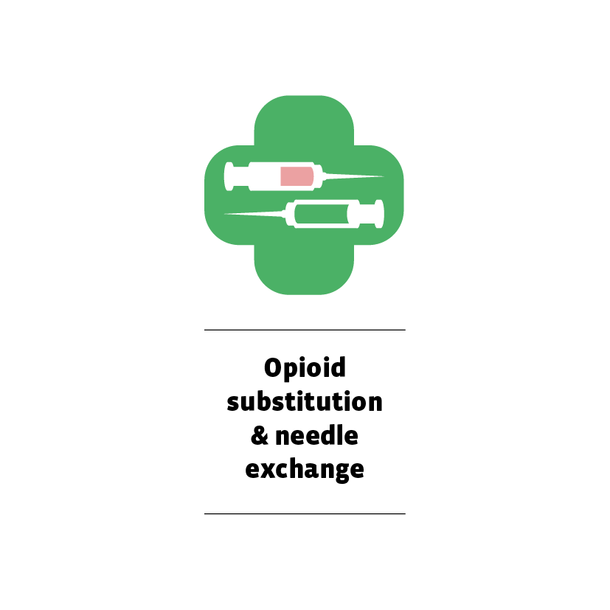
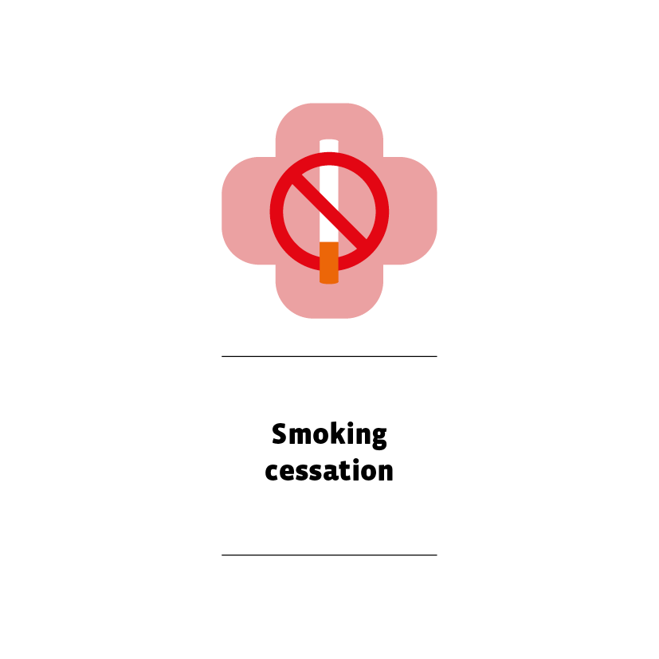
They already provide a wide range of health services^{2,7,8}
Examples include

Slide 3
Recognised by major international organisations
The United Nations uses the density of pharmacists as a measure of progress on Sustainable Development Goal target 3.c.⁹
The International Labour Organization classifies pharmacists as health professionals (sub major group 22, unit group 2262).¹⁰
According to the World Health Organization, “community pharmacists are the health professionals most accessible to the public and are a cornerstone of primary health care. The role of community pharmacists is expanding globally”.¹¹
The Organisation for Economic Cooperation and Development has recommended that countries introduce changes to legislation to expand the role of pharmacists to relieve pressure on the rest of the healthcare system.¹²

Slide 4
Some countries have already introduced changes . . .
Americas
Africa
“The status quo isn’t working. As we put our bold plan into action, you will be connected to care when you need it most and where it’s most convenient.”
“Community pharmacists will now be integrated into primary care networks, registered as service providers.”
Sylvia Jones, Deputy Premier and Minister of Health, Ontario, Canada, on an initiative allowing pharmacist prescribing¹⁴
Susan Nakhumicha, Cabinet Minister, Ministry of Health, Kenya, on implementing the country’s new Social Health Authority¹³

Slide 5
Some countries have already introduced changes . . .
Europe
Eastern
Mediterranean
“We’re changing the future of healthcare with more people accessing care closer to home. Community pharmacists have an important role to play” you need it most and where it’s most convenient.”
The Egyptian Ministry of Health and Population’s new National Population and Development Strategy includes use of pharmacies to improve the quality of family planning.¹⁵
Stephen Donnelly, Minister for Health, Ireland¹⁶

Slide 6
Some countries have already introduced changes . . .
Western Pacific
South East Asia
“We know our hardworking pharmacists are more than capable to deliver [services for common health conditions] and divert people away from our emergency departments and GPs.”
“Pharmacists are one of the key players in the health system and can play significant roles in increasing people’s access to primary care.”
Steven Miles, Premier of Queensland, Australia, on an initiative that increases pharmacists’ scope of practice¹⁸
Jadej Thammatacharee, Secretary General, National Health Security Office, Thailand, on the country’s Universal Coverage Scheme¹⁷

Slide 7
Think Health, Think Pharmacy!
The pharmacy profession needs universal recognition of its unique place in primary health care.
It is through the pharmacy profession that much progress towards Sustainable Development Goal 3 (“good health and well-being for all”) will be made.
We need policymakers to think about universal pharmacy coverage when they think about universal health coverage.
We want everyone to think about pharmacy when they think about their health!
Support the campaign
www.fip.org/think-health-think-pharmacy

Slide 8
References
L’Assurance Maladie: https://tinyurl.com/mr2fwd85
International Pharmaceutical Federation https://tinyurl.com/22h8axhj
International Pharmaceutical Federation www.fip.org/file/5848
Centers for Disease Control and Prevention https://tinyurl.com/mseny9nc
Terry DR et al. Rural and remote health www.rrh.org.au/journal/article/8687.
Price E et al. International Journal of Pharmacy Practice https://pubmed.ncbi.nlm.nih.gov/37543960/
International Pharmaceutical Federation www.fip.org/file/5656.
International Pharmaceutical Federation www.fip.org/file/1348
United Nations https://bit.ly/3Ng0C1k.
International Labour Organization https://bit.ly/3iwI7Yi.
World Health Organization Regional Office for Europe https://bit.ly/3LcsKjZ.
Organisation for Economic Cooperation and Development https://bit.ly/3wJKejE.
Ministry of Health, Kenya https://x.com/MOH_Kenya/status/1800934788984963122
Ontario Newsroom https://news.ontario.ca/en/release/1002683/your-health-a-plan-for-connected-and-convenient-care
Ministry of Health and Population, Egypt https://tinyurl.com/4vb94phe
Stephen Donnelly Twitter https://twitter.com/DonnellyStephen/status/1784308555119579376
National Health Security Office, Thailand https://tinyurl.com/373fyzbm.
Queensland Government https://tinyurl.com/2wrjuxfu.

