Slide 1




FIP Transforming Vaccination Globally & Regionally
Series 2 Setting transformative goals
2.1 Vaccination from specialist practice to every day practice: FIP DG 4 Advanced & Specialist Development
Notes:
At the beginning
Welcome everyone and thank you to those joining us live, and to those listening in afterwards! I’d also like to warmly welcome our guests today who I’ll shortly introduce.
My name is (introduce yourself)
FIP’s vision is a world where everyone benefits from access to safe, effective, quality and affordable medicines and health technologies. Our mission is to support global health by enabling the advancement of pharmaceutical practice, sciences and education.
We’re pleased to be delivering this event, titled “2.1 Vaccination from specialist practice to every day practice: FIP DG 4 Advanced & Specialist Development
”

Slide 2





Announcements
This webinar is being recorded and live-streamed via Facebook
The recording will be freely available on our website www.fip.org
You may ask questions using the question box provided
You are welcome to provide feedback to webinars@fip.org
Become a member of FIP at www.fip.org/membership_registration
©FIP: All the information in this video are confidential and cannot be copied, downloaded or reproduced without the formal approval of FIP (International Pharmaceutical Federation).
Notes:
Some housekeeping announcements first….
This webinar is being recorded and live-streamed via Facebook
The recording will be freely available on our website www.fip.org
You may ask questions using the question box provided
You are welcome to provide feedback to webinars@fip.org
Become a member of FIP at www.fip.org/membership_registration

Slide 3
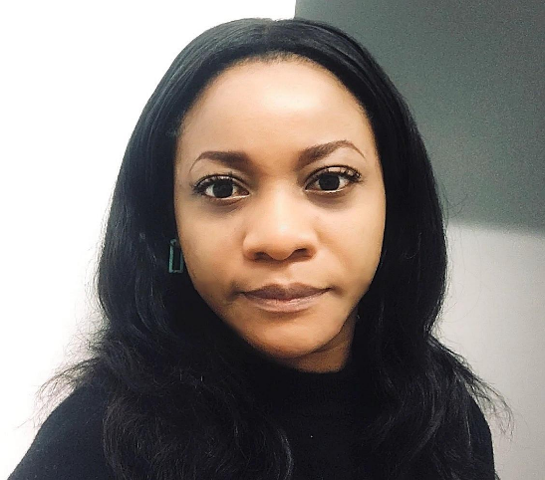
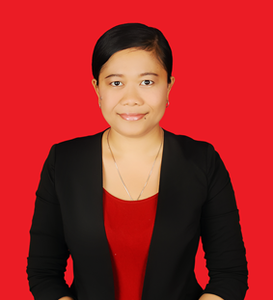
Moderator (s)
Arit Udoh
Desak Ketut Ernawati
Senior Clinical Project Manager - University of Birmingham
Global Lead FIP DG4, Advanced & Specialist Development
Academic and Researcher- Faculty of Medicine Universitas Udayana
Global Lead FIP DG4, Advanced & Specialist Development
Notes:
Introducing moderator and co-moderator (if applicable)
Arit Udoh
Biography:
Arit Udoh is a research professional with a doctorate in advance pharmacy practice and experience in clinical trials, health service evaluation and policy development. She works at the University of Birmingham as the Senior Manager for the Royal College of Surgeons (RCS) Robotics Group research programme in oncology. Arit is also Global Lead for Advance Practice and Specialisation within the Workforce Development Hub of the International Pharmaceutical Federation (FIP). Her research interests are in pharmaceutical public health, health workforce development, medicine use optimisation and drug development.
Desak Ketut Ernawati
Biography:
Desak is an enthusiastic, positive, opened minded, active and fast learner. Her passion is to develop the practice of collaboration among healthcare professionals to ensure the safe use of medication. Her research interests are within clinical pharmacy, pharmacy practice, basic and clinical pharmacology, as well as health workforce competence.

Slide 4

Welcome to the “Transforming Vaccination Regionally & Globally” Programme
Transforming Vaccination Regionally and Globally is the first
FIP Transformation outcome-based online programme of its
kind underpinned by the FIP Development Goals (FIP DGs).
Final outcome of the programme is a historic global
FIP Commitment to Action on Vaccination in Pharmacy.
A FIP Transforming Vaccination Collection (2021).
Notes:
Transforming Vaccination Regionally and Globally is the first FIP Transformation outcome-based online programme of its kind underpinned by the FIP Development Goals (FIP DGs).
Final outcome of the programme is a historic global FIP Commitment to Action on Vaccination in Pharmacy.
A FIP Transforming Vaccination Collection (2021)

Slide 5
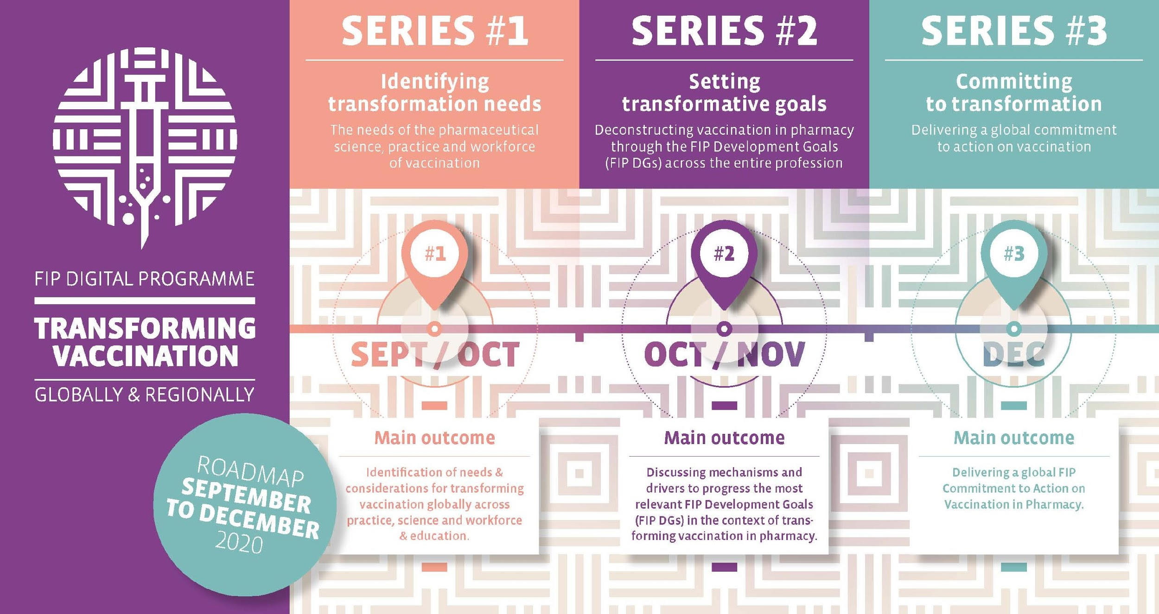
Notes:
The series will run from September to December.
Series 1 events will focus on identifying the needs of the pharmacist and pharmaceutical scientist workforce to deliver on vaccination transformation.
Series 2 events will discuss the actions required to deliver on the needs identified in series 1, aligned to the FIP Development Goals.
Series 3 will focus on FIP member organizations across 6 regions, and how they have addressed or will address these actions to deliver on the commitment to transform vaccines globally and regionally.

Slide 6
Important Links & Resources
Transforming Vaccination Regionally & Globally Webpage
transformingvaccination.fip.org
Engage with us and help us answer the following questions:
What single factor should be prioritized to transform pharmacy vaccination services globally and regionally?
What would be the most important achievement in terms of pharmacy vaccination services in your country in the next five years?
What else should the FIP Commitment to action outline?
Notes:
We urge you to engage with us and help us answer those questions, type your answers in the chat box
In your opinion:
What single factor should be prioritized to transform pharmacy vaccination services globally and regionally?
What would be the most important achievement in terms of pharmacy vaccination services in your country in the next five years?
What else should the FIP Commitment to action outline?

Slide 7

Today’s Learning Objectives
To understand the impact of FIP Development Goal 4: Advanced & Specialist Development in the Transformation of Vaccination Globally and Regionally.
Notes:
In today’s episode: “Vaccination: From Specialist Practice to Every Day Practice” – is an interview format that focuses on the FIP Development Goal 4: Advanced & Specialist Development from the perspective of vaccination by pharmacist. We discuss the process required to take vaccination by pharmacists from a specialised field that few pharmacists deliver in some jurisdictions, to a standard part of pharmacists care in all settings and locations.
Among many others, our main outcome for today is to understand the impact of FIP Development Goal 4: Advanced & Specialist Development in the Transformation of Vaccination Globally and Regionally

Slide 8
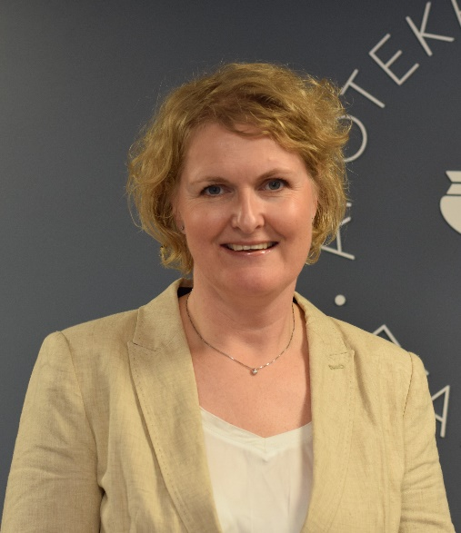
Speaker 1
Hanne Merete Andresen
Director Pharmaceutical Affairs
Norwegian Pharmacy Association
Notes:
I’m now pleased to be introducing our first speaker Hanne Merete Andresen
Biography: She has her background from different positions in Norsk Medisinaldepot (NMD) which is the Norwegian subsidiary of the McKesson group. NMD is one out of three wholesalers in Norway and operates two pharmacy chains (Vitusapotek (about 270 pharmacies owned by NMD) and Ditt Apotek (75 privately owned pharmacies)). She worked for NMD for 17 years as director for quality and pharmacy services most of the time, but have also experience from logistics, HR and hospital tender business.
During this time (from 1997 until 2014) pharmacy market in Norway went through a deregulating process which gave many “once in a lifetime” experiences when regulations changed and the pharmacy chains was developed.
In 2014 she decided to establish her own private pharmacy and left NMD. Maura pharmacy is a local community pharmacy, where she worked as chief pharmacist from the start until May this year. During this time vaccination was introduced as a service in most Norwegian pharmacies, and she has experience from the practical work for the last two flu seasons.
In May she joined the Pharmacy Association as Director for Pharmaceutical Affairs, and today vaccination and further development of the service is one of her responsibilities. This September Norwegian Pharmacists got the right to prescribe the flu vaccine, and there are a lot of activities going on in the pharmacies these days. Be the end of last week pharmacies had already administered 23 000 doses…….

Slide 9
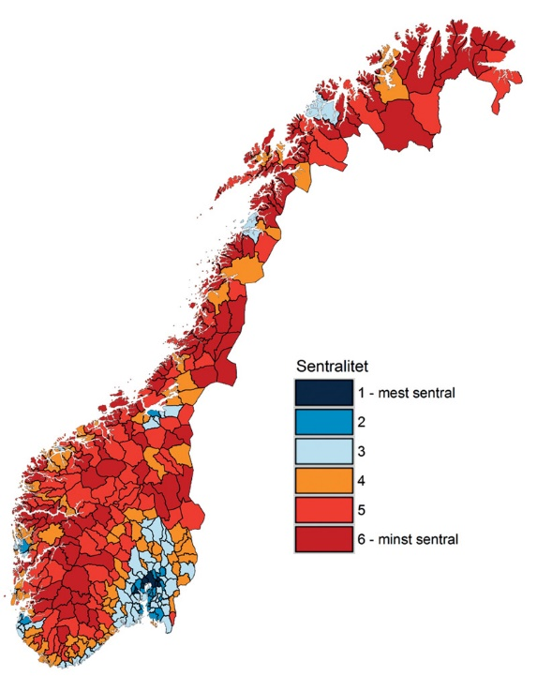
Vaccination - Norway
Demographic facts
National Immunisation Programme organised by the Norwegian Institute of Public Health
The municipalities are responsible for vaccination
​About 900 deaths/year due to seasonal flu influenza
1,6 mill persons in risk groups
Vaccine coverage in risk groups:
39% vaccinated in 2019 (WHO target: 75%)
High pressure on primary health care and GP’s
Notes:
I will first give a very short update on some demographic facts and facts regarding vaccination in our country.
Vaccines in the immunisation program are distributed by the Norwegian Institute of Public Health. The program defines and includes people in risk groups for influenza. Vaccines are distributed to the municipalities, and further to GPs and local vaccination centres. The Program includes vaccination for the children, influenza, and this week Covid-19 vaccines will be included in the regulations.

Slide 10
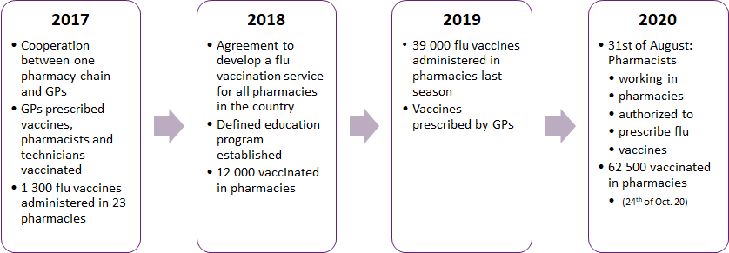
Developing vaccination service in pharmacies
Flu vaccination in Norwegian pharmacies – timeline
Notes:
The first vaccines where administered by pharmacist in 2017. It was then part of a project in one of our pharmacy chains.
All pharmacies in Norway are members of the Norwegian Pharmacy Association, and we have a good tradition for cooperation between the chains when it comes to the development of national services. The Pharmacy Association coordinated the project and worked with the politicians and the government to get acceptance and support. We introduced vaccination as a national service in 2018.
After 2018 the chains continued to educate and train pharmacists and technicians according to the national standards, and 39 000 vaccines where administered in pharmacies in 2019.
In 2019 39000 vaccines was administered in the pharmacies based on prescriptions from the GPs. Feedback from the patients was very positive.
The legal changes was communicated the 31st of August, Pharmacists authorized to prescribe vaccines.
The 8th of September we published our national service for prescribing flu vaccines for all pharmacies in the country. This includes standards for prescribing flu vaccines together with a training program.
Ten days later the pharmacies where instructed only to offer vaccines to people in defines risk groups. As explained earlier it’s the National Institute for public Health that buy and distribute vaccines to people in the national program. This year the pharmacy wholesalers had orders for 300’ vaccines in addition to the quantities the institute had ordered. By this temporary legislation the authorities made sure only people in risk groups are vaccinated until the 1st of December.
Today there is uncertain if there will be more vaccines available after the 1st of December

Slide 11
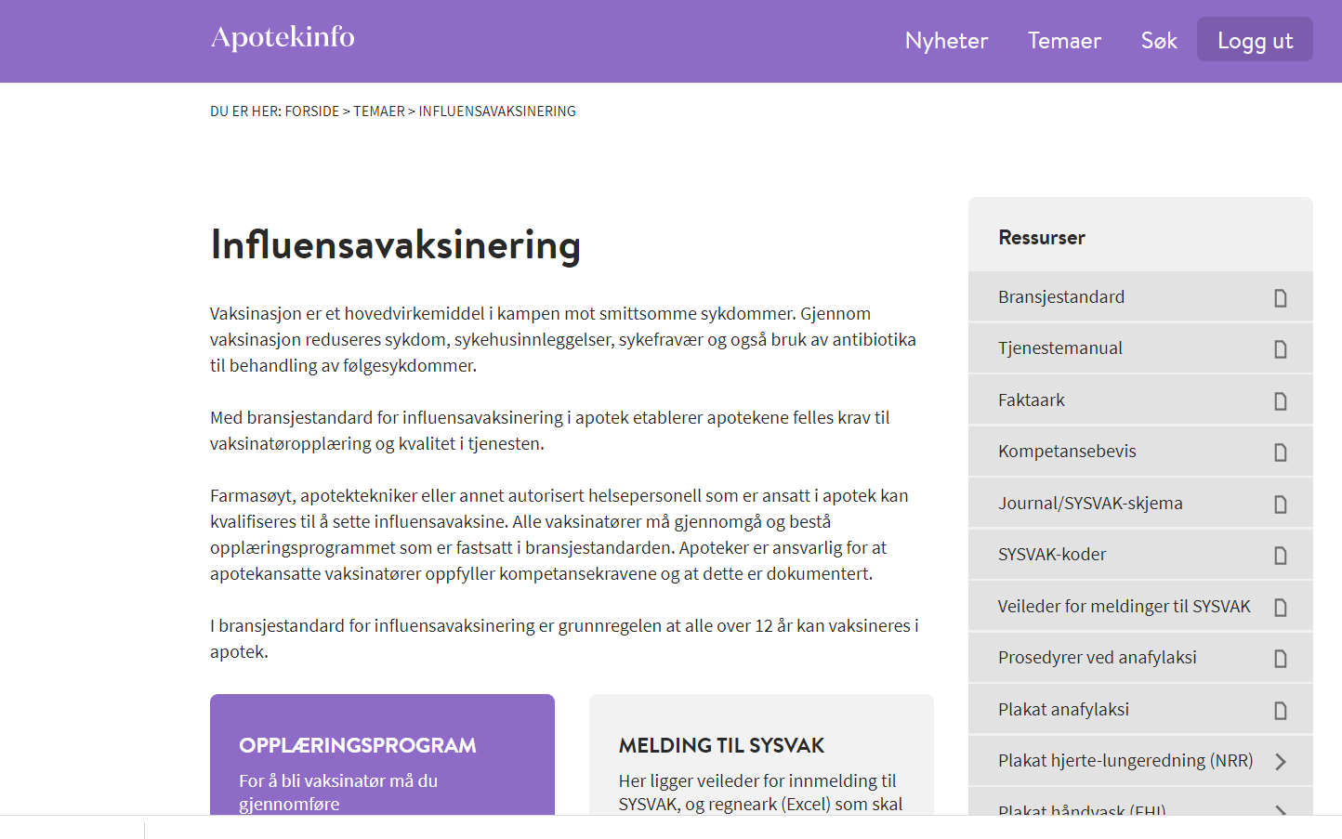
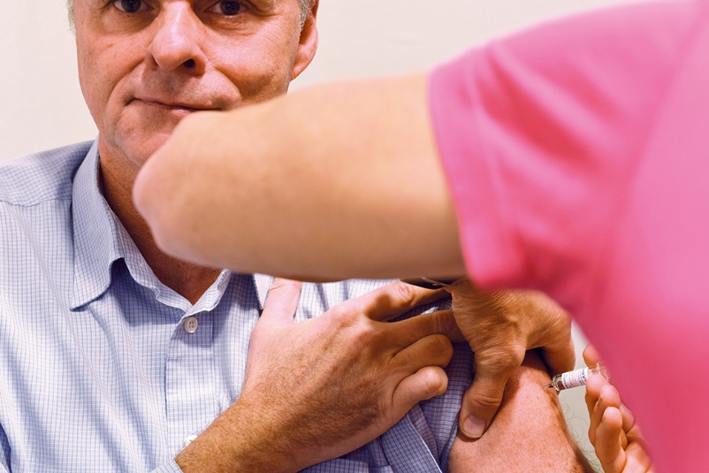
Administration of flu vaccines
Notes:
Standardized program for flu vaccine injections in all pharmacies. Procedures published for all Norwegian pharmacies on The Pharmacy Association Intranet.

Slide 12
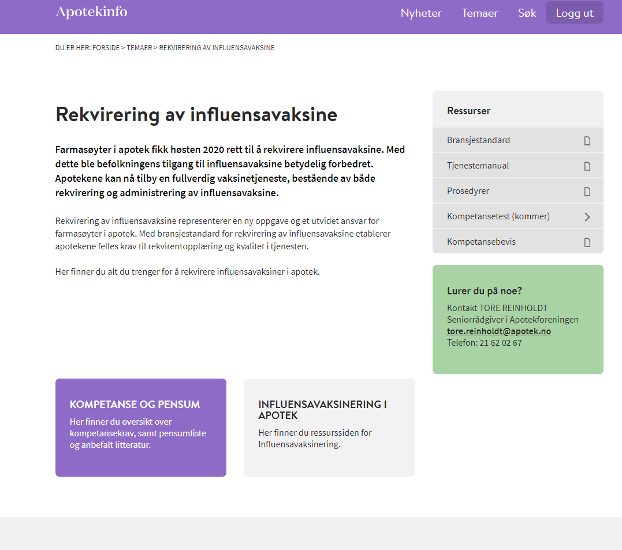
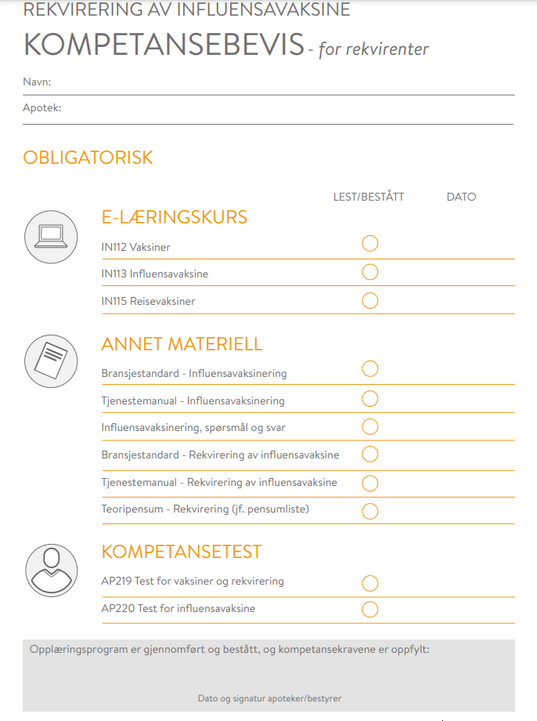
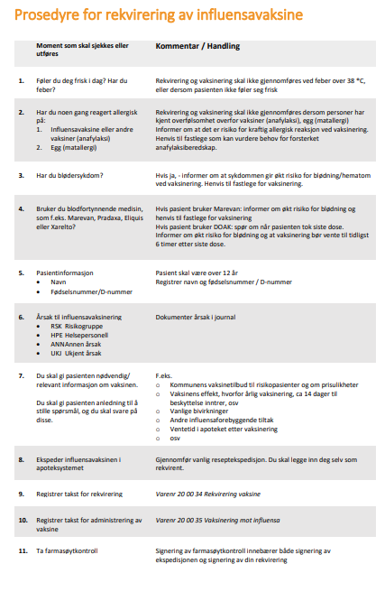
Standardised prescribing procedure published 8th of September

Slide 13
Status by the end of week 43
85 % out of our pharmacies offer vaccine service
2 000 pharmacists prescribe
4 000 pharmacy employees administer vaccines

Slide 14
Work in progress – preparations for 2021
Positioning the pharmacies as a part of the National immunisation program (including reimbursement) for both seasonal flu vaccination and Covid-19
Improve digital reporting to the national register for vaccination
Educate more pharmacy staff to vaccinate
Cooperate with the universities to include the service in the education
Cooperate with the Authorities to prepare for the next flu season
  vaccines for 2021/2022 to be ordered just in a few weeks time…..

Slide 15
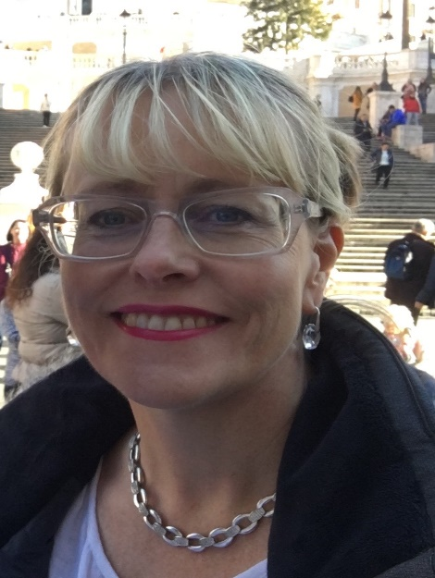
Speaker 2
Andi Shirtcliffe
Clinical Chief Advisor – Pharmacy, Quality Use of Medicines, Allied Health
Ministry of Health
Notes:
Our second speaker is Andi Shirtcliffe
Biography: Andi is the clinical lead for pharmacy and quality use of medicines for the New Zealand Ministry of Health. She has worked in community pharmacy, general practice, residential care and provided domiscilary medicines optimization services in high needs communities. In the last year Andi has been the New Zealand Ministry’s pharmacy lead on the COVID19 response, New Zealand’s Measles outbreak response and catch up campaign, a member of the New Zealand COVID19 technical advisory group and the Ministry lead on the COVID19 clinical technical advisory group. Andi has worked in New Zealand and the United Kingdom, has studied at Otago and Oxford Universities, and is an Honorary Associate Professor at the Auckland School of Pharmacy, University of Auckland. Andi has had a governance role on many of the New Zealand National Pharmacy organisations including being Deputy Chair of the New Zealand Pharmacy council for five years. She has also held a number of Ministerial appointments, her current appointment being Chair of New Zealand’s Medicines Classification Committee.

Slide 16






Andi Shirtcliffe, B.Pharm, PG Dip (Clin) Pharm, FPS, Reg Pharm NZ
Clinical Chief Advisor – Pharmacy, Quality Use of Medicines, Allied Health
Ministry of Health, New Zealand
Manatu Hauora, Aoteoroa
Notes:
Biography

Slide 17
Scope of Practice
The practice of pharmacy is necessarily broad and is wider than pharmacists working directly with patients, given that such roles influence clinical practice and public safety. In a clinical role, the pharmacist acts as a medicines manager, providing patient-centred medication therapy management, health improvement and disease prevention services, usually in a collaborative environment. Pharmacists ensure safe and quality use of medicines and optimise health outcomes by contributing to patient assessment and to the selection, prescribing, monitoring and evaluation of medicine therapy.
The practice of pharmacy may include but is not limited to: the custody, preparation and dispensing of medicines and pharmaceutical products; the selection and provision of non-prescription medicine therapies and therapeutic aids; health promotion, including health screening; administration of medicines, including injectable medicines; researching and evaluating information and providing evidence-based advice and recommendations on medicines and medicine-related health issues; teaching and advising; policy development; management; manufacturing; and auditing.
New Zealand’s Intern Pharmacist scope includes the potential for administration of medicines as well.

Slide 18

Competence Standards, Training and Audit
Competence Standards & Training
Public Health Care 02
O2.1 Contribute to community health
O2.2 Health promotion
O3: Supply and administration of medicines
O3.1 Assess prescriptions
O3.2 Dispense medicines
O3.3 Compound pharmaceutical products
O3.4 Administer medicines
O3.5 Provide patient counselling
https://www.pharmacycouncil.org.nz/
https://www.otago.ac.nz/pharmacy/index.html
https://www.psnz.org.nz/
https://www.immune.org.nz/pharmacists

Slide 19
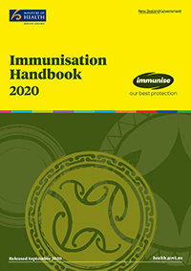
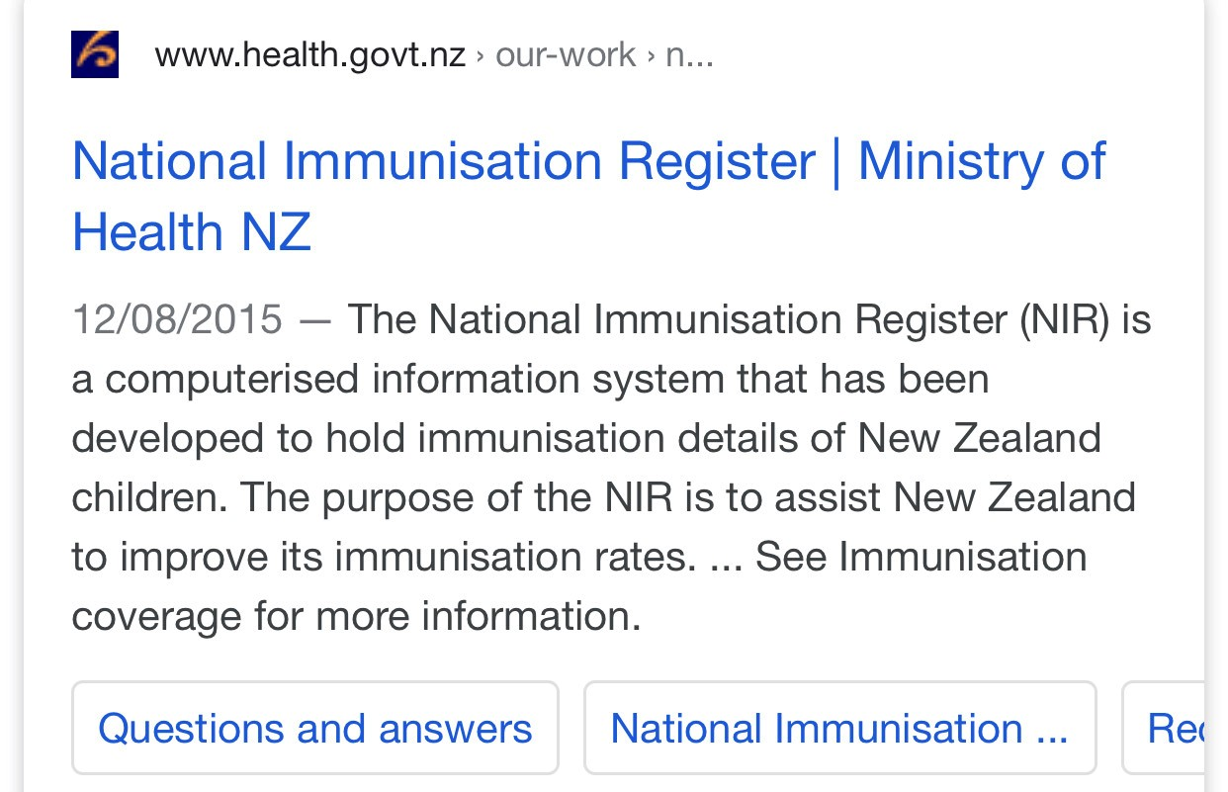
Funding and documentation mechanisms
National Community Pharmacy Agreement (Contract)
Contents
Part A Background, Part B Service and quality requirements, Part C General terms, Part D Payment and claiming terms, Part E Definitions
Schedule 1 Dispensing and professional advisory services
Schedule 2 Additional Professional Advisory Services
Schedule 3A.1 Opioid Substitution Treatment Services
Schedule 3A.2 Aseptic Services
Schedule 3A.3 Sterile Manufacturing Services
Schedule 3A.4 Clozapine Services (Monitored Therapy Medicine Services)
Schedule 3A.5 Influenza Immunisation Services
Schedule 3B.1 Long-Term Conditions Pharmacy Services
Schedule 3B.2 Community Residential Care Pharmacy Services
Schedule 3B.3 Age-Related Residential Care Pharmacy Services
Schedule 3B.4 Special Foods Services
Schedule 3B.5 Community Pharmacy Anti-Coagulation Management Services
Schedule 3B.6 Smoking Cessation Services Schedule 3C.1 [Other Services]
https://tas.health.nz/dhb-programmes-and-contracts/community-pharmacy-programme/

Slide 20
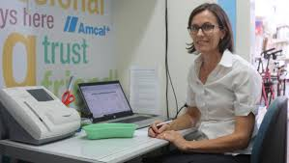




Innovation and perception
Pharmacists in NSW now able to administer vaccinations
outside pharmacies
Beehive.govt.nz The official website of the New Zealand Government
October 2019
Community pharmacists to deliver MMR vaccinations
Hon Julie Anne Genter
Associate Minister of Health Julie Anne Genter says trained pharmacist vaccinators in approximately 450 pharmacies across New Zealand will soon be able to deliver MMR vaccinations to people aged 16 and over, as the latest step in the Government’s plan to stop the measles outbreak and improve the immunity of New Zealanders.
Australian Pharmacists Empower Consumer Savings of $11 Per Year
October 1, 2019
6 min read
Pharmacist vaccination services reduce costs and are easily accessed

Slide 21
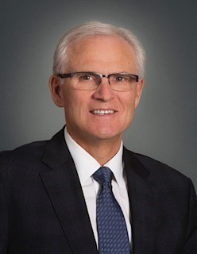
Speaker 3
Greg Eberhart
Registrar - Alberta College of Pharmacy
Notes:
Our third speaker is Greg Eberhart
Biography: Greg Eberhart is the Registrar of the Alberta College of Pharmacists (ACP). He contributed to the establishment of the National Association of Pharmacy Regulatory Authorities (NAPRA) in 1995. He has provided leadership nationally through the Canadian Pharmacists Association (CPhA), NAPRA, and the Council of Pharmacy Registrars of Canada. In 2008-09, he participated on CPhA’s “Blueprint Steering Committee” that developed a blueprint for the future of pharmacy in Canada. Greg led the development of provincial legislation (proclaimed in 2007), enabling pharmacists in Alberta to prescribe and administer drugs by injection. He was a member
of the Alberta Pharmacists Association’s “Pharmacy Practice Models Initiative” advisory committee, a demonstration project in 2009-10, focused on innovative reimbursement methods for pharmacists practicing in new practice models. Greg was a member of the “Minister’s Advisory Committee on Health” in 2010, mandated to lead the development of new umbrella health legislation and is a member of
the provincial Health Information Executive Committee. He is a member of the Primary Health Care Strategy Working Group and co-chair of the Cultural Change Expert Advisory Group. Also in 2010, Greg lead the development and signing of, a TriProvincial Resolution, between the regulatory colleges in Alberta, British Columbia, and Saskatchewan to work together in supporting the principles of the Western Economic
Partnership agreed to by the provincial Premiers.
In 2008, Greg was presented with a University of Alberta Alumni Honour Award in “recognition of significant contributions made over a number of years to his local community and beyond”. In 2011, he was amongst 103 Albertans awarded the Alberta Pharmacy Centennial Award for Distinction for “having advanced pharmacy in Alberta to the leadership position it holds today”.
And in 2014, Greg was honoured with an Outstanding Pharmacy Alumnus Award in recognition of pharmacy alumni who have made outstanding contributions to their professions, their communities, to society at large, or to the University of Alberta Faculty of Pharmacy and Pharmaceutical Sciences.

Slide 22

Greg Eberhart BSc. Pharm
Registrar
Alberta College of Pharmacy
Edmonton, Alberta, Canada
Greg.Eberhart@abpharmacy.ca
www: abpharmacy.ca
Notes:
Biography

Slide 23
Identifying and Responding to Need/Opportunity
1995-2000
Provincial immunization targets were not being met
  Infants, seniors, chronically ill
Opportunity to change public policy – redefine role of pharmacists (1995-1997)
Capitalize on accessibility of pharmacists and foundational knowledge in drug therapy
  Reframed role from that of dispenser/retailer to primary care provider
  Proposed new authorities – prescribing and administering drugs by injection

Slide 24
Building Possibility
2000-2010
What we did
Developed solution to respond to need
Advocated need, and why pharmacists were a preferred solution
Built alliances – external support from nursing and health regions
Pursued legislative amendment and new authorities for pharmacists (2007)
Lessons Learned
Understand WHY -clearly understand the nature and scope of the problem
Determine WHAT – pharmacists can do to respond to the problem
  Why might they be a preferred choice
  Identify and mitigate risks
Reimagine HOW – build alliances and get other opinion leaders to advocate for you

Slide 25
Building Capacity
2007-2020
What we did
Competencies, training, standards, authorization
Sought public funding
  First public payment – H1N1 Dec.2010
Public funding for seasonal influenza 2012
NAPRA competencies approved 2012
Added more vaccines and changed patient eligibility
Practice leaders sought additional training
Lessons learned
Administering injections changes pharmacists’ relationships with patients
Kotter’s 8 step cycle for change https://www.kotterinc.com/8-steps-process-for-leading-change/
Reimbursement can’t be the driver of change, but is an important catalyst for uptake

Slide 26
Changed Public Expectations
https://napra.ca/sites/default/files/2017-09/Supplemental_Competencies_on_Injection_for_Canadian_Pharmacists2012.pdf
Today
Training is provided in undergraduate curriculum
  Remains a separate authorization
80% of pharmacists in Alberta are authorized to administer drugs by injection
2018/19 influenza season, pharmacists administered 55% of publicly funded vaccines (nearly 724K doses)
Today
Public expects pharmacists to administer vaccines
  Is one of highest recognized services
Pharmacies are seen as an accessible solution by government
  Government platforms matter
Success depends on consistent positive experiences, free of risk

Slide 27
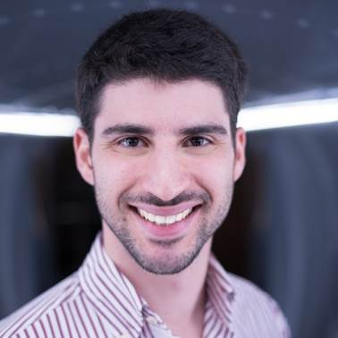
Speaker 4
Jorge Batista
International Affairs Lead - Portuguese Pharmaceutical Society
Member of the Regulators Forum Advisory Committee -FIP
Notes:
Our final speaker is Jorge Batista
Biography: Jorge Batista works at the Portuguese Pharmaceutical Society (PPS), since 2018 as International Affairs Lead, being responsible for coordinating the international activities, including representation at FIP, PGEU, AFPLP, EurHeCA, Permanent Delegation in Brussels, and other fora of international discussion. He is a member of the Council for Lusophone Cooperation, and of the Qualification and Admission Council of the PPS, supporting CPD and Competency development. Jorge is the Executive Manager of the Biomedical Ethics and Regulatory Capacity Building Partnership for Portuguese-Speaking African Countries Project (BERC-Luso), supported by the European Union, and financed by EDCTP.
After graduating in 2015, with the thesis topic on “Asthma in the Paediatric Population - Therapeutic Approaches in Europe”, he worked until 2018 as a Pharmacist in the South and Autonomous Region Branche of the PPS, in the area of Continuous Professional Development, strategic planning and promotion of the Continuous Training Program.
He is currently a PhD candidate in International Health at the Portuguese Institute of Hygiene and Tropical Medicine, specializing in Health Policies and Development.

Slide 28

Jorge Batista
International Affairs Lead
Portuguese Pharmaceutical Society
Lisbon, Portugal
jorge.batista@ordemfarmaceuticos.pt
www.ordemfarmaceuticos.pt
Notes:
Biography

Slide 29
Historic Background and legal changes in Portugal
Recognition of Vaccination as a priority
2007 – Community Pharmacies are recognized as healthcare spaces
      – New legislation allowing pharmacies to expand their scope of activity onto new areas: vaccination (vaccines not included in the National Vaccination Plan)
2008/2009 – First Nationwide Pharmacy-Based Influenza Immunization Campaign
2010 – The Medicines Regulator recognized the Portuguese Pharmaceutical Society as the regulatory body responsible for Vaccination Training accreditation
2013 – Creation and Development of the Pharmaceutical Competency
2020 – Certification of over 5.000 Pharmaceutical Competencies

Slide 30

Certification Model
Theoretical and Practical Training (75% / 25%)
Program of 7+ hours
  Immunology
  Vaccines and Injectable Drugs
  Legislation and Good Pharmacy Practices
  Administration Techniques
  Service safety
  Patient handling
Mandatory Basic Life Support training (4+ hours)
  Guidelines on vaccination service certification: minimum requirements for accreditation

Slide 31
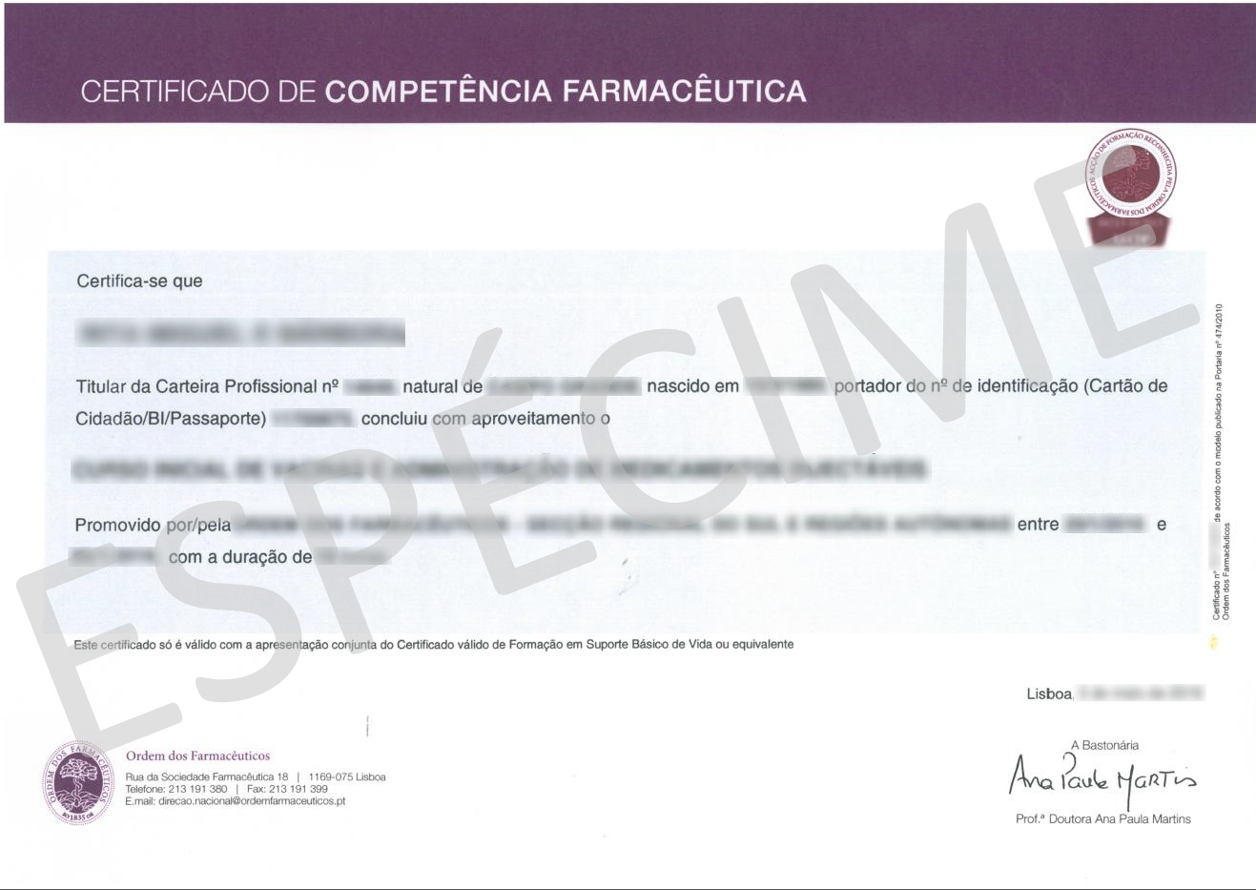
Pharmaceutical Competency and Certification
1st Pharmaceutical Competencies certified in 2013
Competencies are valid for a period of 5 years
After this period, a recertification training (Knowledge recycling) is mandatory
Certification to provide the service:
  Complete initial training
  Complete recertification every 5 years
  Evidence of continued activity

Slide 32
At the moment…
Vaccination in Community Pharmacies in Portugal
More than 1/3 of Community Pharmacists have a Pharmaceutical Competence and is valid as of today
98,2% of patients are satisfied or highly satisfied with the service provided in the pharmacy
12 years of experience with high satisfaction rates
Loures Municipality: pilot project increased flu vaccination by 32%
Seasonal flu 2020/2021: Pharmacies vaccinate with the same conditions as in PHC Centres
Notes:
PHARMACY PILOT PROJECT INCREASES FLU VACCINATION BY 32%
A six-week pilot project in the Loures Municipality in Portugal increased vaccination rates by almost one third’
Pharmacists in Portugal have been providing vaccination services for 10 years. Patients needed a medical prescription and the vaccine was not reimbursed. However, a new initiative, trialled in an area north of Lisbon, expanded its services to make it easier for people to avail of flu vaccination in their community pharmacy.
The pilot project ran from October 15 to 31 December 2018 and offered people aged 65 and over access to flu vaccination on the same terms as in National Health Service primary care units: They did not need a prescription and there was no administration fee.
Giving pharmacists ‘parity’ with NHS primary care units made vaccination in the community more appealing. The vaccination pilot in Loures is an additional and important step towards achieving the WHO goal of 75% flu vaccine uptake among older, people.

Slide 33
Futures perspectives
Lessons learned and looking ahead
Expansion of vaccines administered by pharmacists in community pharmacies
Off-site immunization (under pharmacy umbrella)
Nation-wide vaccination campaigns
Freedom of choice for citizen and equality in care – pharmacies and PHC Centres
COVID-19 vaccination
…

Slide 34




Relation with FIP
FIP Development Goals

Slide 35
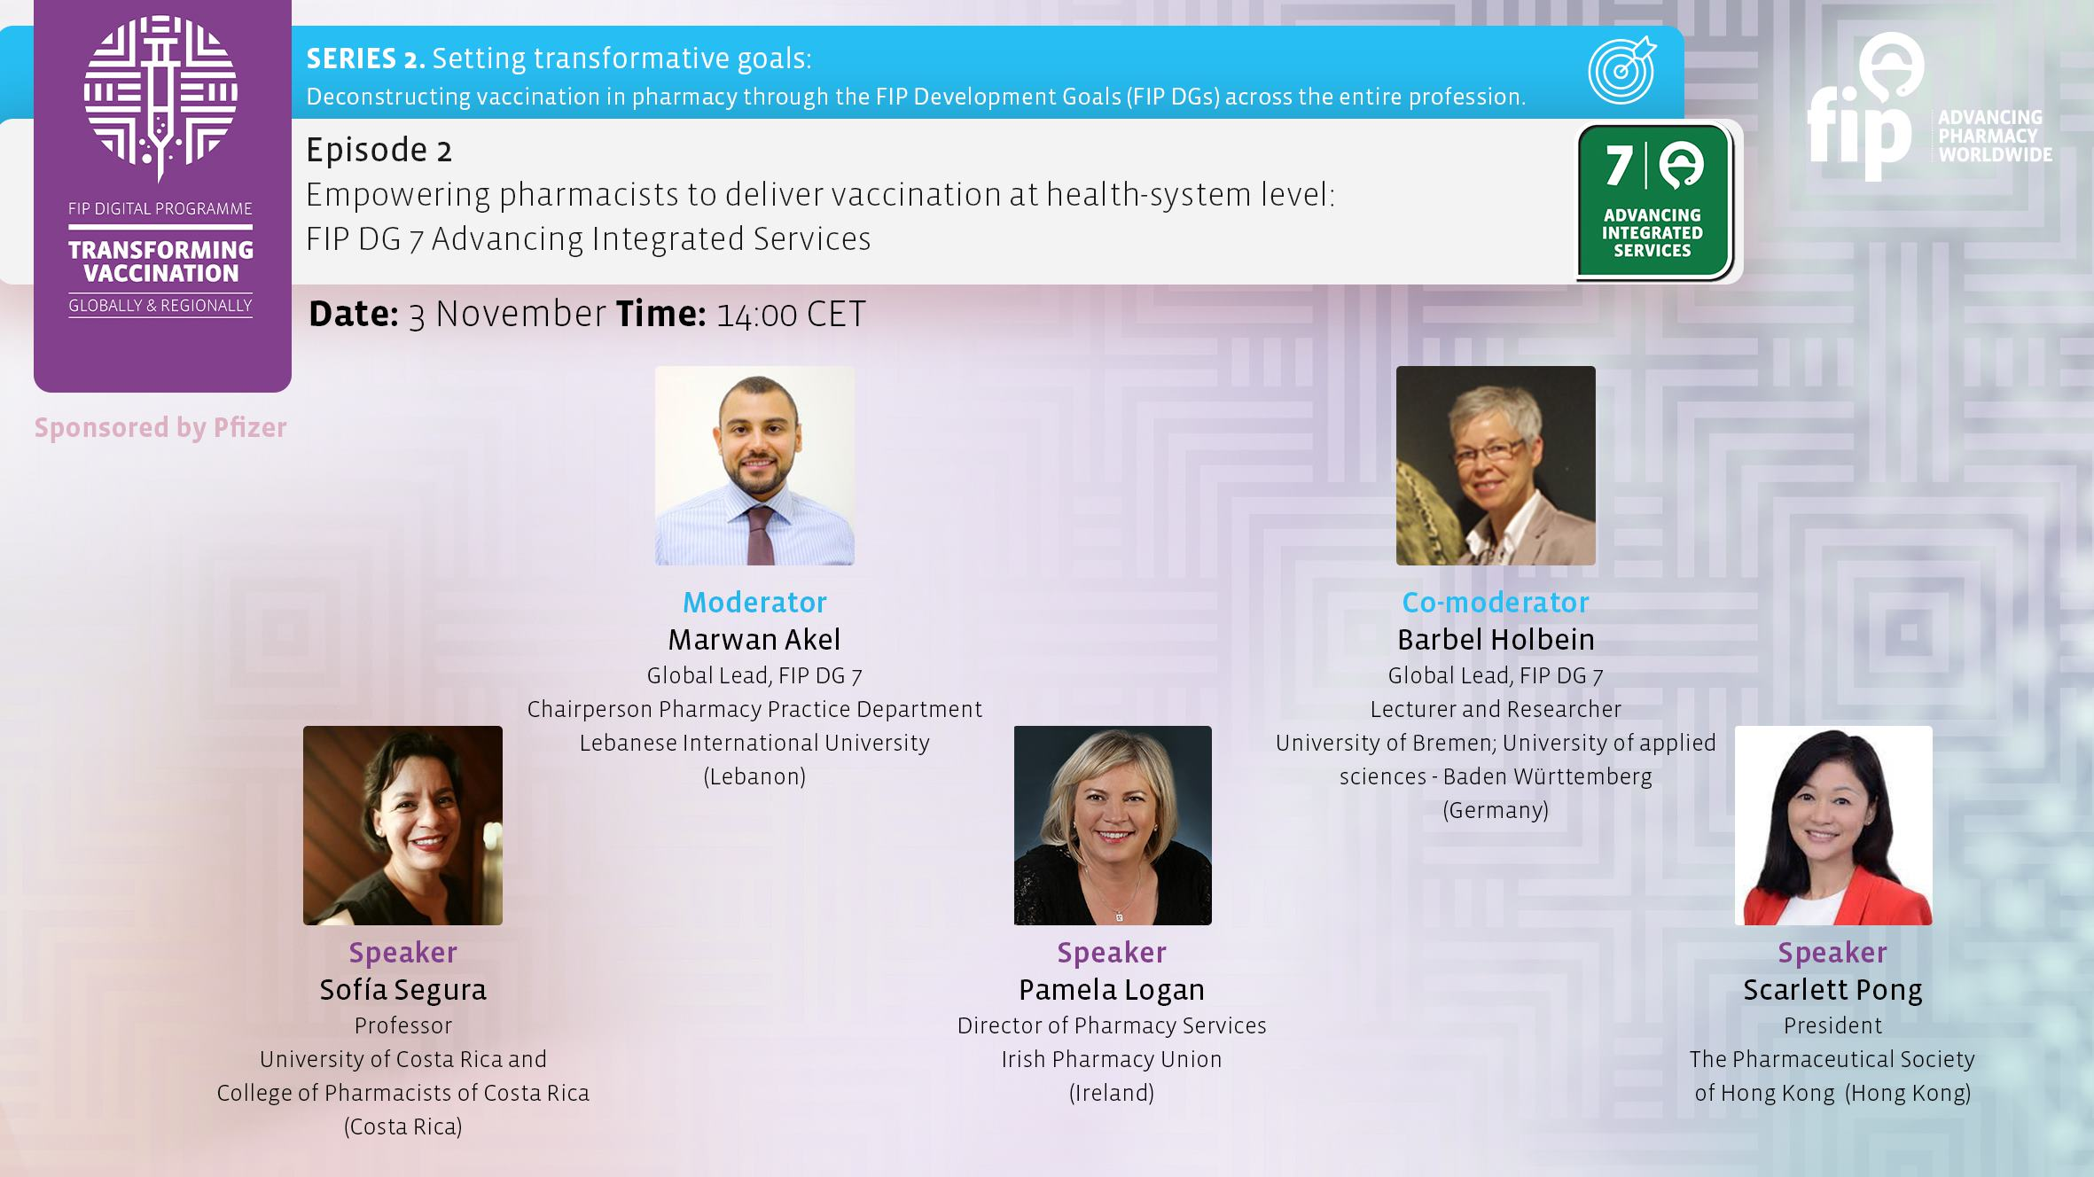
Notes:
Please join our next event on the 3rd of November at 14:00 CEST
In this episode – “Empowering Pharmacists to Deliver Vaccination at health-system level” – is an interview format that focuses on the FIP Development Goal 7: Advanced Integrated Services from the perspective of vaccination by pharmacist. We discuss change management principles in the context of integrating advanced practice services into every day practice, ensuring that vaccination by pharmacists in all settings and jurisdictions is consistent with best evidence and practice guildelines. Where a pharmacist is present in all settings, vaccinations can be provided. Ensuring collaborative work and shared documentation with all healthcare professionals to ensure it is an integrated service.
REGISTER ONLINE AT TRANSFORMINGVACCINATION.FIP.ORG

Slide 36
Thank you for participating!
Recording of this episode will be available at
www.fip.org
www.transformingvaccination.fip.org
Your feedback is welcome at webinars@fip.org
Notes:
I would like to sincerely thank our speakers & co moderator (if applicable).
The recording of this episode will be made available on www.fip.org and www.transformingvaccination.fip.org
Please give us your feedback to webinars@fip.org so we may continue to improve our digital event offerings.
Thank you very much and good day to you all!

