Slide 1
An overview of pharmacy’s impact on immunisation coverage
Key findings from a global survey
6 August 2020

Slide 2
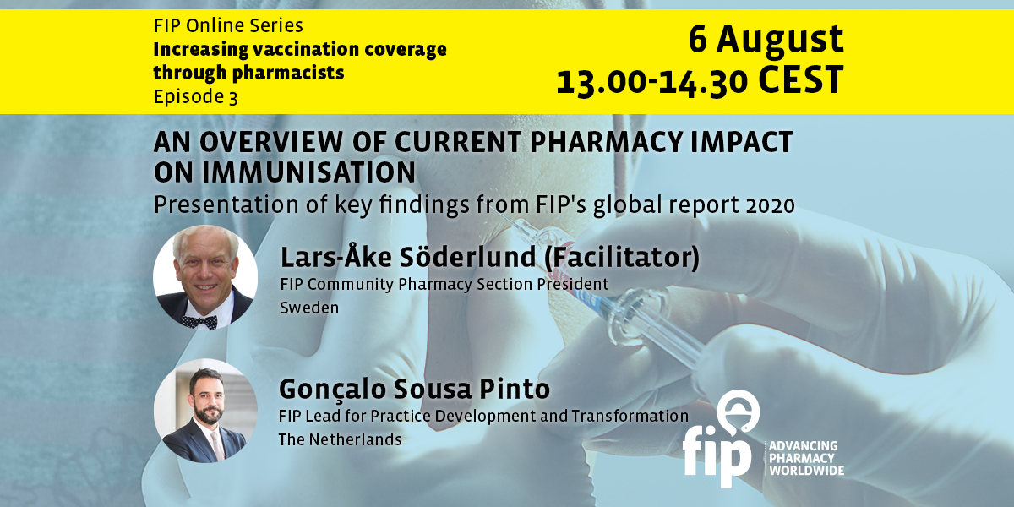

Slide 3
Announcements
Webinar house rules
This webinar is being recorded and live-streamed via Facebook.
The recording will be available on our website www.fip.org.
You may ask questions using the questions box.
You are welcome to provide feedback to webinars@fip.org.
We invite you to become a member of FIP at www.fip.org/membership_registration
©FIP: All the information in this video are confidential and cannot be copied, downloaded or reproduced without the formal approval of FIP (International Pharmaceutical Federation).

Slide 4


FIP would like to thank GSK and Sanofi Pasteur for funding the study that will be presented at this webinar.

Slide 5
Community pharmacies – Way beyond dispensing medicines
Community pharmacists and pharmacies have a key role to play in supporting healthy ageing and the maintenance of good health and quality of life across the life course.
Widespread distribution and accessibility
Close relationship with and knowledge of the community they serve
Long opening hours and,
In most countries, teams of highly qualified health professionals
Developing and delivering primary health care strategies, in collaboration with colleagues across the health care team

Slide 6
Three core areas in which pharmacy plays a key role in healthy ageing and primary health care include:
Effective management of non-communicable diseases (NCDs)
Promotion of vaccination and immunisation
Support of adherence to treatments
But also: Public health and communicable diseases and outbreak preparedness/response (e.g. coronavirus)

Slide 7

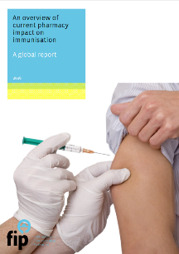


A decade of commitment to improving vaccination coverage
2011
2016
2016
2017
2018
FIP / WHO GPP Guidelines: “Administration of medicines, vaccines and other injectable medications” defined as a key role of pharmacists
“An overview of current pharmacy impact on immunisation: A global report”. Survey and case studies on vaccine-related roles by pharmacists.
Leadership conference at FIP congress in Buenos Aires on vaccination
New survey report “Pharmacy – A Global overview”: Pharmacy-based vaccination practices had expanded in just one year.
Amsterdam summit: “Pharmacists’ role in immunisation — advocacy approaches”

Slide 8

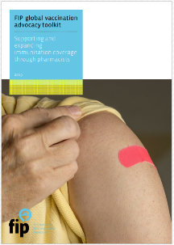
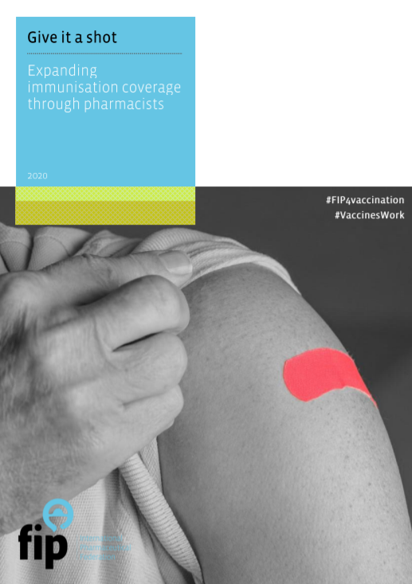
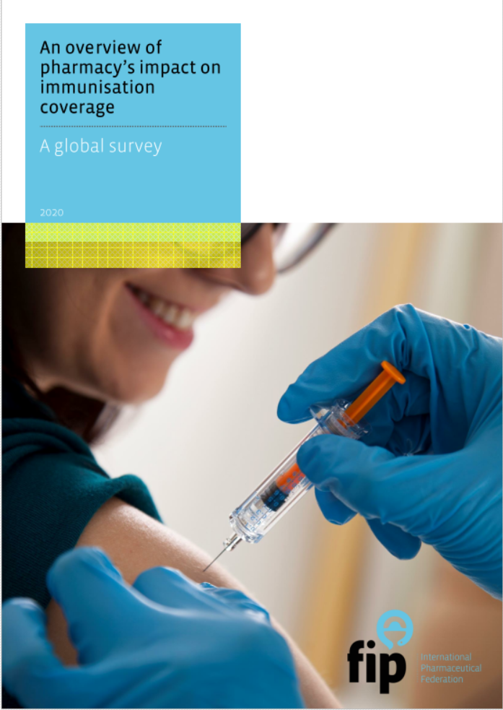







A decade of commitment to improving vaccination coverage
2018
2019
2020
2011-2020
2019
Policy conference on vaccination with WHO, the International Federation on Ageing and the International Longevity Centre and other partners
FIP joins steering committee of Immunisation for all ages coalition
FIP global vaccination advocacy toolkit
Give it a shot: expanding immunisation coverage through pharmacists
New survey on the role of pharmacists in improving vaccination coverage
Series of online events
FIP advocated at multiple WHO governance meetings, as well as regional and national pharmacy conferences for expanded role in vaccination, and supported its members
+ Regional conference sessions
+ Training courses

Slide 9
Pharmacy’s unique contribution
Access, proximity, extended hours, especially when others are closed
Ability to identify high-risk patients easily based upon their medications•
Public’s trust and enthusiastic acceptance
Practice guided by nationally adopted guidelines
Support completion of multi-dose vaccines (ie: HPV, etc)
Knowledgeable vaccine resource
Education/training
Ability to handle storage issues

Slide 10
Vaccinations – the case for pharmacy involvement
Allowing pharmacy vaccination improves efficiency and increases vaccination rates
Pharmacies provide services much closer to people’s homes or offices
Patients obtain vaccines at more convenient hours, such as lunchtime, evenings, or weekends
Pharmacies frequently administer vaccines at lower costs than doctor’s offices or medical clinics
Improve access to health care in rural and medically under-served areas

Slide 11
Immunizations at a glance
Preventable diseases such as influenza continue to kill too many people each year
Vaccination rates need to be higher than they are
Patients want access to healthcare at a time and in a place that suits them, from a trusted healthcare professional
Pharmacists are the most accessible healthcare professional; pharmacies the nearest local health facility
People trust their local pharmacist
To improve vaccine access and uptake, health systems must fully involve pharmacists in their vaccination strategy

Slide 12
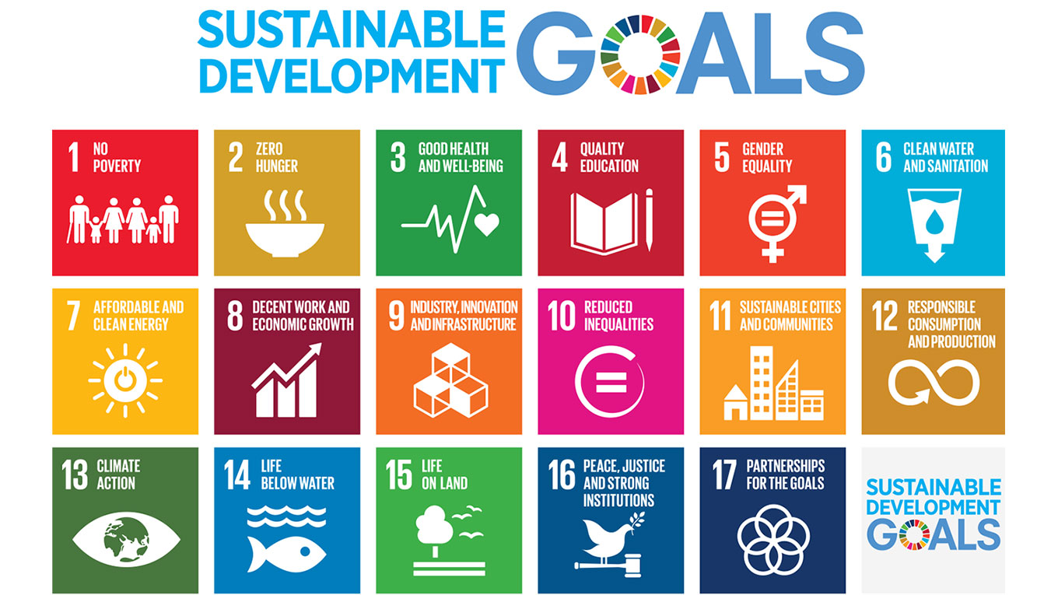
The Immunization Agenda
A world where everyone, everywhere, at every age, fully benefits from vaccines for good health and well-being.
Immunization linked to...
...14 of 17 SDGs
A broad set of
compelling arguments
for value of vaccines

Slide 13

FIP global vaccination advocacy toolkit (2019)
Supporting and expanding immunisation coverage through pharmacists
What is this publication?
  An advocacy toolkit to support national pharmacists organisations – be them advocacy bodies, organisations with regulatory responsibilities, academic and scientific leaders – in introducing or expanding pharmacy-based vaccine-related services.
  A source of global data, evidence, best practices and expertise that are required for effective advocacy.

Slide 14
After this webinar the participants should be able to understand:
1. The evolving roles that pharmacists play around the world to improve vaccine confidence and vaccination coverage.
2. The current situation with regards to pharmacy practice and regulation in the area of vaccination.
3. The gaps and challenges that require the attention of pharmacy organisations to develop these roles further into the future

Slide 15

Speaker
Gonçalo Sousa Pinto
FIP Lead for Practice Development and Transformation

Slide 16

An overview of pharmacy’s impact on immunisation coverage:
A global survey
Released 4 August 2020
Available at: https://www.fip.org/file/4751

Slide 17
WHO – Impact of vaccines on global health
Over 26 infectious diseases can be effectively prevented by a vaccine (1)
Immunisation currently averts an estimated 2 to 3 million deaths every year (1)
  An additional 1.5 million deaths could be avoided if global vaccination coverage improves
There are now vaccines to protect against malaria, dengue and Ebola virus disease, and promising vaccines against respiratory syncytial virus, tuberculosis and all influenza virus strains are in the pipeline (2) – and COVID-19.
Increasingly, vaccines are protecting health beyond infancy – in adolescence and adulthood, during pregnancy and for older people. (2)
(1) WHO 2017 Fact Sheet: http://www.who.int/mediacentre/factsheets/fs378/en/
(2) WHO. Immunization Agenda 2030 A global strategy to leave no one behind.
https://www.who.int/immunization/IA2030_draft_4_WHA.pdf?ua=1

Slide 18
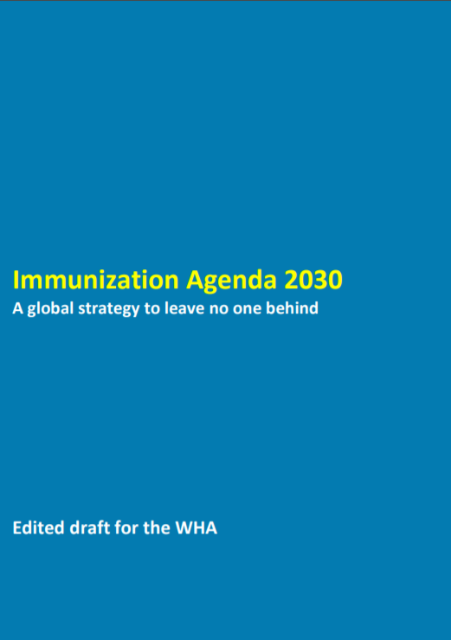
WHO Immunization Agenda 2030:
A Global Strategy to Leave No One Behind
Builds on and addresses gaps left by the Global Vaccine Action Plan 2011-2020
Sets an ambitious, overarching global vision and strategy for vaccines and immunisation for the decade 2021–2030.
Will come into effect by the end of 2020.
“Through collective endeavor, countries and partners will achieve the vision for the decade: A world where everyone, everywhere, at every age, fully benefits from vaccines for good health and well-being.”
WHO. Immunization Agenda 2030 A global strategy to leave no one behind.
https://www.who.int/immunization/IA2030_draft_4_WHA.pdf?ua=1

Slide 19
WHO Immunization Agenda 2030:
A Global Strategy to Leave No One Behind
Vaccines are critical to the prevention and control of many communicable diseases and therefore underpin global health security.
They are also critical for addressing emerging infectious diseases, for example by containing or limiting outbreaks or combatting the spread of antimicrobial resistance.
Vaccines will help keep an estimated 24 million people from falling into poverty by 2030.
WHO. Immunization Agenda 2030 A global strategy to leave no one behind.
https://www.who.int/immunization/IA2030_draft_4_WHA.pdf?ua=1

Slide 20
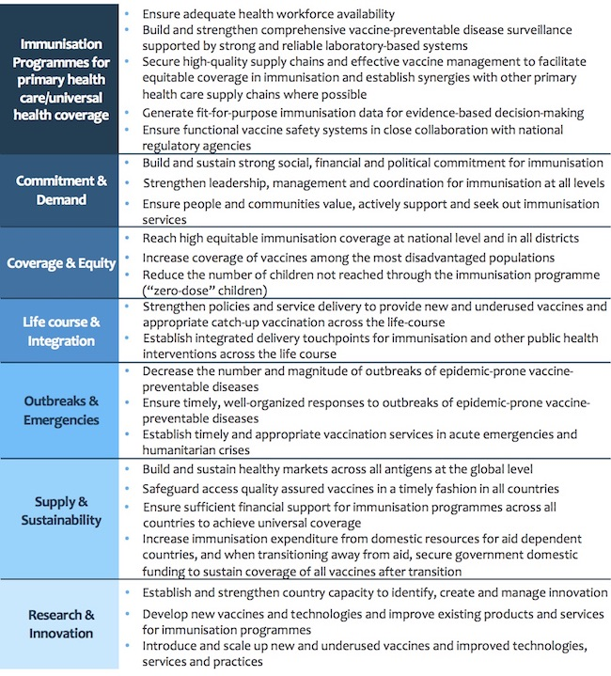
WHO Immunization Agenda 2030:
A Global Strategy to Leave No One Behind
Strategic priority goals:
#3: Everyone is protected by full immunization, regardless of location, age, socioeconomic status or gender-related barriers.
#4: All people benefit from recommended immunizations throughout the life course, effectively integrated with other essential health services.
Establish integrated delivery points of contact between immunization and other public health interventions for different target age groups.
WHO. Immunization Agenda 2030 A global strategy to leave no one behind.
https://www.who.int/immunization/IA2030_draft_4_WHA.pdf?ua=1

Slide 21
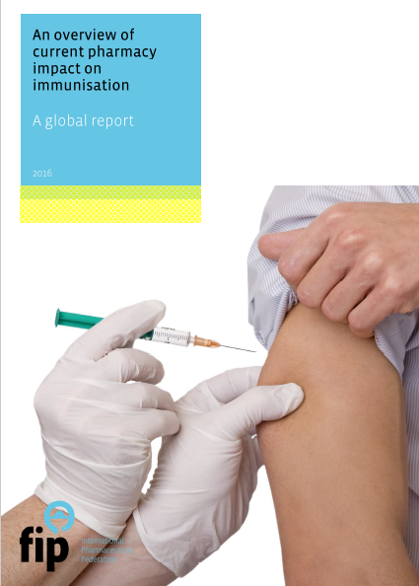
2016
2020
Authors:
Gonçalo Sousa Pinto
Matthew Hung
Audrey Wong
Authors:
Dr Helena Rosado
Prof. Ian Bates

Slide 22
About this study: Aims
A) To gain a better understanding and data on the following topics:
  Pharmacists’ roles in promoting vaccination awareness and uptake and advocating for vaccination
  Regulatory and contractual frameworks for pharmacy-based vaccination
  Administration of vaccines
  Training of the pharmacy workforce for vaccination services
  Vaccination records
  Limitations to the development of pharmacists’ role in vaccination
B) To identify developments in this area in the past four years and trends that will shape pharmacy-based vaccination in the coming five to 10 years.

Slide 23
About this study: Study sample and demographics
Survey conducted between December 2019 and March 2020, in five languages (Arabic, English, French, Russian and Spanish)
141 pharmacist organisations from 112 countries and territories were invited to participate
Responses from 106 organisations from 99 countries and territories. Response rate of 88.4%, i.e., 99 countries and territories out of 112 – most representative study ever in this area.
Population of the countries and territories represented in this study (6,402 million) accounts for 83% of the world’s population in 2019 (7,713 million).

Slide 24
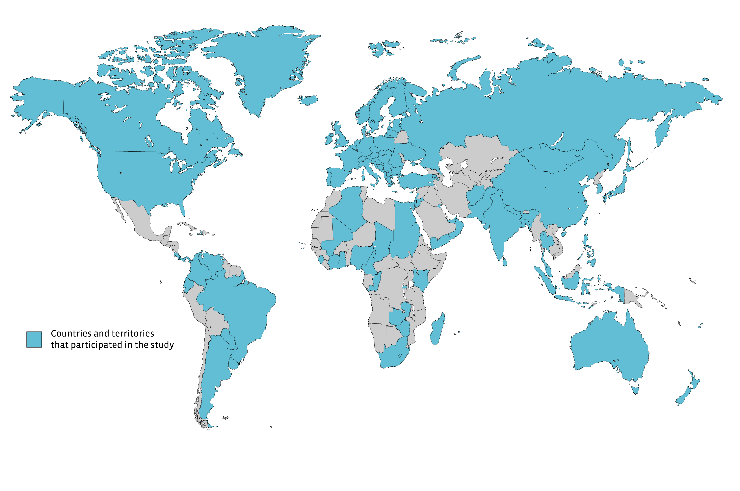
About this study: Study sample and demographics

Slide 25
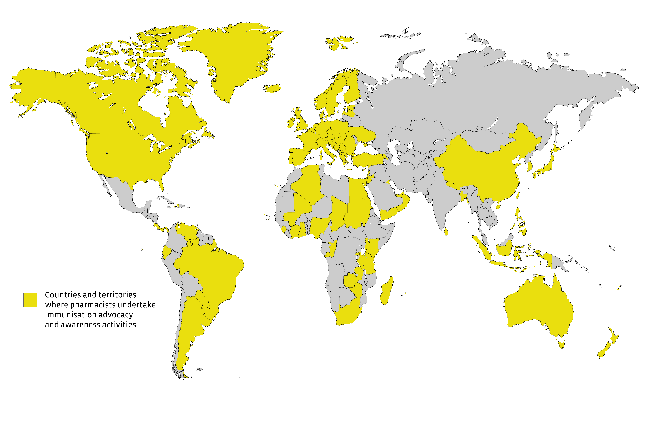
Pharmacists’ roles in immunisation
Educators
  Providing evidence-based information and advice
Advocates/promotors
  Engaging in campaigns (including multi-disciplinary campaigns)
  Identifying and advising high-risk patient groups
  Serving or advising immunisation committees
Facilitators (managing vaccination schedules and appointments)
Storage and supply (including supply chain management)
Vaccine administration
Vaccination records
86 countries out of 93 (92.5%)
Source
International Pharmaceutical Federation (FIP). An overview of pharmacy’s impact on immunisation coverage: A global survey. The Hague: International Pharmaceutical Federation; 2020

Slide 26
Pharmacists’ roles in promoting vaccination awareness and uptake and advocating for vaccination
89 countries (92.5%) are involved in at least one type of awareness raising or advocacy activity
Only a few reported higher levels of engagement activities, such as assessing vaccination status and identifying high risk groups. Engagement in more proactive advocacy activities is recommended to further expand pharmacists’ role in immunisation.
n=93
Source
International Pharmaceutical Federation (FIP). An overview of pharmacy’s impact on immunisation coverage: A global survey. The Hague: International Pharmaceutical Federation; 2020

Slide 27
Regulatory and contractual frameworks for pharmacy-based vaccination
Pharmacy-based vaccination (PBV) is now available in at least 36 countries and territories, 16 more than were indicated in our study in 2016.
Nearly 1.8 billion people can access vaccination services at a community pharmacy around the world – almost twice as many as in our 2016 study.
Vaccine administration by pharmacists is authorised in 26 countries and territories, compared with 13 in 2016. Nevertheless, 66 countries and territories in our sample (a two-thirds majority) do not have PBV, so there is still a long way to go.
Sixteen of these 66 countries and territories are proposing or developing pharmacist-led vaccination policies. Most reported that the change should take effect within one to five years. If these changes are confirmed, the number of countries with PBV could rise to 52 in the next few years.

Slide 28
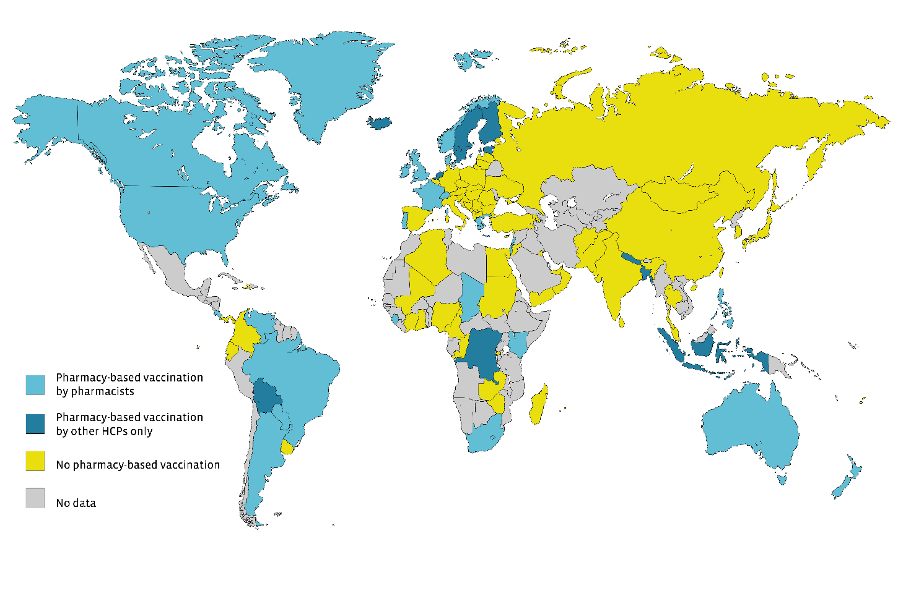
Countries and territories with or without pharmacy-based vaccination (n=101; 2020)
Source
International Pharmaceutical Federation (FIP). An overview of pharmacy’s impact on immunisation coverage: A global survey. The Hague: International Pharmaceutical Federation; 2020

Slide 29
Cells highlighted in dark blue indicate a confirmed change of status since 2016; those in light blue indicate countries and territories with pharmacy-based vaccination for which there were no data from 2016.

Slide 30
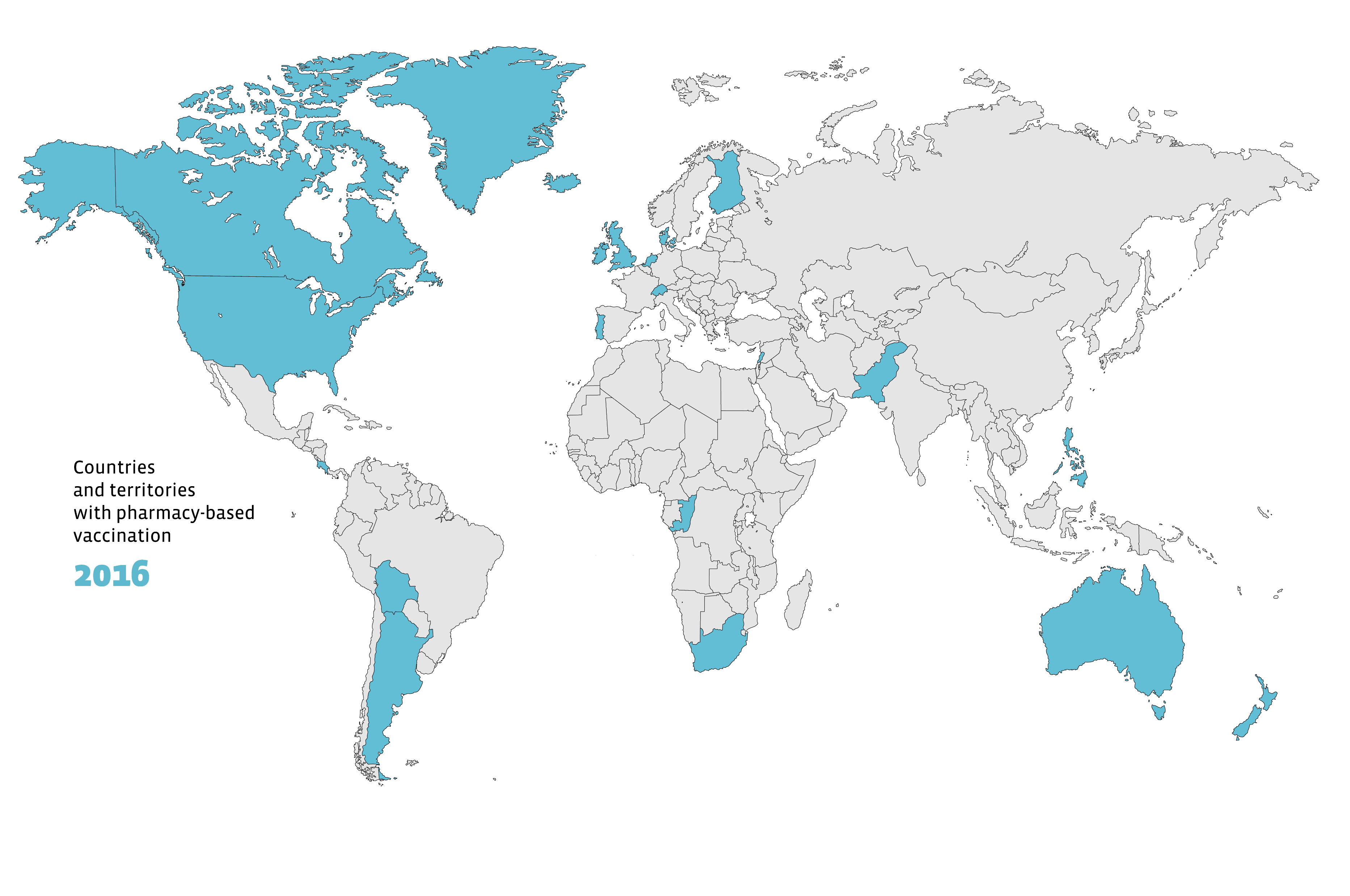
Countries and territories with pharmacy-based vaccination
16
Source
International Pharmaceutical Federation (FIP). An overview of pharmacy’s impact on immunisation coverage: A global survey. The Hague: International Pharmaceutical Federation; 2020

Slide 31
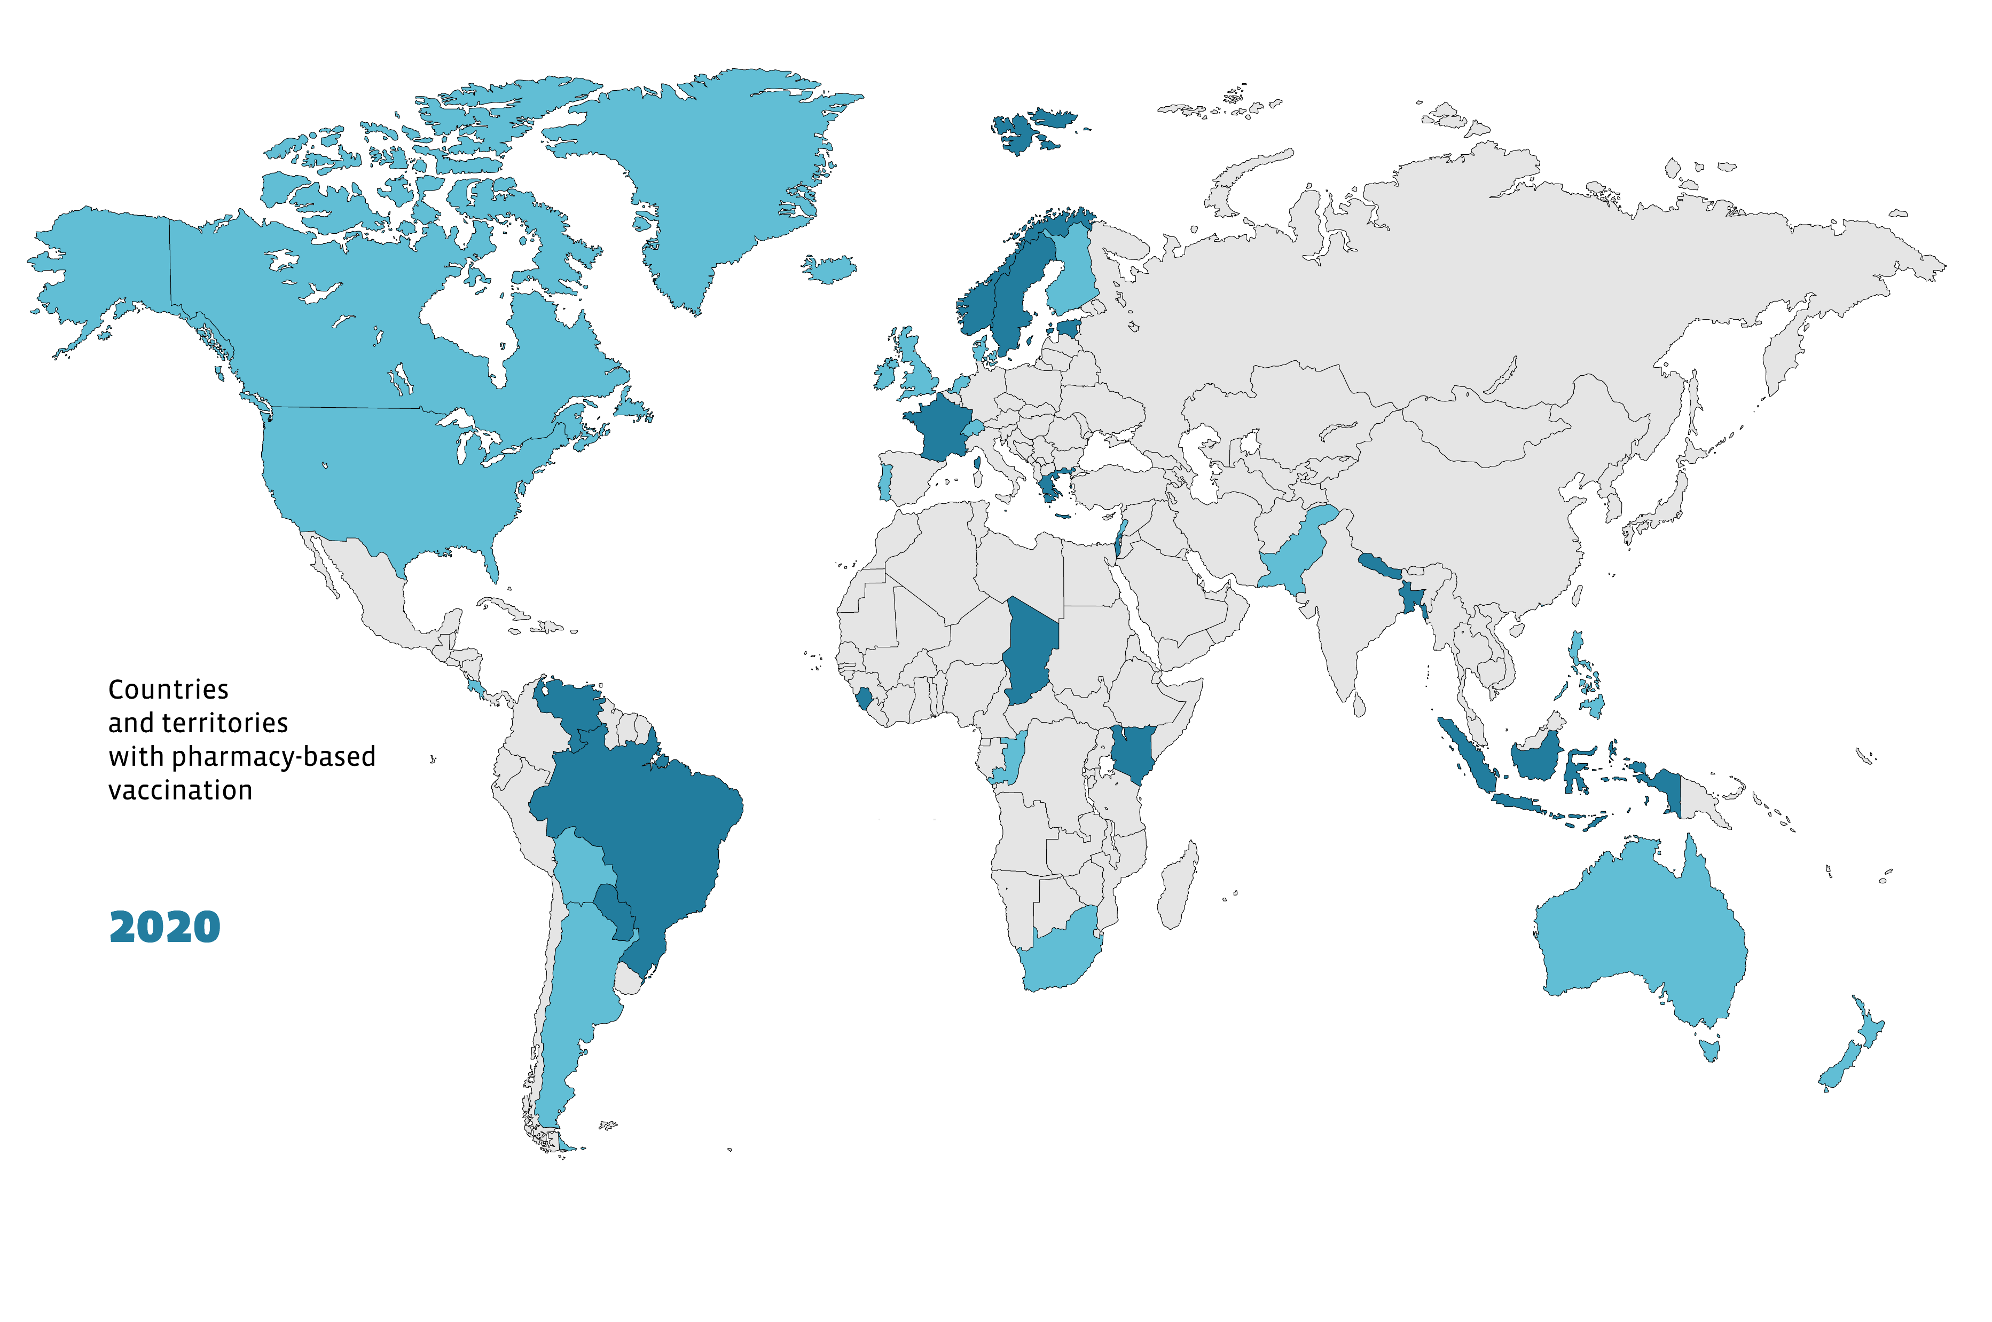
Countries and territories with pharmacy-based vaccination
36
16
Source
International Pharmaceutical Federation (FIP). An overview of pharmacy’s impact on immunisation coverage: A global survey. The Hague: International Pharmaceutical Federation; 2020

Slide 32
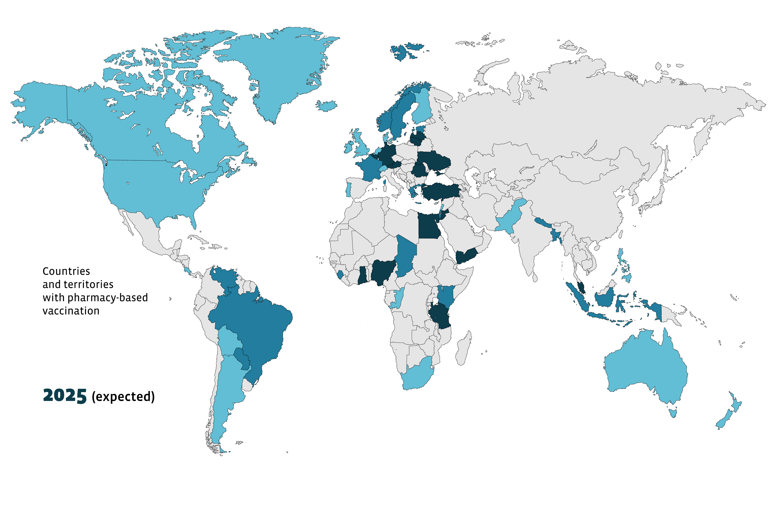
Countries and territories with pharmacy-based vaccination
52
Source
International Pharmaceutical Federation (FIP). An overview of pharmacy’s impact on immunisation coverage: A global survey. The Hague: International Pharmaceutical Federation; 2020
Notes:
An important point to note is that this survey was largely conducted before the COVID-19 pandemic. The pandemic may have accelerated the introduction of PBV in several countries – and possibly even in some countries not represented in this map.

Slide 33
Reimbursement for vaccination services
Reimbursement mechanisms for PBV services are linked to policies and strategies to foster equity in access to vaccines and vaccination providers, and to achieve high vaccination coverage rates.
It is also essential to ensure the sustainability of this service.
Reimbursement for vaccination services was perceived as important or very important by 78.4% of respondents.

Slide 34
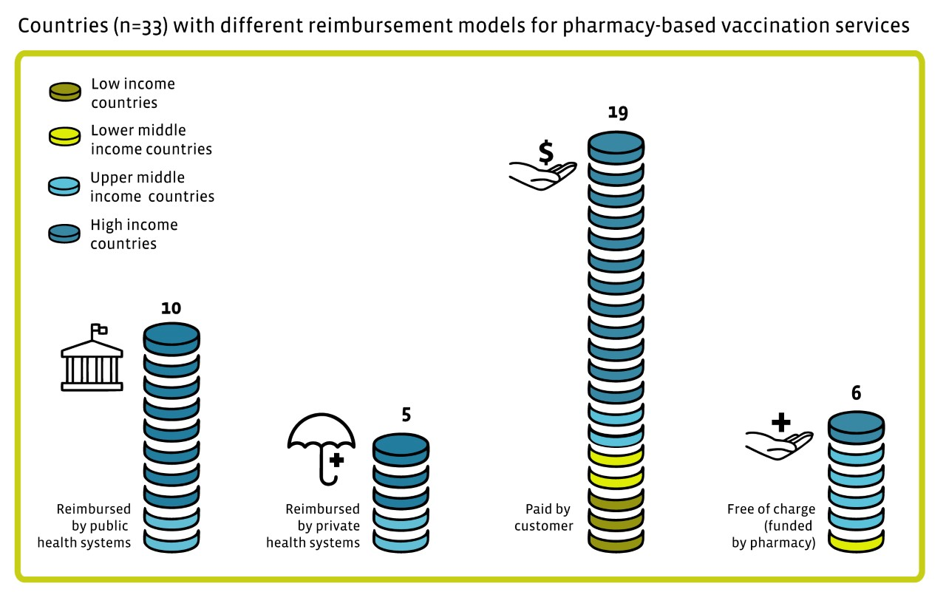
Reimbursement for vaccination services
Source
International Pharmaceutical Federation (FIP). An overview of pharmacy’s impact on immunisation coverage: A global survey. The Hague: International Pharmaceutical Federation; 2020
Notes:
Pharmacy vaccination services are paid for by the customer in most countries and territories.
Ten respondents reported that the service is reimbursed by public health systems, and five by private health systems.
In six cases, the service is provided at no cost to the patient or health system (the cost is taken up by the pharmacy).

Slide 35
Vaccine administration
Pharmacies are involved in the administration of 36 different vaccine types.
Among 34 respondents with PBV, 24 (71%) reported that pharmacists may not prescribe vaccines.
Pharmacists are accountable for the vaccination process as the vaccine administrator, pharmacy manager or pharmacy owner in nearly 80% of vaccinations at a pharmacy.

Slide 36
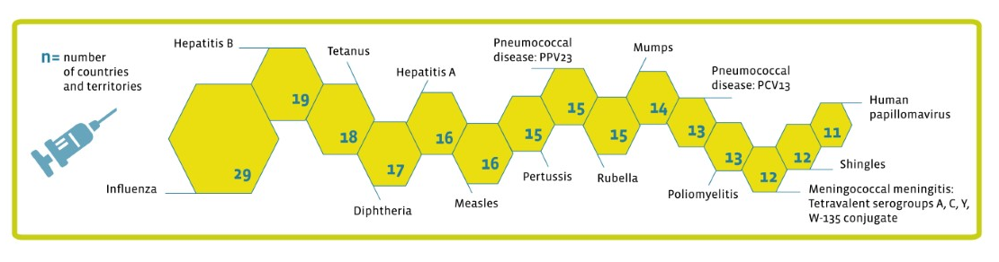
The 15 vaccines most commonly administered at pharmacies
Out of 31 countries with pharmacy-based vaccination
Vaccines commonly administered in pharmacies include influenza (94% of respondents), hepatitis B (61%) and tetanus (58%).
Source
International Pharmaceutical Federation (FIP). An overview of pharmacy’s impact on immunisation coverage: A global survey. The Hague: International Pharmaceutical Federation; 2020
Notes:
Influenza, pneumococcal disease, herpes zoster and pertussis are a significant cause of morbidity and mortality in older people, in whom the importance of vaccination is often underestimated. It is of paramount importance to increase focus on vaccination throughout the life course.
In addition, as soon as vaccines against COVID-19 become available, mass immunisation — especially for those vulnerable to severe forms of the disease — will be essential and urgent, and pharmacies should be part of the vaccination pathways

Slide 37
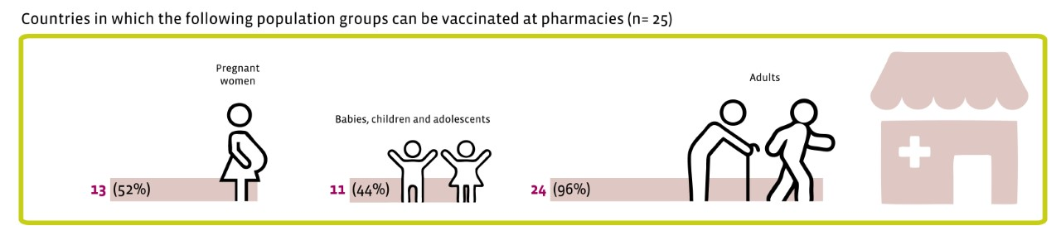
Population groups that can be vaccinated at pharmacies
Source
International Pharmaceutical Federation (FIP). An overview of pharmacy’s impact on immunisation coverage: A global survey. The Hague: International Pharmaceutical Federation; 2020
[insert compliance job number]
All rights reserved.
July 2020

Slide 38
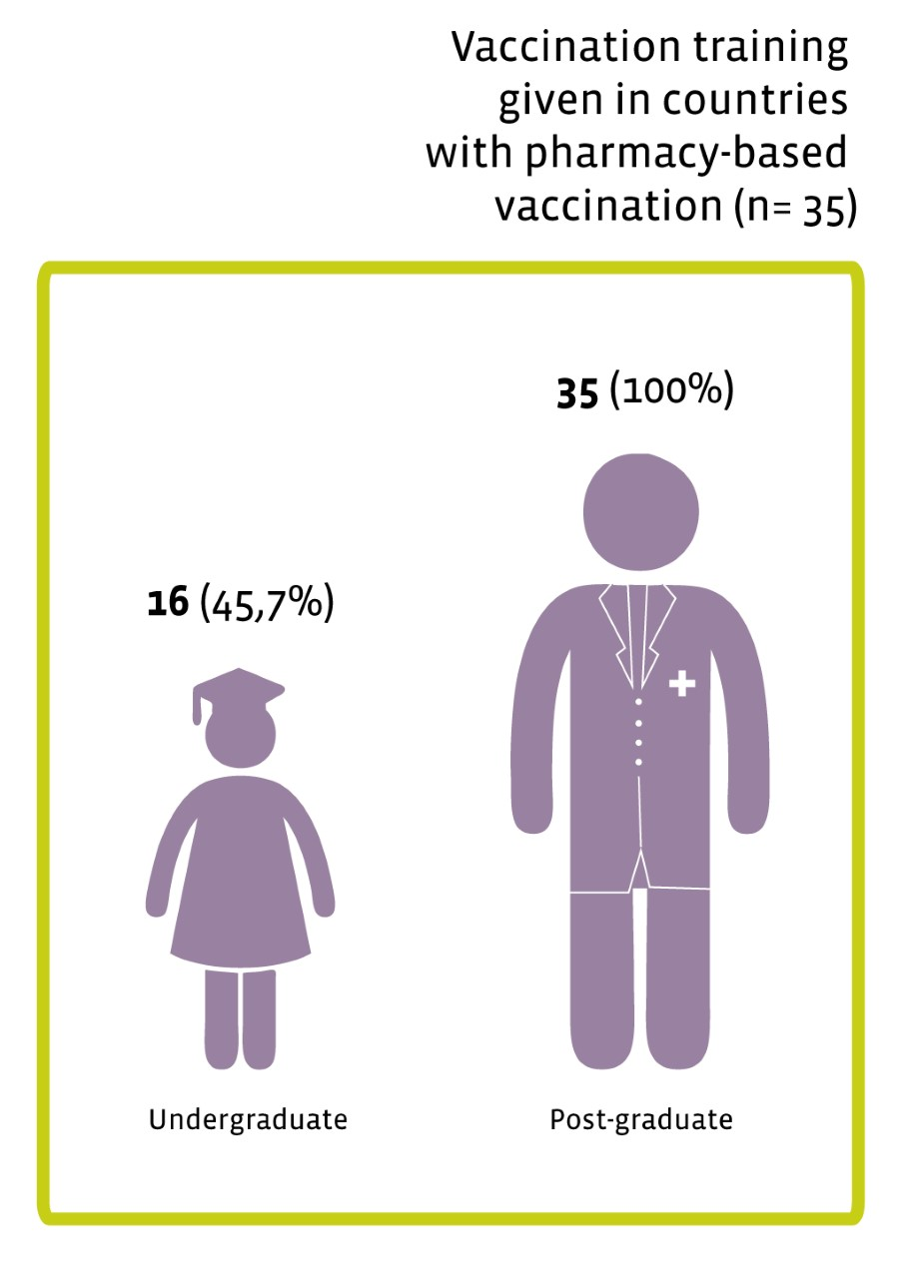
Training for vaccination services
With more pharmacists gaining the authority to administer vaccines, it is imperative that training is put in place, in addition to certification renewal programmes, to ensure quality and sustainability of services.

Slide 39
Vaccination records
Pharmacists do not have access to vaccination records in most countries and territories (67% of respondents), which is regrettable.
Even in countries with PBV, full access to vaccination records is available in only 12 out of 33 countries and territories, with the other 21 respondents reporting access to some records only.
In close to half of the countries and territories with PBV, pharmacists do not possess the authority to record vaccination details in a shared vaccination record.
Paper vaccination records are most common (73% of respondents). Shared electronic systems exist in 27 countries and territories but barriers exist for pharmacists to be given read and write access.

Slide 40
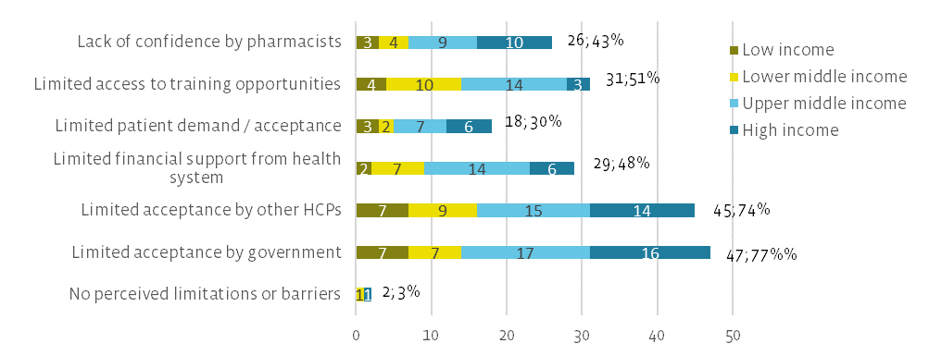
Perceived limitations to the development of pharmacists' role in vaccination in countries WITHOUT PBV
n=61
Source
International Pharmaceutical Federation (FIP). An overview of pharmacy’s impact on immunisation coverage: A global survey. The Hague: International Pharmaceutical Federation; 2020
Notes:
Important differences in perceived barriers are found between countries and territories with or without PBV, for example, the perceived lack of patient demand or acceptance for PBV services. While this was reported by 18 respondents (30%) from countries without PBV, it was reported by only one (3%) of those with pharmacy-based vaccination. This suggests that, once the service is implemented, patients recognise its value and actively seek the service.
The same happens with the limitations related to the lack of confidence by pharmacists (43% in countries without PBV vs. 19% in those with the service) and limited access to training opportunities (51% vs. 23%). These limitations are greatly overcome once regulatory frameworks support the delivery of this service and implementation begins.
Data seem to suggest that, as the implementation of vaccination services becomes more established and consolidated, the perceived barriers to these services seem to wane

Slide 41
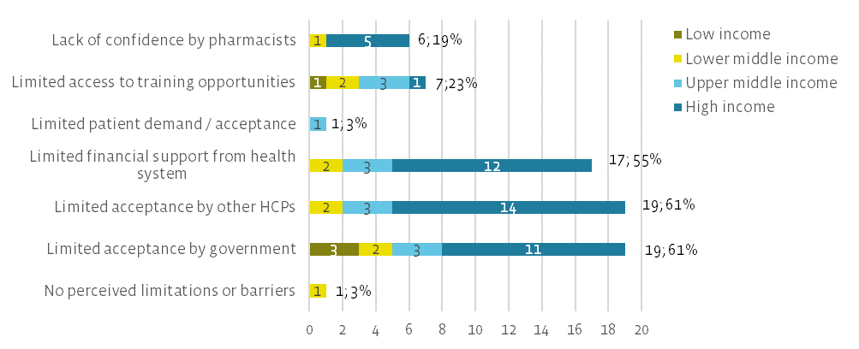
Perceived limitations to the development of pharmacists' role in vaccination in countries WITH PBV
n=31
Source
International Pharmaceutical Federation (FIP). An overview of pharmacy’s impact on immunisation coverage: A global survey. The Hague: International Pharmaceutical Federation; 2020

Slide 42
Conclusions
Since the previous survey report, progress is evident.
Significant increase in the availability of this service around the world.
High number of countries where policy development is under way
The expansion of pharmacists’ authority to vaccinate is encouraging, but not sufficient.
Legislative and regulatory barriers must be overcome through evidence-based, quality advocacy, and they must address key issues, including reimbursement schemes.
Read and write access to vaccination records are fundamental points to develop

Slide 43
Conclusions
Expanding pharmacists’ scope of practice as vaccinators will ultimately further their contribution to increased immunisation coverage and to public health
A life-course approach to vaccination strategies, and the involvement of pharmacies in immunisation against COVID-19 will be essential developments

Slide 44
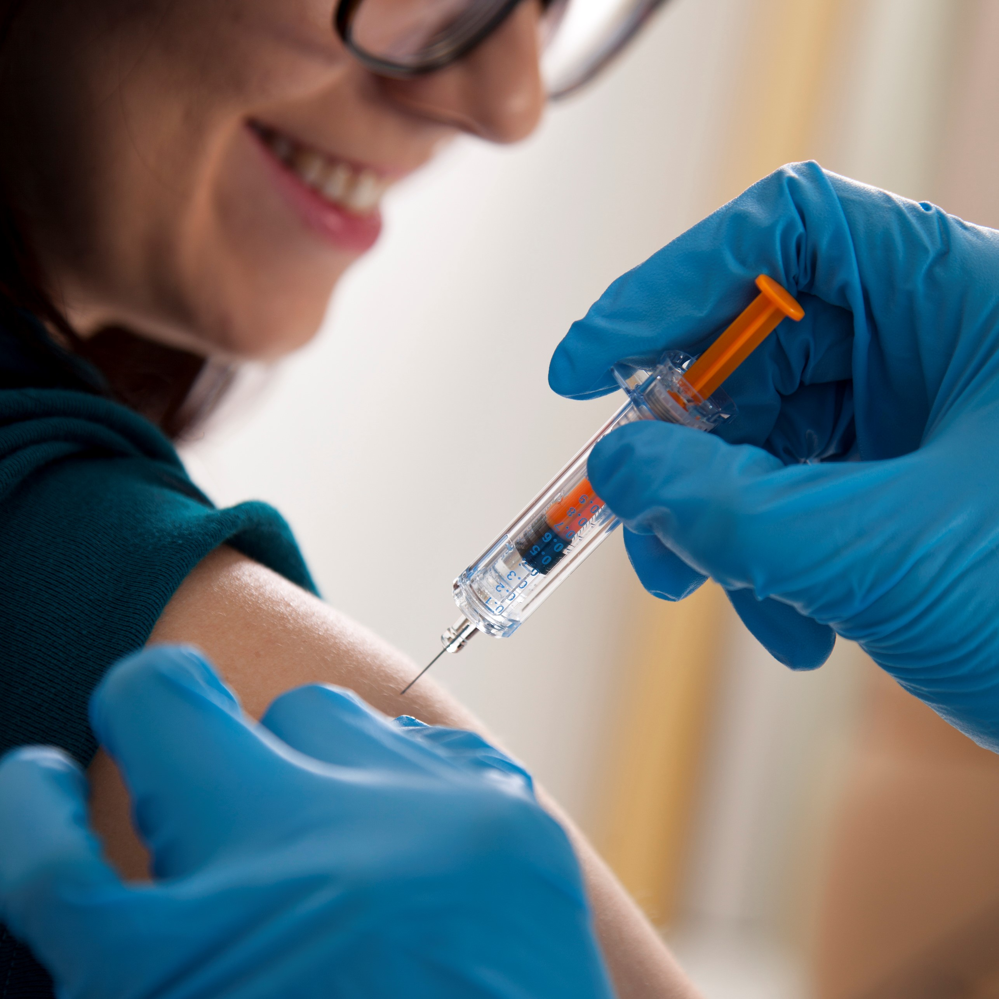
Any questions?
Please use the Q&A tool

Slide 45
Wrap up & Conclusions
©FIP: All the information in this video are confidential and cannot be copied, downloaded or reproduced without the formal approval of FIP (International Pharmaceutical Federation).

Slide 46
LIVING AND LEARNING THROUGH THE
COVID-19 PANDEMIC – GLOBAL REFLECTIONS
4 – 25 September 2020

Slide 47
Why register?
This will entitle you to:
Access to all the sessions during the full event or the day(s) of your choice
Access to all the Professional Development events
Access to all the posters, abstracts and short oral presentations
Certificate of attendance
Take this unique opportunity and JOIN US!
https://virtual2020.fip.org/

Slide 48
Thank you for attending!

