Slide 1
“Responding to the Pandemic Together” Programme
Event 30: Pharmacy practice research priorities during the COVID-19 pandemic
Delivered by FIP Pharmacy Practice Research Special Interest Group and Health and Medicines Information Section in collaboration with Research in Social and Administrative Pharmacy, Journal of Pharmaceutical Policy and Practice and Pharmacy Education Journal

Slide 2
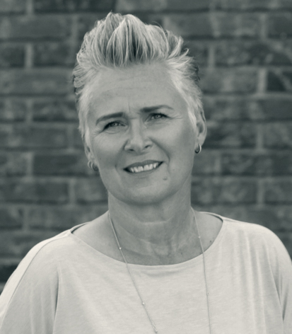

Moderator
Dr Charlotte Verner Rossing
Director of Research and Development at Pharmakon, Danish college of Pharmacy practice
Vice-chair - FIP SIG Pharmacy Practice research
Email: cr@pharmakon.dk @CharRossing

Slide 3

Welcome to the “Responding to the Pandemic Together” events
FIP’s Special Online Programme on COVID-19
To share ideas on webinar topics we should feature, or if you’d like to share your story on dealing with the pandemic please email
lina@fip.org
These webinars aim to:
Provide relevant information and interim guidelines for pharmacists and the pharmacy workforce on Coronavirus SARS-CoV-2/COVID-19 pandemic.
Share and discuss strategies adopted by pharmacy leaders and workers - including our Member Organisations – in response to the pandemic.
Describe sector or area-specific implications, innovations and approaches adopted across pharmaceutical science, practice and education.
Engage frontline workers of the health and pharmacy workforce to know about the realities facing them around the world.
Discuss the implications of the pandemic on issues such as safety, supply, shortages that have been exacerbated by COVID-19, across our nations and regions.
Consider the impact of this disease on patients across age groups and with concurrent conditions.
Assess and discuss the evidence behind treatments and the process of developing therapies, vaccines and tests.
This Photo by Unknown Author is licensed under CC BY-SA

Slide 4

Important Links & Resources
FIP Covid-19 Information Hub
A comprehensive FIP webpage containing all of our resources and outputs relating to COVID-19, including recordings of previous webinars.
Link: https://www.fip.org/coronavirus
FIP Facebook Group: “COVID-19 & pharmacy”
Link:https://www.facebook.com/groups/covid19andpharmacy/

Slide 5
Announcements
FIP Digital Events House Rules
This webinar is being recorded and live streamed on Facebook
The recording will be freely available at www.fip.org/coronavirus and on our YouTube channel
You may ask questions by typing them into the Q&A box
Your feedback is welcome (webinars@fip.org)
©FIP: All the information in this video are confidential and cannot be copied, downloaded or reproduced without the formal approval of FIP (International Pharmaceutical Federation).

Slide 6

Moderator
Dr Dalia Dawoud
Associate Professor,
Faculty of Pharmacy, Cairo University, Egypt
Associate Editor,
Research in Social and Administrative Pharmacy (RSAP) and Value in Health, Elsevier, UK
Email: ddawoud@hotmail.com
@drddawoud

Slide 7
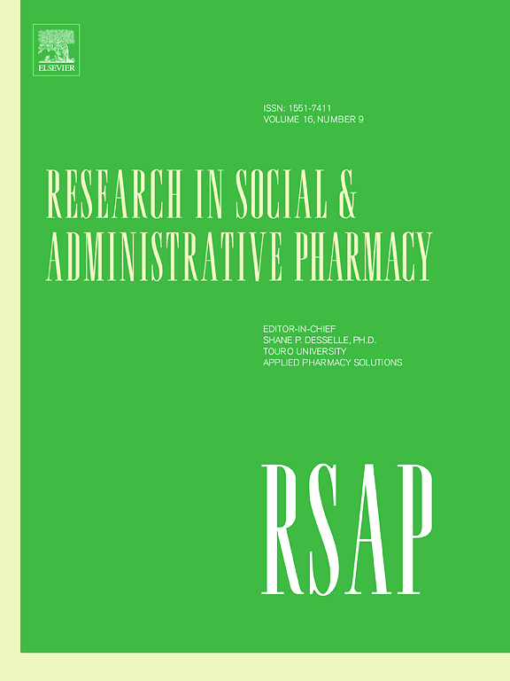
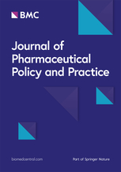

Event 30: Pharmacy practice research priorities during the COVID-19 pandemic
FIP Pharmacy Practice Research Special Interest Group
Health and Medicines Information Section
In collaboration with:
Research in Social and Administrative Pharmacy,
Journal of Pharmaceutical Policy and Practice,
Pharmacy Education

Slide 8
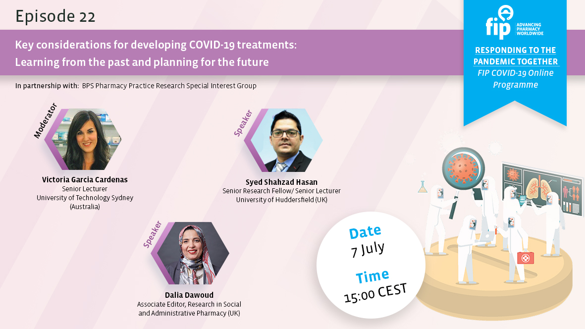
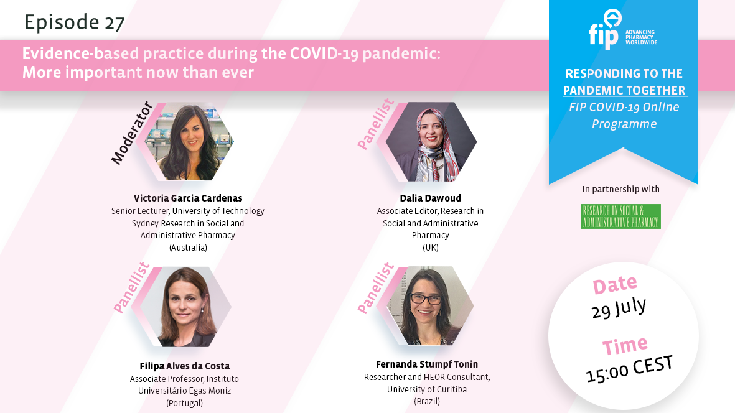
COVID-19 Webinar series
FIP Pharmacy Practice Research SIG
https://www.fip.org/events?event=489
https://www.fip.org/events?event=510

Slide 9
Learning Objectives
Event 30: Pharmacy practice research priorities during the COVID-19 pandemic
To identify how pharmacy practice research can contribute to the practice of pharmacy during the COVID-19 pandemic
- To discuss pharmacy practice research priority areas during the COVID-19
https://www.sciencedirect.com/science/article/abs/pii/S1551741120310445

Slide 10
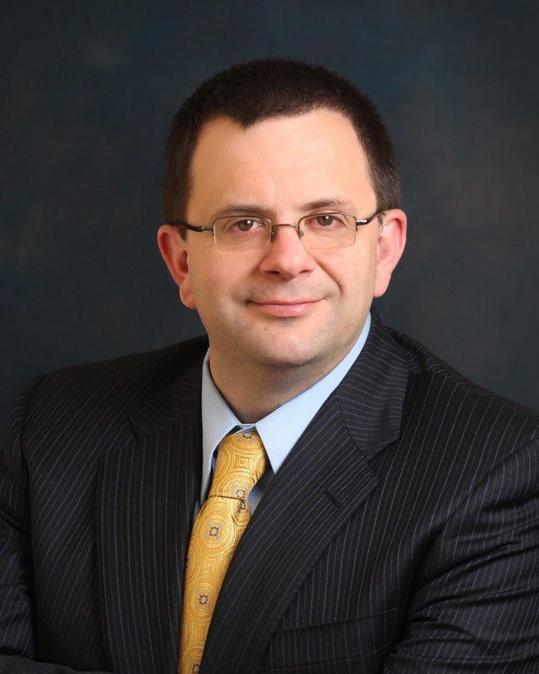
Speaker 1
Professor Shane P. Desselle
Touro University California, USA
Editor-in-Chief, Research in Social and Administrative Pharmacy
Email: shane.desselle@tu.edu
Add picture of speaker here

Slide 11
The Beginning (& Middle & End) of Good Research is Grounded in Solid Theory
Or at least has otherwise a strong foundation and cogent sense of purpose
The best research regarding the pandemic comes not from persons who abandon their current stream of research nor people not experienced in research; rather from investigators who tailor/adapt their current research in light of or to evaluate some aspect of the pandemic

Slide 12
The Beginning (& Middle & End) of Good Research is Grounded in Solid Theory
Consider sociobehavioral theories in patient communication, public health campaigns, educational interventions, teaching pedagogy, how to handle various aspects of the pandemic, and how to optimize patient safety
  Health belief model
  Transtheoretical model of change
  Self-efficacy theory
  Theory of Reasoned Action/Planned Behavior
  Anderson & Aday Health Utilization
  Locus of control
  Diffusion of innovation
  Ecological models
  Implementation science
  Systems re-engineering
Adapt existing research frameworks into evaluating various aspects of the pandemic

Slide 13
Early Response by Pharmacists in Macau
Among the first papers to discuss safety of pharmacy personnel, hygiene, and reduction of transmission in the pharmacy, itself
Addressed lack of knowledge among pharmacists in preparation of alcohol-based handrub formulations
Implementing “The Guaranteed Mask Supply for Macau Residents” scheme
Active surveillance of “suspicious cases”

Slide 14
How to link patients with COVID-19 to the health system from community pharmacies? A route proposal
c
c
c
1
2
3
User who comes with the flu, cough, fever, shortness of breath, sore throat
User requesting anti-flu medications
User who comes to buy mask, alcohol, glycerinated alcohol, antibacterial soap
Ask the user
Recommend the use of face masks for any of the symptoms of: runny nose, sneezing, general discomfort, headache, muscle pain, sore throat
¿Fever?
Have you developed a fever?
Yes
Evaluate other symptoms
No
Have you had a sensation of increased body temperature?
No
No
¿ Have you had a cough, sore throat, or shortness of breath *?
Yes
Do you have an infrared thermometer or a non-contact thermometer?
Yes
No
No
Was the temperature measured with a thermometer?
In the last 14 days, were you traveling to a country with active circulation of the virus?
Yes
Yes
No
Activate the containment stage care route by the community pharmacies
Is the temperature value greater than 37.3 ° C?
Have you had close contact with a person with a probable or confirmed case of COVID-19?
Yes
Measure body temperature
Yes
No
Call the designated lines for reporting cases
Fever confirmed
Strengthen self-care measures
* Shortness of breath: Feeling tight in your chest, or you cannot take a deep breath, or you are having trouble breathing more than usual
End of care by the community pharmacies

Slide 15
Recommendations and guidance for providing pharmaceutical care services during the COVID-19 pandemic: A China perspective
Community pharmacy service and the special needs of community patient population during the COVID-19 pandemic
Recommendations on providing pharmaceutical care
  Pharmacy management
  Ensuring adequate supply of medications and products related to COVID-19
  Ensuring safe and efficient operations
  Staff training
  Disease management
  Safe use of infusions
  Patient education
  Home care

Slide 16
Fighting against COVID-19: Innovative strategies for clinical pharmacists
Develop interim guidance for pharmacists and other workforce members
Create formulary manuals and Medicine News
Establish drug registration research
Establish evidence-based drug evaluation and guidelines
Remote inpatient order review and dispensing
Telepharmaceutical care in Fangcang shelter hospital
Develop individualized treatment with a multidiciplinary team
Telehealth counseling and patient education
Multimedia health education

Slide 17
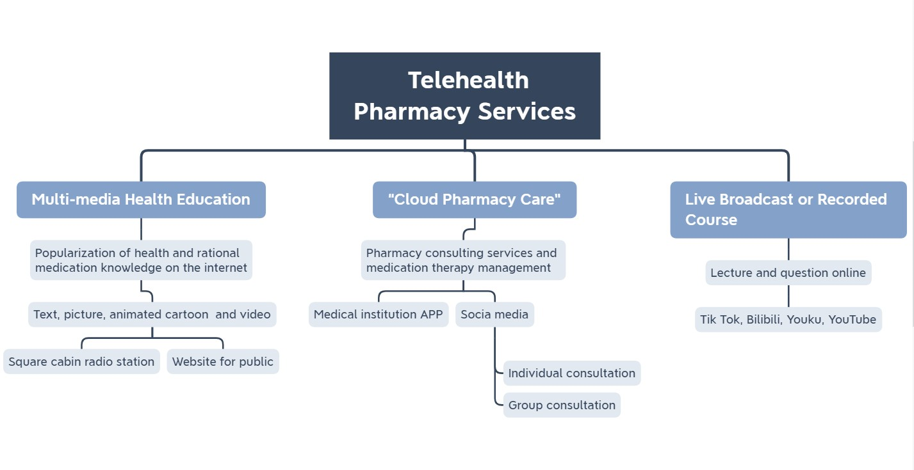

Slide 18
On the frontline against COVID-19: Community pharmacists’ contribution during a public health crisis
Prevention (Measures to reduce the health risks posed by the pandemic)
Provide factual and reliable information on the disease and associated symptoms
Educate the public on infection control and preventive measures to reduce transmission (e.g. hand hygiene, social distancing, self-isolation)
Implement infection control measures (e.g. cleaning and disinfection of the pharmacy environment, limiting public access to the pharmacy)
Preparedness (Measures to ensure timely and effective responses from the healthcare system)
Maintain continuity of pharmacy services, including supplies of essential medications and other products (e.g. hand sanitizers, protective masks)
Assist local and national management teams in ensuring a coordinated health service response
Keep informed of relevant updates from public health agencies and regulatory bodies
Response (Immediate actions in response to the pandemic)
Implement referral pathways for any suspected cases
Facilitate continued supply of over the counter and prescription medications to patients (including emergency supply of repeat medications where necessary)
Assist in dealing with any supply shortages (e.g. sourcing therapeutic alternatives, preparing alcohol-based hand sanitizer formulations)
Recovery (Measures to return to ’normal’ activities post-pandemic)
Re-establish normal working services and stock levels
Identify and prioritise the care of vulnerable patient groups
Update relevant patient records and ensure that patients have valid prescriptions on file

Slide 19
On the front lines (cont’d)
Managing minor ailments
Extending prescribing roles and related activities
Balancing supply and demand
Promoting continued medication adherence
Other areas

Slide 20
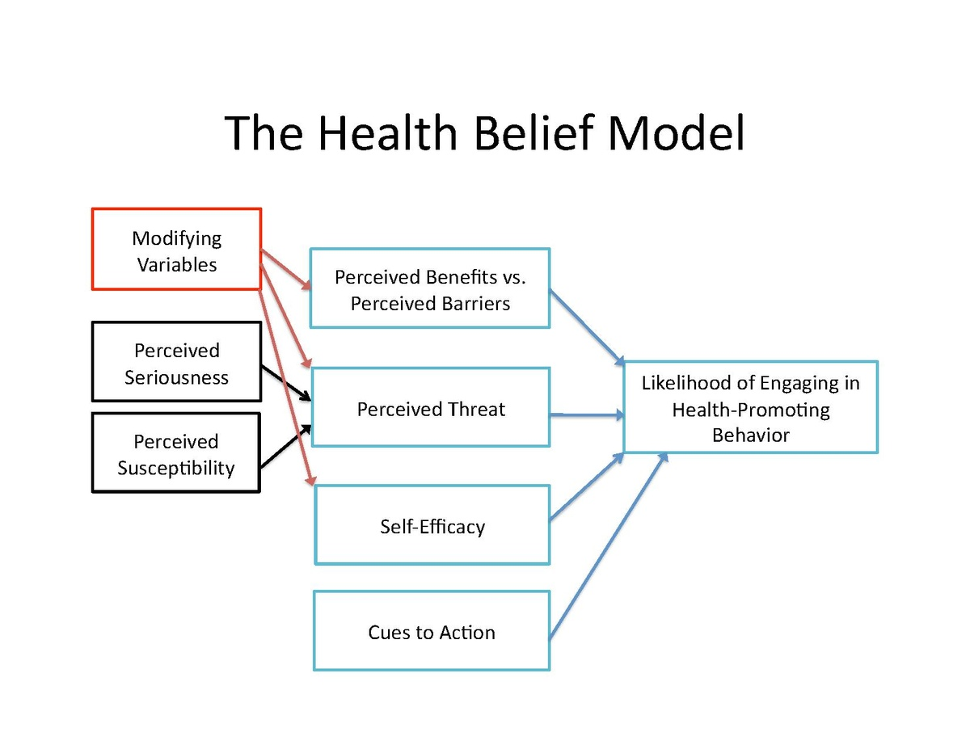
Community pharmacists and communication in the time of COVID-19:Applying the Health Belief Model

Slide 21
HBM (cont’d)
Applying the HBM to COVID-19 mitigation behaviors in community pharmacy patients
Modifying factors
Perceived susceptibility, perceived severity, and perceived threat
Perceived benefits
Perceived barriers
Perceived self-efficacy

Slide 22
Emergency preparedness (cont’d)
Emergency response
Supply chain
Inventory
Patient management
Workplace safety
Expanded roles
Dissemination of research

Slide 23
Resilience in the time of pandemic: The experience of community pharmacists during COVID-19
Resilience issues/facilitators in pharmacy:
  Use of and comfort with technology
  Early adoption of corporate and professional guidance
  Workplaces that maintained a unitary task focus, rather than multitasking
  Scheduling methods and practices in the workplace are important for personal resiliency
  Dedicated specialty staff allowed pharmacists to focus on their work
  Provision of personal protective equipment and supports was essential
Author keynoted a conference based on this paper
  Discussed individual resilience
  Discussed organizational resilience and the need for educators to teach this aspect

Slide 24
Provision of Community Pharmacy Services During the Pandemic: A cross sectional study of experiences with preventative measures and sources of information
Employed the Transtheoretical Model
Community pharmacists were actively involved in implementation of activities and measures aimed at preventing COVID-19 transmission.
Greater implementation of preventative measures by pharmacies was associated with perceptions that pharmacists and the pharmacy profession were valued more by patients and to some extent by other health professionals.
Information distributed by professional organizations such as FIP, was identified to be most useful by pharmacists in dealing with COVID-19 and this information was mainly accessed via mobile devices.

Slide 25
Pharmacists’ Involvement in Successful Emergence from Lockdowns
Role modeling behaviors
Antigen and antibody testing
Supply chain of PPE and medications
Adapting to and pioneering the use of technology
Vaccination hubs
Continue gaining public trust

Slide 26
Cognitive Moral Reasoning and Handling of Drug Supply Shortages
Interesting thus far . . .

Slide 27
Upcoming Title: Forecasting Pharmacy Capacity to Immunize in the COVID-19 Pandemic and Beyond
Background
  Pharmacists as immunizers
  Roles in previous emergencies and disasters with regards to immunizations (e.g. H1N1)
  Logistics, supply chain, and procurement
COVID-19 pandemic
Epidemiological considerations
Benefits to the community with immunizations
Role of pharmacies in COVID-19 immunizations
Developing immunization logistics
Data procurement and challenges
Computing logistics for adequate immunization coverage of a population and procurements
Pharmacies as immunization hubs and MOUs
Statewide Immunization Information Systems

Slide 28
Research Priorities (NOT an exhaustive list)
Therapeutic effectiveness
Pharmacists’ and pharmacy workforce support personnel expansion of roles to improve patient access and outcomes
Systems re-engineering for optimization of efficient care delivery
Forecasting educational and labor needs
Piloting and evaluation of interventions
  In various pharmacy practice settings
  In various mediums
  To various populations

Slide 29
Research Priorities (NOT an exhaustive list)
Pharmacy workforce and quality of work life issues
Resilience and other characteristics (eg, grit, moral reasoning, communication, negotiation, empathy, motivational interviewing, entrepreneursim, innovativeness) that will help pharmacists thrive, particularly in any new normals, other crises, and pandemics
Safety of pharmacy personnel
Telepharmacy and other ‘alternative’ models
Pharmacovigilance, including patients’ use of OTCs, alternative & complementary medicines, “folklore”, and other beliefs regarding medicines and non-pharmacological aspects of wellness and safety
Epidemiological investigations
Supply chain issues
Interdisciplinary teamwork and multi-professional delivery of care/alternative models
Reimbursement for services/recognition as health providers and health educators
Legal/regulatory issues and frameworks

Slide 30
Conclusion
More data and literature being added every day!
Check credible resources for the rapid advances in public health taking place

Slide 31
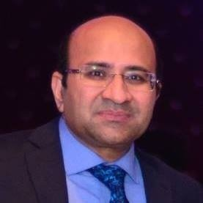
Speaker 2
Professor Zaheer-Ud-Din Babar
University of Huddersfield, UK
Director, Pharmaceutical Policy and Practice Research Centre, University of Huddersfield
Editor-in-Chief, Journal of Pharmaceutical Policy and Practice
Email: z.babar@hud.ac.uk

Slide 32
Presentation Outline
Public health pharmacy research in the times of COVID 19

Slide 33
COVID 19 and pharmacy research
The COVID-19 has brought immense challenges to healthcare systems, and societies, pushing governments and other stakeholders to come together to respond to this crisis.
However, to deal with this situation, evidence-based research is needed.
Babar, Z.U.D. (2020) The Need for an Evidence-Based Encyclopaedia in Health Services Research in Pharmacy. Int. J. Environ. Res. Public Health 2020, 17(7), 2549; https://doi.org/10.3390/ijerph17072549

Slide 34
Research & Pharmacy
Research is not just for academics but is about real issues that affect patients and pharmacists
Roberts R, Kennington E, The Pharmaceutical Journal, News Item
https://www.pharmaceutical-journal.com/news-and-analysis/opinion/comment/pharmacy-practice-research-has-an-impact-on-each-and-every-pharmacist/11001265.article

Slide 35

The types of research and the best evidence
Medicines related research
Pharmacy related research
Original Research/commentaries
Systematic reviews/meta-analysis
Editorial and Commentaries

Slide 36
Medicines related research in COVID-19
  Chloroquine
    Hydroxychloroquine or chloroquine with or without a macrolide for treatment of COVID-19: a multinational registry analysis-retracted from Lancet)
Lopinavir and ritonavir (Kaletra)
Interferon β 1a (SNG001)
Remdesivir
Tocilizumab (Actemra)
Favipiravir (Avigan)
BMJ 2020; 368 doi: https://doi.org/10.1136/bmj.m1252

Slide 37
Pharmacists and COVID 19 Research

Slide 38
Scarcity of Pharmacy Practice Research Literature !
Historically few evidence-based studies in pharmacy and pharmaceutical public health space.
There are currently 39 systematic reviews relevant to the "pharmacy" in the Cochrane Library. In many of these reviews, the pharmacists are not the main focus.
Evidence-based studies have provided guidance towards practice and policy change in the past
Increasing need for evidence-based information during the current COVID19 crisis.
Bond C. Pharmacy Practice, Evidence and Impact. Pharmacy Practice Research Methods, Ed, Babar ZUD Springer Publishing 2020

Slide 39
Pharmacists and COVID 19 Research
A large number of research articles on COVID-19 ( 88 K items and 65 K Researchers on Research Gate)
Policy guidelines from FIP, CPA, RPS on pharmacists’ involvement with pandemic
Thematic Series in different journals JoPPP, RSAP etc
  Pharmacists and the COVID-19 Pandemic https://www.biomedcentral.com/collections/PharmCovid

Slide 40
Analysis of publications!
What is published?
What topics need emphasis?
What resources are required to undertake pharmaceutical health services research?

Slide 41
Thematic Series in JoPPP
Pharmacists and the COVID-19 Pandemic
Journal of Pharmaceutical Policy and Practice has received a large number of submissions on COVID19 and has published a thematic series on the issue .
Editorials, commentaries, reviews
https://www.biomedcentral.com/collections/PharmCovid

Slide 42
Pharmacists at the frontline beating the COVID-19 pandemic
Synthesis of literature
Guidelines development
Pharmacists at the frontline beating the COVID-19 pandemic. J of Pharm Policy and Pract 13, 8 (2020). https://doi.org/10.1186/s40545-020-00210-w

Slide 43
Pharmacists reinventing their roles to effectively respond to COVID-19
Costa et al discussed the changing role of pharmacists from different parts of the world including Asia, Europe, the Americas and Africa during COVID19.
The services include essential and extended services, continuity of care, supply of essential medicines, and emergency care.
Alves da Costa, F., Lee, V., Leite, S.N. et al. Pharmacists reinventing their roles to effectively respond to COVID-19: a global report from the international pharmacists for anticoagulation care taskforce (iPACT). J of Pharm Policy and Pract 13, 12 (2020). https://doi.org/10.1186/s40545-020-00216-4

Slide 44
Mental health issues impacting pharmacists during COVID-19
Elbeddini et al emphasized on mental health issues impacting pharmacists during COVID 19, highlighting increasing workloads.
Elbeddini, A., Wen, C.X., Tayefehchamani, Y. et al. Mental health issues impacting pharmacists during COVID-19. J of Pharm Policy and Pract 13, 46 (2020). https://doi.org/10.1186/s40545-020-00252-0

Slide 45
Research in COVID-19 and pharmacy
The community pharmacy is seeing increasing patients and users,
Demand for services
  screening,
  medicines information
  information related to safety and effectiveness of medicines.

Slide 46
Research on COVID-19: What to cover?
Reviews on the role of pharmacist during COVID-19
Pharmacists roles in the future, during pandemics
Drive-thru pharmacies
Effectiveness of telemedicine
Remote counseling and patient health outcomes
Pharmacists’ roles in medicines information ( with the increasing information and literature for patients)
Drug shortages/supply chain
Visacri MB et al . Role of pharmacist during the COVID-19 pandemic: A scoping review. Res Social Adm Pharm. 2020;doi:10.1016/j.sapharm.2020.07.003
Hussain R, et al . Drive-thru pharmacy services: A way forward to combat COVID-19 pandemic Res Social Adm Pharm. 2020;S1551-7411(20)30601-X. doi:10.1016/j.sapharm.2020.07.015

Slide 47
Supply chains and quality, safety of medicines
The current crisis has also seen an impact on medicines supply lines and health systems.
This has been seen all across (high, middle and low-income countries)
Impact on access and availability of essential medicines/drug shortages
Substandard and falsified medicines.
  The quality and safety of pharmaceuticals are increasingly important when a large number of people are paying out of pocket.
Oxford Collaboration, Newton, P. N., Bond, K. C., & Babar, Z. (2020). COVID-19 and risks to the supply and quality of tests, drugs, and vaccines. The Lancet Global Health, 8(6), e754-e755. https://doi.org/10.1016/S2214-109X(20)30136-4

Slide 48
What is needed to produce evidence informed research in COVID-19?
Human resource
Understanding of methods (quantitative, qualitative, systematic reviews, meta analysis, RCT)
Health systems, clinical, pharmacy knowledge (global versus local understanding)
An understanding how this research would be used
  Who will be the end users?

Slide 49
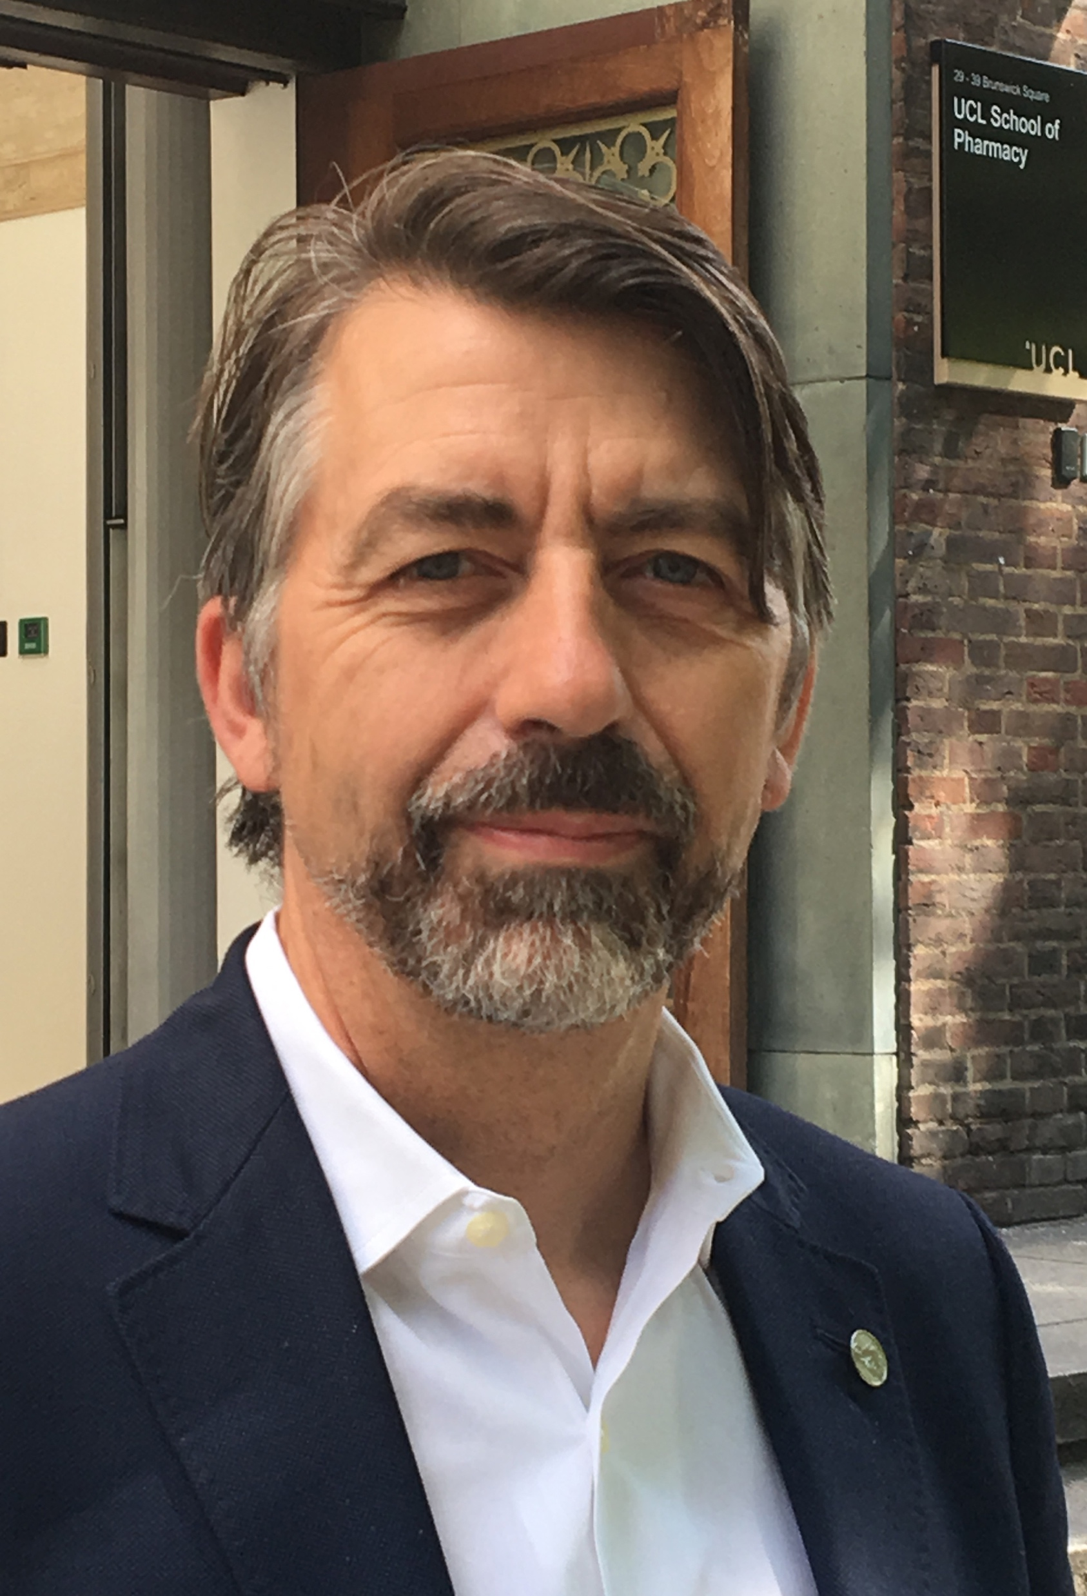
Speaker 3
Professor Ian Bates
UCL School of Pharmacy
Editor-in-Chief, Pharmacy Education
Director FIP Global Pharmaceutical Observatory
Email: education@fip.org

Slide 50
Education and workforce
Global CV19 “lockdown” – FIP rapid response survey
Retrospective & trends on submissions to Pharmacy Education
Pharmacy workforce and continued training & development

Slide 51
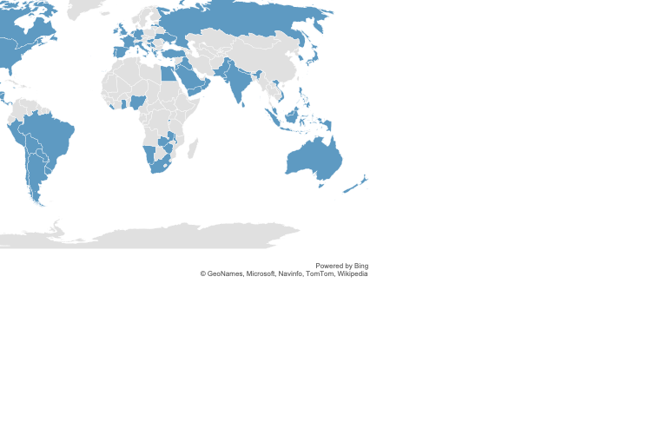
Higher Education – FIP Rapid response survey
211 valid responses from Universities providing
Pharmacy initial E & T programmes
Responses from 63 countries
across all WHO regions

Slide 52
Higher Education
CV19 “lockdown” decisions:
3% - not switched to online provision at time of survey
75% - switched to online in March
16% - switched to online in April
(Remainder from May onwards…)
2 cases switched in FEBRUARY (Italy & South Korea)

Slide 53
Prior to CV19 - NOT using online delivery of…

Slide 54
Online curriculum access prior to CV19…

Slide 55
Effects of CV19…
Previously un-recorded capability to make significant decisions
A general low level of IT/digital provision – some, not a majority
Online assessments a critical challenge reported by many
Experiential learning in the spotlight
Social restrictions and access to faculty spaces…

Slide 56
FIP Pharmacy Education journal retrospective survey
R², p<0.001
Year of Article | N [sampled] | %
2008 | 7 | 3.3
2009 | 6 | 2.8
2010 | 19 | 8.9
2011 | 25 | 11.7
2012 | 8 | 3.8
2013 | 22 | 10.3
2014 | 13 | 6.1
2015 | 35 | 16.4
2016 | 23 | 10.8
2017 | 27 | 12.7
2018 | 28 | 13.1
Total | 213 | 100

Slide 57
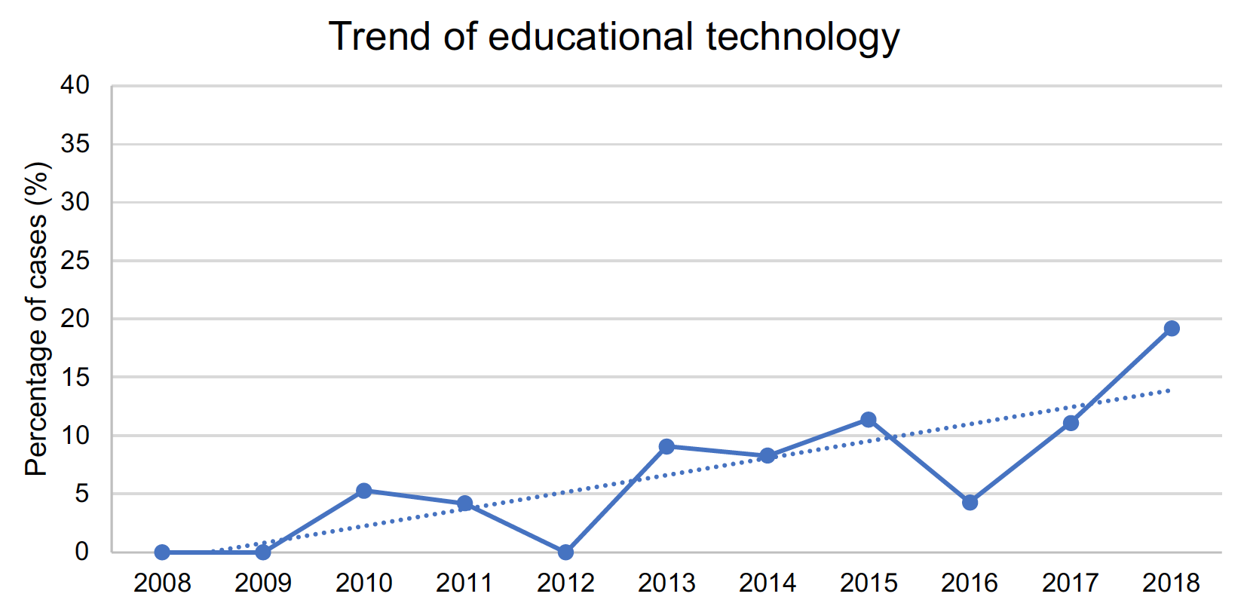
FIP Pharmacy Education journal retrospective survey

Slide 58
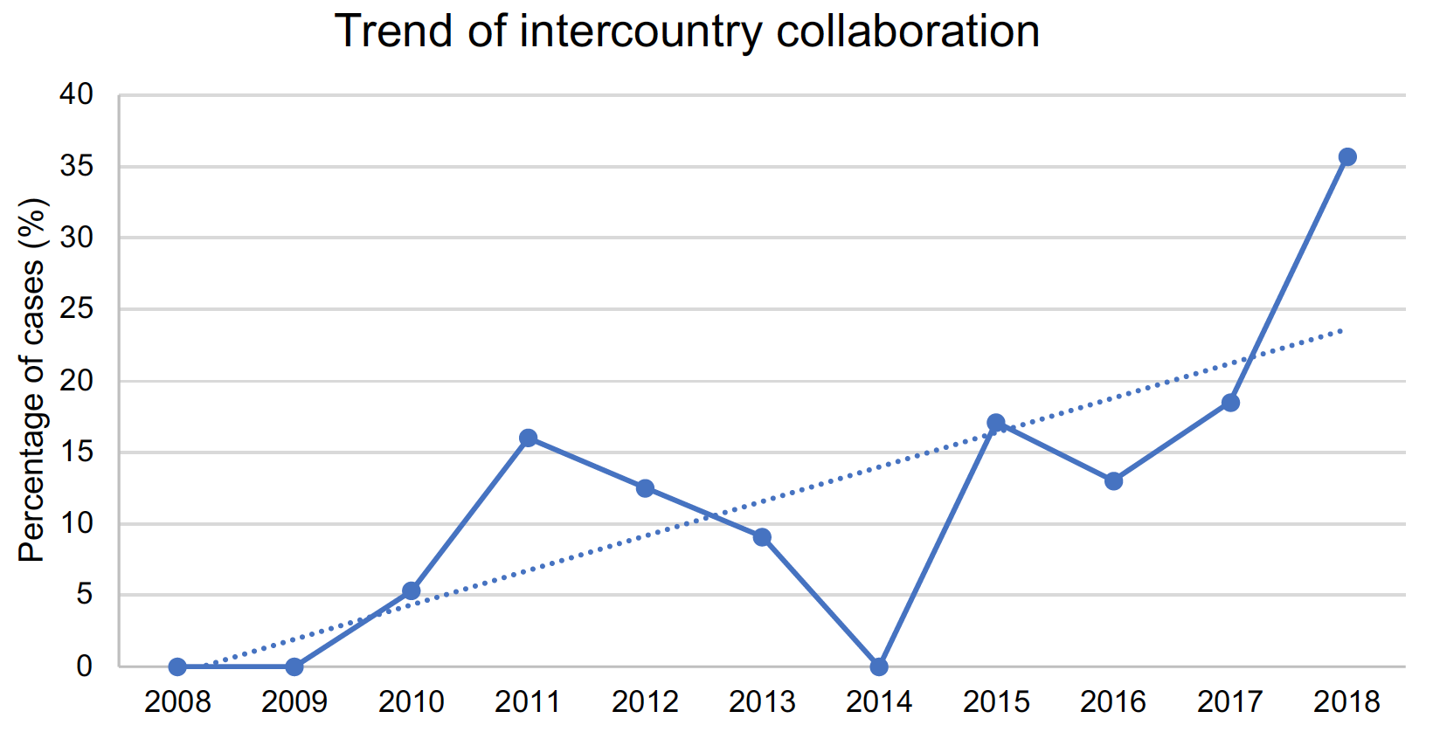
FIP Pharmacy Education journal retrospective survey

Slide 59
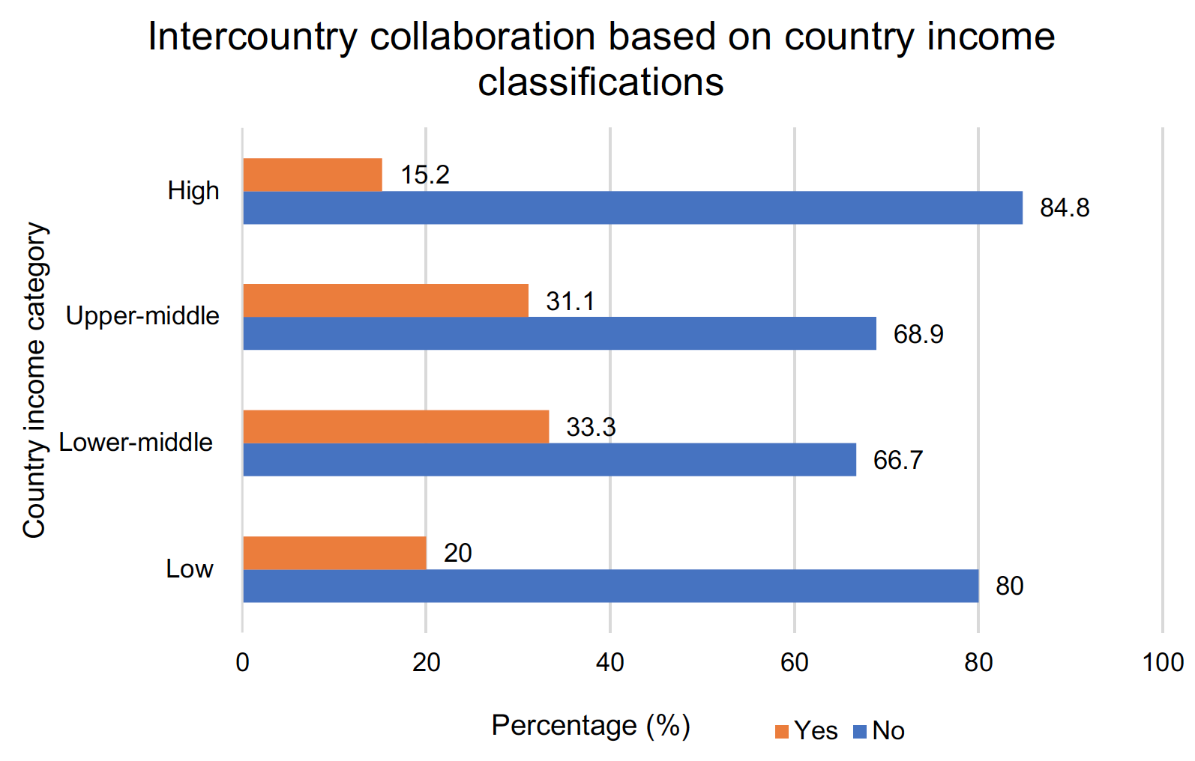
FIP Pharmacy Education journal retrospective survey

Slide 60
FIP Pharmacy Education journal retrospective survey
Trends in educational technology have been accelerated by CV19
Pharmacy Education publishing n=40 innovative case stories of transition to online, in conjunction with the Rapid-Response survey
Enhanced interest in experiential learning triggered
In general, an enhanced focus on evaluating what we are doing in education and learning across the scope of practice

Slide 61
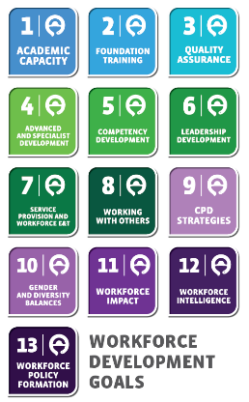

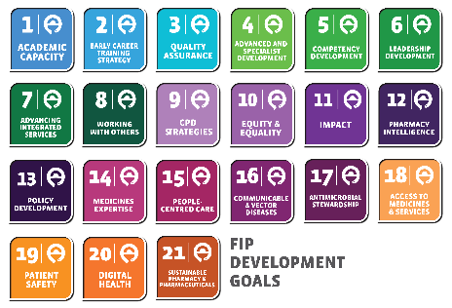
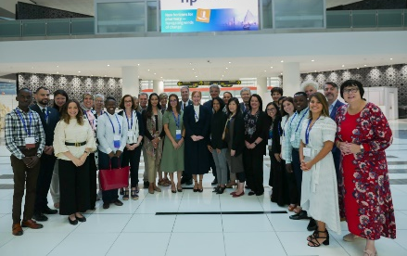
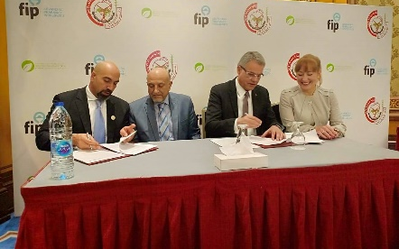
Workforce: From WDGs to FIP DGs…
2016
2017
2018
2019
2020
FIP Pharmaceutical Workforce Development Goals
FIP Nanjing Report on Workforce & Education
FIP Workforce Development Hub
FIP Workforce Transformation Programme
FIP Development Goals
Launched in Nanjing to support the implementation of the FIP Global Vision for Education and Workforce
Launched to confirm commitment to action by FIP to support Members implement the PWDGs
Launched to develop evidence, tools & frameworks for the FIP PWDGs implementation
Launched to support country-level action and Member implementation of the FIP PWDGs using Hub output
Launched to support the FIP Mission to advance practice, science and education

Slide 62

From WDGs to FIP DGs…R&E priorities…CV19 adjacency
Academic systems focus
Key workforce challenges
Evidence and data
focus

Slide 63
Global imperative for “One FIP” goals
Bringing practice, science and workforce together
We believe it is imperative to bring science, practice and workforce & education together into one transformative framework to more clearly set out the goals for development.
Together with the existing goals for workforce & education, new goals for practice and science will be core elements of the integrated FIP Development Goals.
FIP believes that we can have no pharmaceutical care without a pharmaceutical workforce, and we can have no pharmaceutical care without a scientific foundation for the next decade.
PRACTICE
WORKFORCE
SCIENCE

Slide 64
Research urgencies in pharmaceutical education…
Outreach to more Regions, especially LMIC nations
Continue the upward trend in IT/digital evaluation of learning and provision effectiveness
Focus more on experiential learning
Focus more on outcomes
Workforce is now a much more complex and integrated challenge…

Slide 65
Q&A

Slide 66
Question Time
Please use the chat board to log your questions & comments.
Today’s question(s):

Slide 67
Thank you for participating!
Please provide your feedback through the 4-question survey that will appear to you at the end of the event

Slide 68
LIVING AND LEARNING THROUGH THE
COVID-19 PANDEMIC –
GLOBAL REFLECTIONS
4 – 25 September 2020

