Slide 1
Winter is coming:
Influenza vaccination in times of COVID-19 –
Best practices from the Southern Hemisphere
2 July 2020

Slide 2
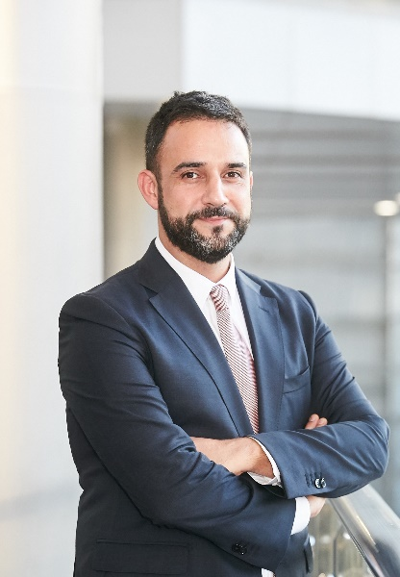
Moderator
Gonçalo Sousa Pinto,
Lead for Practice Development and Transformation
FIP

Slide 3

FIP would like to thank Sanofi Pasteur for funding this online event through an unrestricted educational grant.

Slide 4
Announcements
Webinar House Rules
This webinar is being recorded and live-streamed via Facebook.
The recording will be available on our website www.fip.org.
You may ask questions using the questions box.
You are welcome to provide feedback to webinars@fip.org.
We invite you to become a member of FIP at www.fip.org/membership_registration
©FIP: All the information in this video are confidential and cannot be copied, downloaded or reproduced without the formal approval of FIP (International Pharmaceutical Federation).

Slide 5
Programme of today’s webinar
Overview
Introduction - Gonçalo Sousa Pinto
How to secure the effective implementation of a pharmacy-based influenza immunisation campaign in the context of the COVID-19 pandemic? Best practices from the Southern Hemisphere
  Mariet Eksteen, South Africa – 15 min
  Bettina Caponi, Argentina – 15 min
  Andi Shirtcliffe, New Zeland – 15 min
Panel discussion and questions from the audience – 30 min
Wrap-up and take-home messages – 5 min
©FIP: All the information in this video are confidential and cannot be copied, downloaded or reproduced without the formal approval of FIP (International Pharmaceutical Federation).

Slide 6
Learning objectives
After this webinar the participants should understand:
The impact that pharmacy-based immunisation can have on vaccination coverage rates;
Why vulnerable populations (older people and chronic patients) should be vaccinated against influenza, especially in the context of the pandemic
The role that pharmacists can play in normal circumstances and in times of crisis in improving vaccination coverage
How some countries in the Southern Hemisphere have adopted strategies to increase flu vaccination through pharmacies.
©FIP: All the information in this video are confidential and cannot be copied, downloaded or reproduced without the formal approval of FIP (International Pharmaceutical Federation).

Slide 7
Introduction
What can we expect as the COVID-19 pandemic evolves and seasonal influenza comes again?
How can the epidemiology and biology of these infections inform our preparation strategies?
Several factors will determine the overall severity of the upcoming respiratory viruses season and can inform our plans:
  Transmission modes
  Co-infection
  Disparities and social determinants
  Vaccination strategies
Singer, B.D., 2020. COVID-19 and the next influenza season. Sci.Adv. DOI: 10.1126/sciadv.abd0086
Notes:
Transmission modes: both viruses are predominantly transmitted via respiratory droplets. As such, preventive measures adopted for COVID-19, including social distancing and the use of masks, are also effective against influenza. So, continuing emphasising these measures will contribute to reducing the number of cases of both disesases.
Co-infection: Co-infection with another respiratory virus occurred in over 20% of the COVID-19 cases early in the pandemic in the USA. This has consequences in terms of diagnoses, clinical management and treatment – especially in areas where testing capacity is limited. As such, the need for accurate rapid diagnostic tests is pressing.
Disparities and social determinants: In countries like the USA, minority populations are over-represented among COVID cases and deaths, and also in vaccination rates, which exposes the need for expanding public health efforts and vaccination among vulnerable populations, including ethnic minorities, the poor and older adults.
Vaccination strategies: As we await the availability of a vaccine against SARS-CoV-2, we need to put in place plans to mitigate the overall burden of respiratory disease, by increasing vaccination coverage rates for the flu, particularly among older adults, who are at higher risk for both diseases.

Slide 8

Mariet Eksteen
  Professional Development and Support
  Pharmaceutical Society of South Africa
  Global Lead: Pharmaceutical Workforce Development Goal 7: Service Provision and Workforce Education & Training, of the FIP Workforce Development Hub

Slide 9
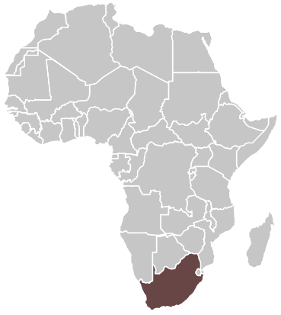

Winter is coming: Influenza vaccination in times of COVID-19 – best practices from the Southern hemisphere
A view from South Africa
Dr Mariet Eksteen
Professional Development and Support
Pharmaceutical Society of South Africa (PSSA)

Slide 10
South African healthcare environment
Current two-sector health care system
59,3 million population
Private health
Public health
84%*
Population coverage
16%
46%
ZAR 15 823
54%
ZAR 3530
Total health expenditure
(per capita expenditure)
Source: Health Systems Trust. 2018. South African Health Review https://www.hst.org.za/publications/South%20African%20Health%20Reviews/SAHR%202018.pdf

Slide 11
Administration of flu vaccines
Private sector:
Pharmacists
Nurse in pharmacy clinic
General practitioners / specialists
Nurse in general / specialist practice
Public sector:
Nurse-driving in Primary Health Care clinics, Community Health Centres, Out-patient departments of District hospitals

Slide 12
Pre-Covid-19:
Priority patients for flu vaccines
High risk patients:
These are patients who are 65 years or older, pregnant or who suffer for one of the following chronic conditions:
Private
Medical scheme will inform high risk patients to obtain a flu vaccine.
Medical aids will liaise with community pharmacies to offer services to their members.
Public
Patients will visit the PHC clinic or CHC to obtain chronic medication or other health care services, and will be offered the flu vaccination in addition.
Offered free of charge to patients.
Cost paid by medical aid as health benefit or by the patient themselves (out of pocket).
Bronchiectasis
Cardiac Failure
Cardiomyopathy
Chronic Obstructive Pulmonary Disease (COPD)
Chronic Renal Disease
Coronary Artery Disease
Diabetes (Types 1 & 2)
HIV
Asthma

Slide 13
Flu vaccine statistics 2019: Private sector
 | 2016 | 2017 | 2018 | 2019
Influenza vaccine (vials / doses) | 918 805 | 735 468 | 934 535 | 894 836
Growth percentage year-on-year |  | -19,95% | 27,07% | -4,25%
Source: IQVIA Total Private Market April 2020

Slide 14
Flu vaccine statistics 2019: PUBLIC sector
Total for public sector:
Received – 1 005 120
Utilized – 944 150
Source: National Department of Health (NDoH). 2019. Influenza vaccine report, 14 October 2019
Portion of SA population | Eastern Cape | Free State | Gauteng | KwaZulu-Natal | Limpopo | Mpumalanga | North West | Northern Cape | Western Cape
Provincial (in million) | 6,5 mil | 2,9 mil | 14,7 mil | 11,4 mil | 5,8 mil | 4,5 mil | 3,9 mil | 2,1 mil | 6,6 mil
Percentage | 11,3% | 5,1% | 25.5% | 19,7% | 10% | 7,8% | 6,9% | 1,2% | 11,5%

Slide 15
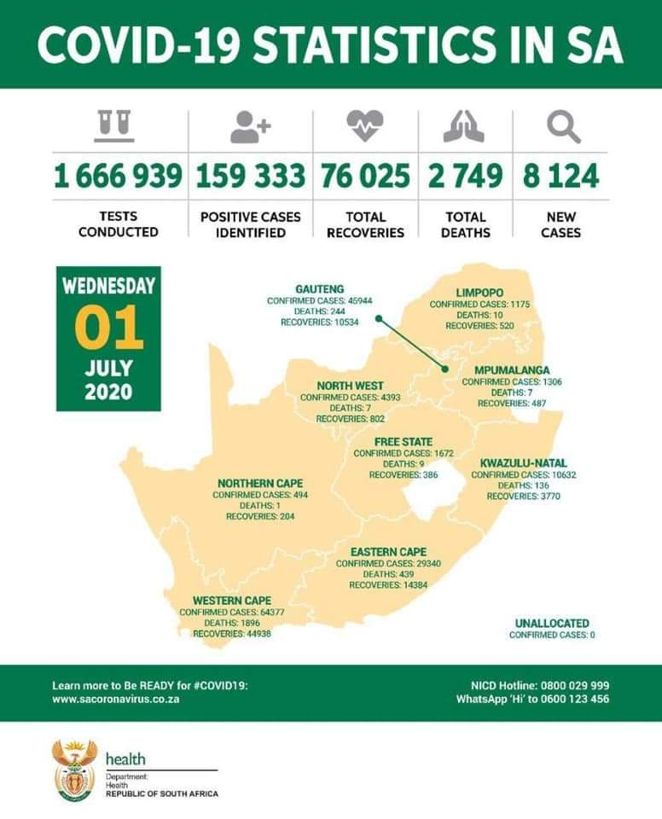
Covid-19 statistics

Slide 16
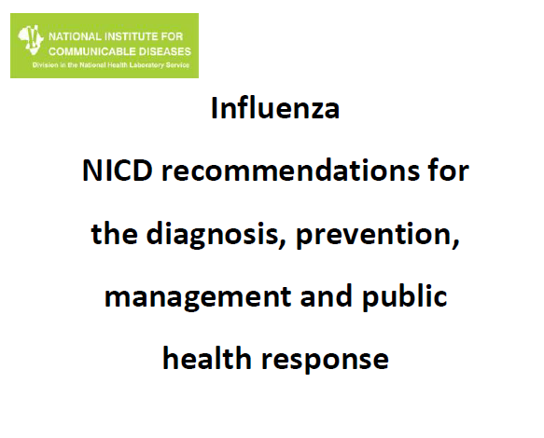
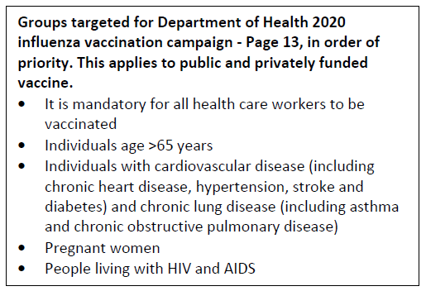
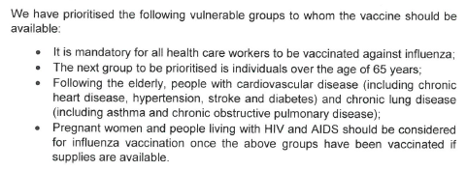
Covid-19:
Priority patients for flu vaccines
Updated 2 April 2020
Guideline for Influenza vaccination 2020, communication issued to CEOs of hospitals and private pharmacies, and managers of clinics by DDG: Communicable & Non-communicable diseases, Dr Yogan Pillay on 24 March 2020

Slide 17
Flu vaccine statistics 2020
Private sector
2019: 894 836
1 316 679 supplied to date
47,14% increase year on year
True demand more towards
1.5-1.8 million
Public sector
2019: 1 005 120
Provinces order according to budget
Dec 2019: 1 062 000 (5,66 % increase)
Tender company brought 1 084 000 Feb 2020
March 2020: NDoH demanded additional
2 million vaccines
Total of 1 378 000 supplied to date
20% increase in initial demand
27% increase year on year
Source of data: Personal communication

Slide 18
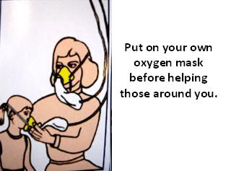
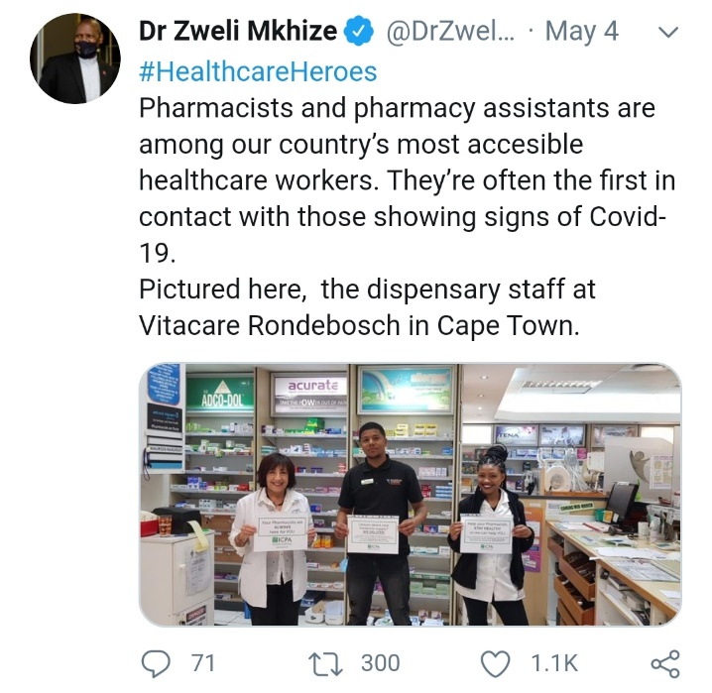
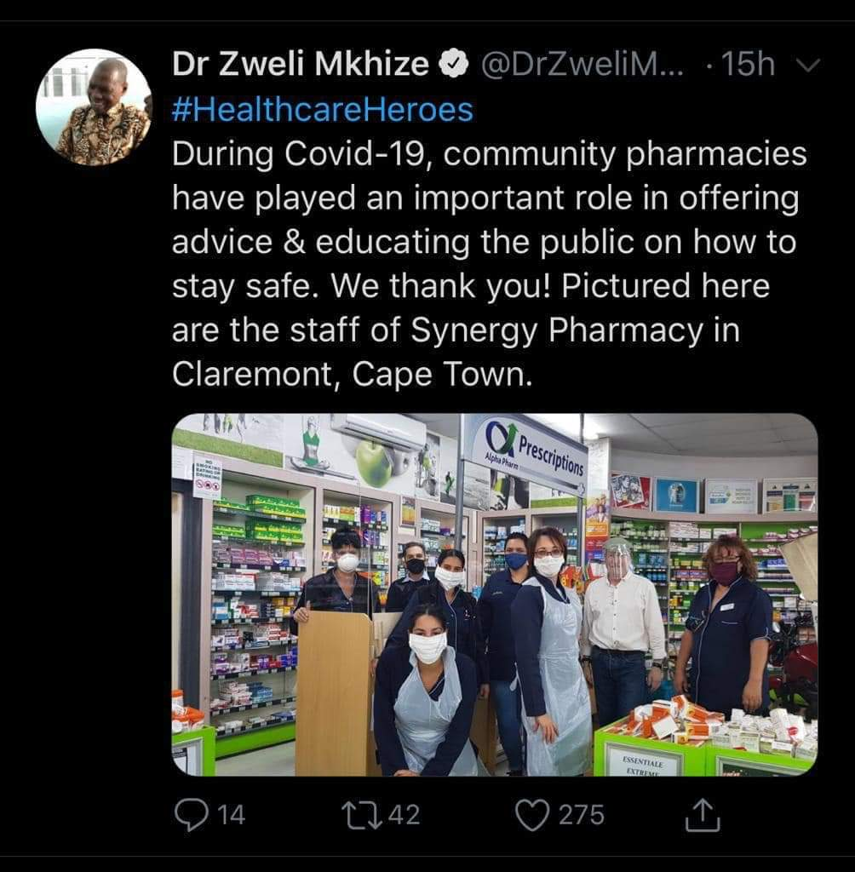
How did covid-19 change the
2020 flu campaign?
Mandatory for HCW to receive the influenza vaccine (first)
Reached anti-Vaxxers / vaccine hesitancy
Acknowledge as most accessible health care workers
by Minister of Health Dr Zweli Mkhize
Increased awareness towards
preventative measures

Slide 19
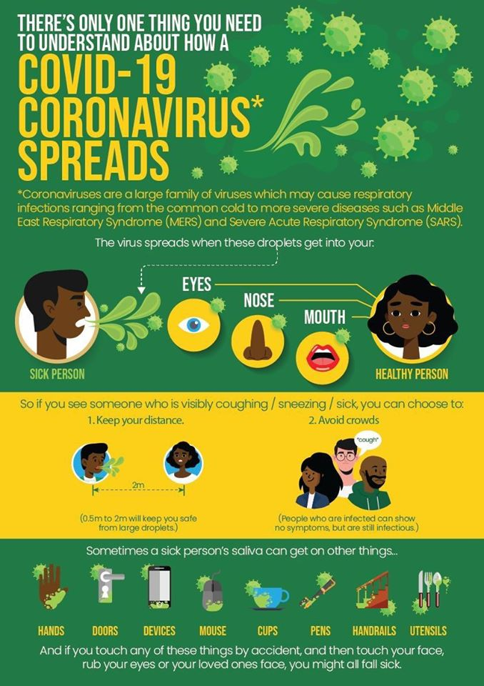
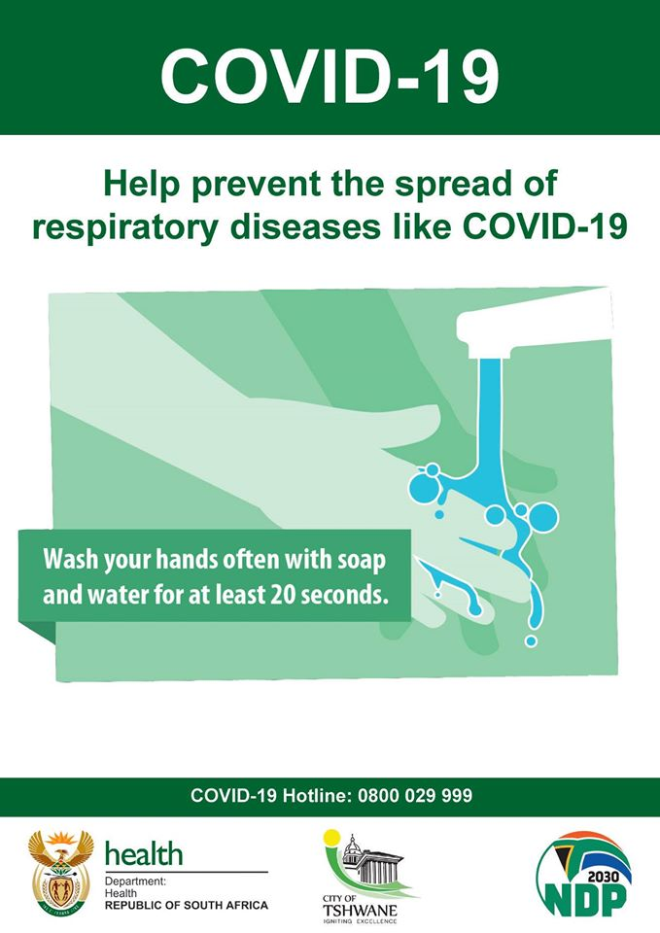
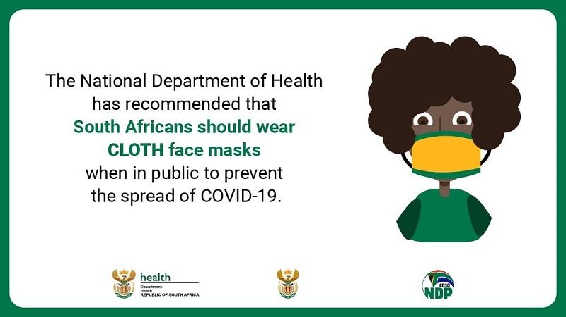
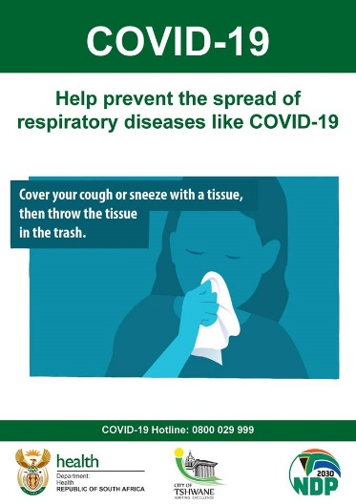
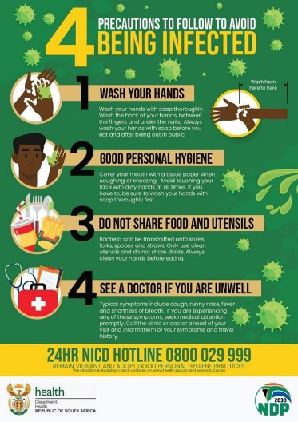

Preventative measures

Slide 20
Vaccination concerns:
National immunisation rates for children under five years have dropped dramatically
[Private corporate pharmacy with 290 pharmacy clinics] Immunisation dropped by 8% in March (before the lockdown), 41% in April, 26% in May and 40% in June.
[Public sector] National immunisation coverage dropped from 83% (April 2019) to 61% (April 2020)
Fear of an outbreak of deadly childhood infectious diseases including measles (dropped from 77% in April 2019 to 55% in April 2020 for second dose immunisation)
“Children are at greater risk of dying from vaccine preventable disease than contracting COVID-19” – Prof Shabir Mahdi, University of Witwatersrand
Source: Spotlight https://www.spotlightnsp.co.za/2020/06/24/dramatic-drop-in-sas-immunisation-rates/

Slide 21
Conclusion and way forward
Going forward:
Influenza vaccination coverage rates are only at 4,5% in South Africa (2.2% private pharmacy-based sector).
Due to patient ease and broader access to pharmacists, we believe that a pharmacy-based immunization project would increase vaccination coverage rates in the country, thereby reducing the burden of influenza disease.
Data source: Personal communication

Slide 22
Acknowledgements
Colleagues and pharmacists who assisted with information, data and review of this presentation:
  Andy Gray, University of KwaZulu-Natal
  Joggie Hattingh, Western Cape Government Department of Health
  Khadija Jamaloodien, National Department of Health
  Jackie Maimin, Independent Community Pharmacy Association
  Annette Meintjies, Private Sector Manager, Sanofi Pasteur
  Neo Molusi, Head of Public Sector vaccines, Sanofi Pasteur
Thank you

Slide 23
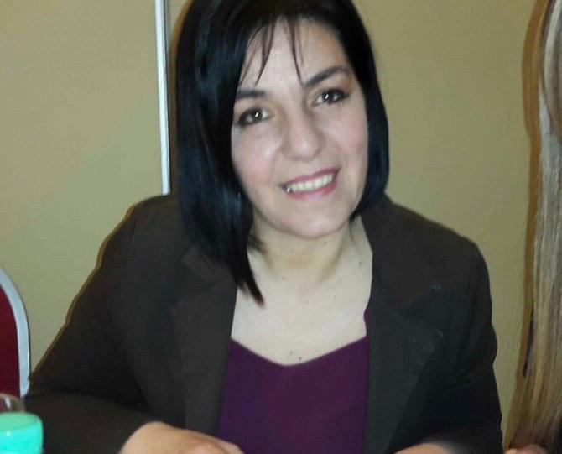
Bettina Caponi
  Community Pharmacist
  Argentinian Pharmaceutical Confederation

Slide 24
A view from Argentina
Bettina Caponi

Slide 25
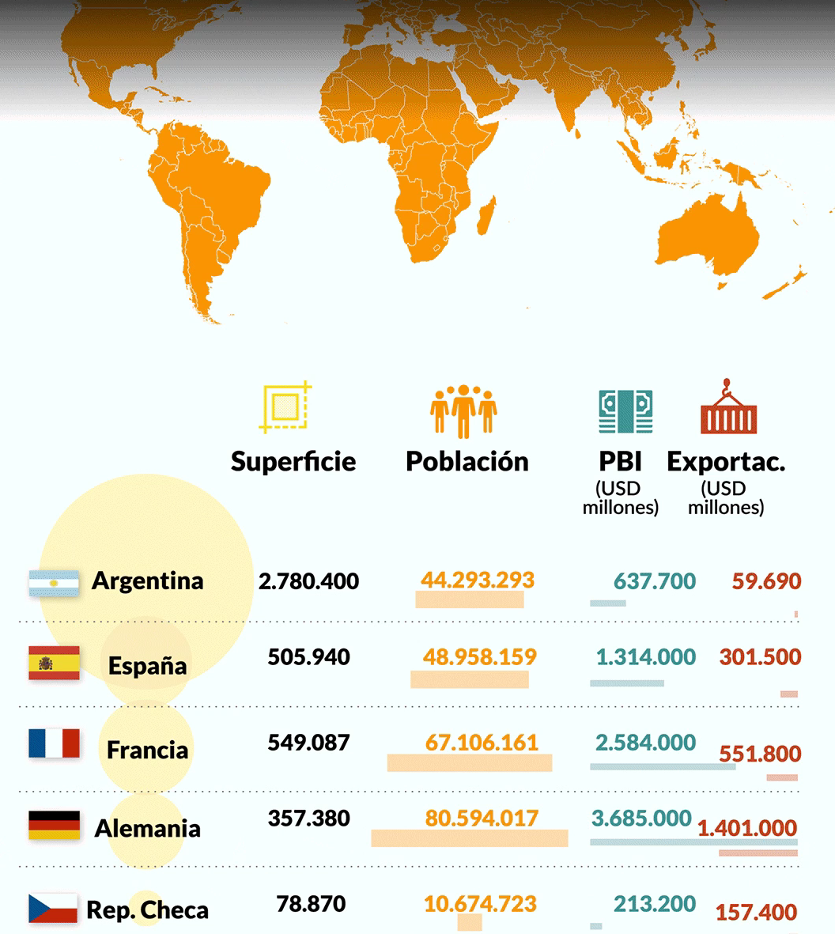

Slide 26
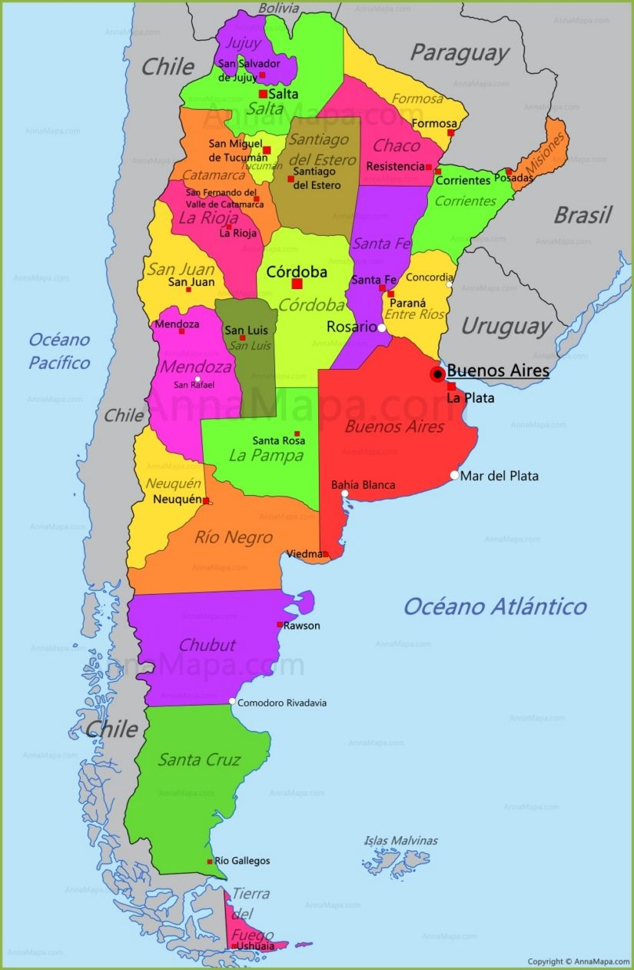
ARGENTINA
24 provincies
Federal organitation
15.000 pharmacies

Slide 27
LEGAL FRAMEWORK
1958 | Res. 1732/58 | IM and SC injections
1967 | 17575/67 | National Pharmacy practice law
1983 | Law 22909 | Prescriptions and registration
1995 | Res 67/95 | Facilities equipment and waste
2000 | Decree 3521/00 | Sanitary cabinet
2004 | COFA norma 404 | Guidelines and recommendations
2011 | Res.1460/11 | Intradermal injections

Slide 28

Argentinian pharmacist vaccinate because…
Duties and responsabilities
Legal Framework
Sanitary cabinet
Certification

Slide 29
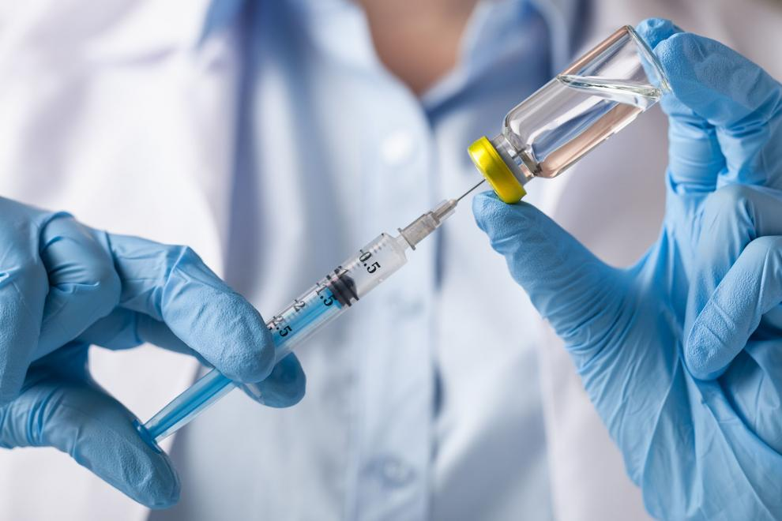
VACCINATION

Slide 30




Vaccination campaigns

Slide 31
Vaccination campaigns for elder people
 | 2009 | 2017 | 2019
Pharmacies | 4500 | 4900 | 6300
Influenza doses | 529000 | 620000 | 830000
Pneumococcal 13 doses |  | 6000 | 253000
Pneumococcal 23 doses |  |  | 218000

Slide 32


2019
REGION | ADMINISTRATED
CAPITAL FEDERAL | 17403
CHACO | 6648
CORDOBA | 74784
CORRIENTES | 10870
ENTRE RIOS | 22068
FORMOSA | 2962
JUJUY | 5464
LA RIOJA | 2005
MENDOZA | 15155
BUENOS AIRES | 297367
RIO NEGRO | 10687
ROSARIO | 25674
SALTA | 7054
SAN JUAN | 5312
SAN LUIS | 3608
SANTA CRUZ | 242
TIERRA DEL FUEGO | 256
TUCUMAN | 15479
Influenza Vaccination
DISTRIBUTED | ADMINISTRATED
555.335 | 526.212
Datos Farm. María Isabel Reinoso

Slide 33
2019
Antineumoccoccal13
DISTRIBUTED | 193.080
ADMINISTRATED | 143.501
PROVINCIA | Stock
BUENOS AIRES | 62.317
CAPITAL FEDERAL | 1.388
CHACO | 2.314
CORDOBA | 19.477
CORRIENTES | 1.091
ENTRE RIOS | 6.986
FORMOSA | 344
JUJUY | 727
LA RIOJA | 301
MENDOZA | 5.899
RIO NEGRO | 2.703
SALTA | 1.515
SAN JUAN | 2.035
SAN LUIS | 1.343
SANTA CRUZ | 39
SANTA FE | 4.669
TIERRA DEL FUEGO | 80
TUCUMAN | 3.494
Datos Farm. María Isabel Reinoso

Slide 34
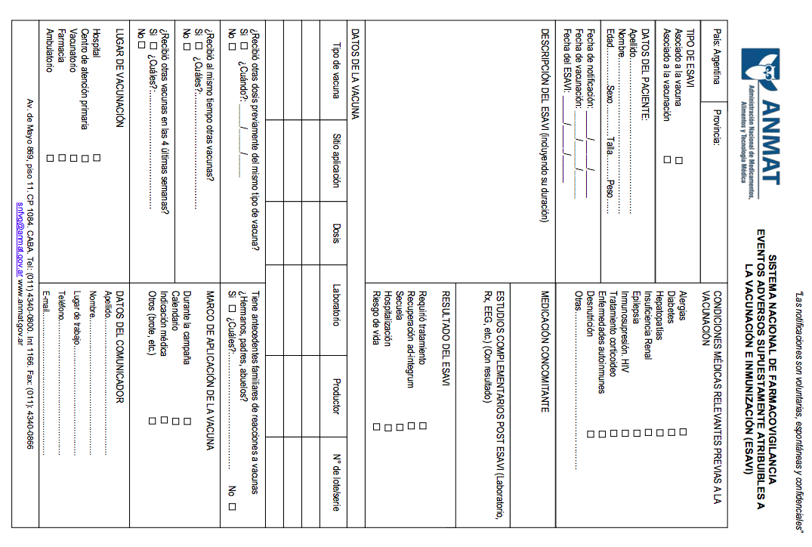
National Pharmacovigilance System
Event Supposedly Attributable to Vaccination or Immunization
(ESAVI)

Slide 35
Events supposedly attributable to vaccination or immunization, Argentina, 2011-2015
 | 2011 | 2012 | 2013 | 2014 | 2015
Applicated doses | 4.936.090 | 4.442.724 | 5.505.674 | 4.463.457 | 5.225.026
ESAVI rate roported | 72 | 44 | 101 | 91 | 92
Notification rate | 1,46 | 0,99 | 1,83 | 2,04 | 1,74
ESAVI related with vaccination or immunization | 54 | 35 | 67 | 49 | 58
ESAVI rate related with vaccination or immunization | 1,03 | 0,78 | 1,22 | 1,10 | 1,11
ESAVI related severe | 7 | 7 | 6 | 6 | 12
ESAVI rate severe | 0,14 | 0,15 | 0,10 | 0,13 | 0,23
Total ESAVI notified in pregnant women | 0 | 1(mild) | 4(mild) | 5 (programmatic errors) | 1(in study)
Pregnant women rate | 0 | 0,27 | 1,05 | 1,42 | 0,27

Slide 36
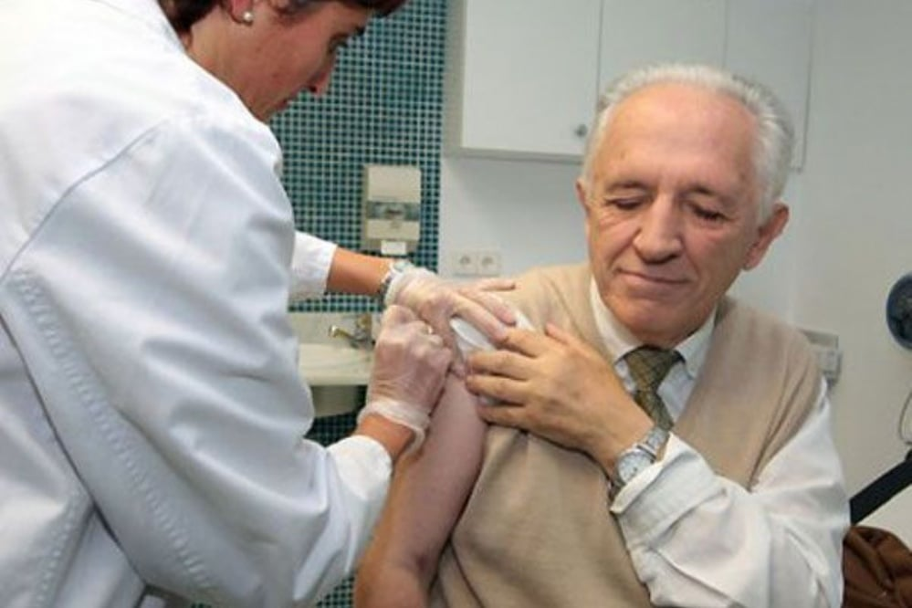
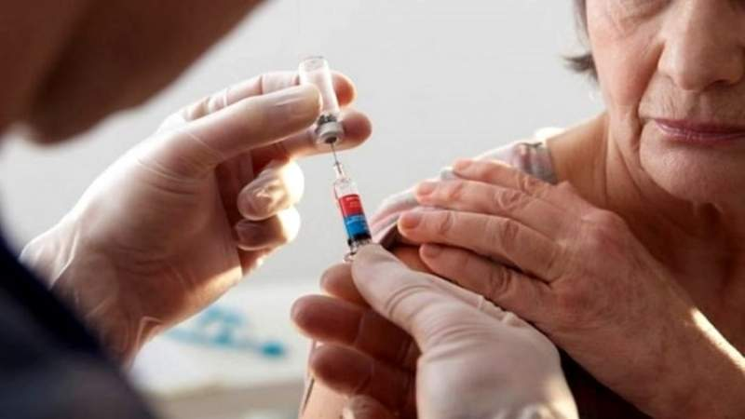

Slide 37
COVID PANDEMIC IN
ARGENTINA

Slide 38
CoFA Protocol
March 13
1st Version
March 17
1st Actualization
April 1
2nd
April 13
3rd
April 27
4th
May 14
5th
June 3
6th
June 12
7th

Slide 39
Themes
Information about COVID infection 19
The preparation of alcohol gel and others solutionsn according to good pharmacy preparation practices (BPPF)
Atenttion to the public in community pharmacies
Protection for the community pharmacist and community pharmacy staff
Evolution of suspicious case and close contract
Care in the community pharmacy of suspected cases of COVID infection 19
Shift services of community pharmacies

Slide 40
Protocol Themes
Hygiene and disinfection of the work enviroment
Recommendations for commuting to and from work
Specific protocol for the health cabinet: how to face a flu vaccination campaign, talking into account that in this action the necessary distance for prevention cannot be met.
Specific protocol for the application of injectables
Specific protocols for taking blood pressure.
Reinforcement of the reccomendation for the protection of pharmacy and pharmacist assitans

Slide 41
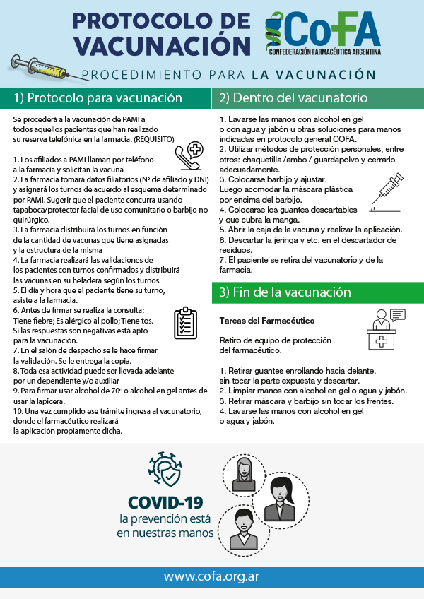
CoFA
Vaccinaton Protocol

Slide 42
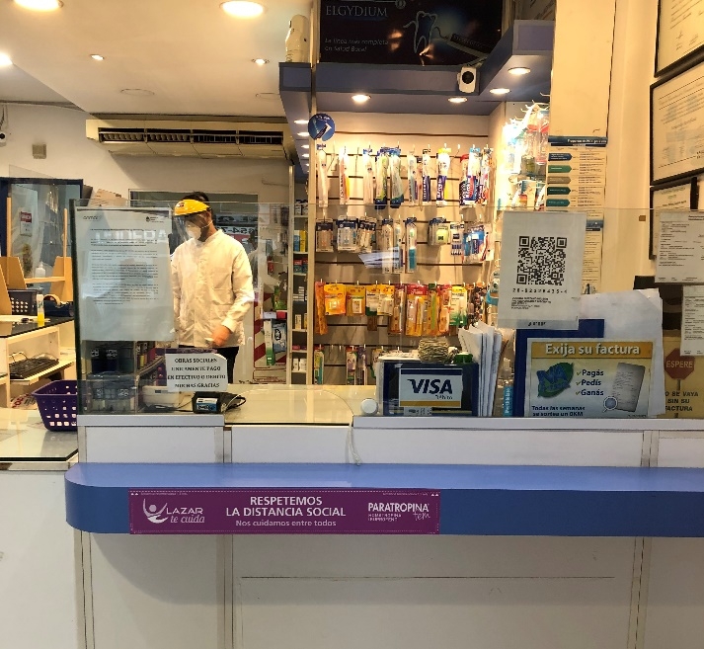
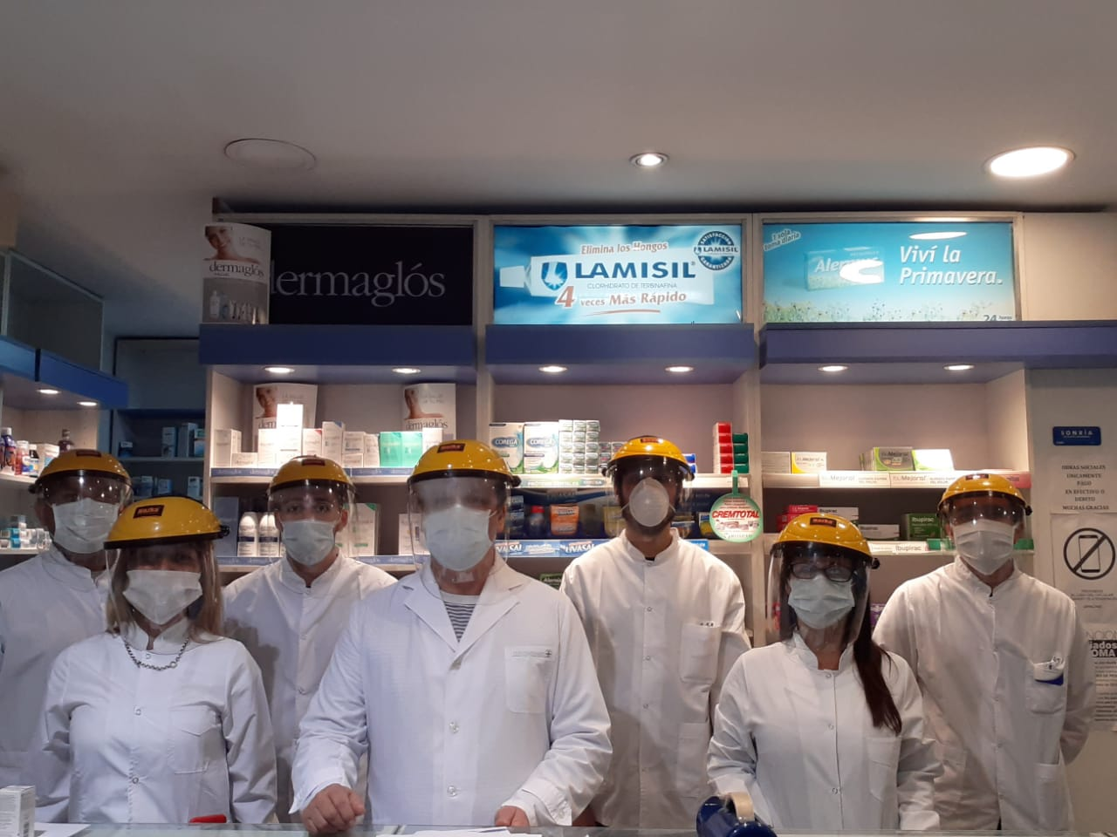
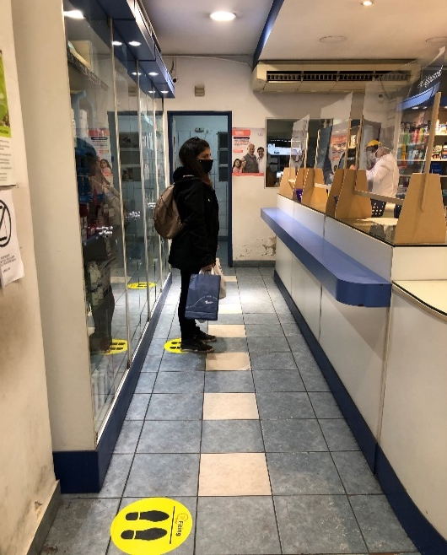

Slide 43
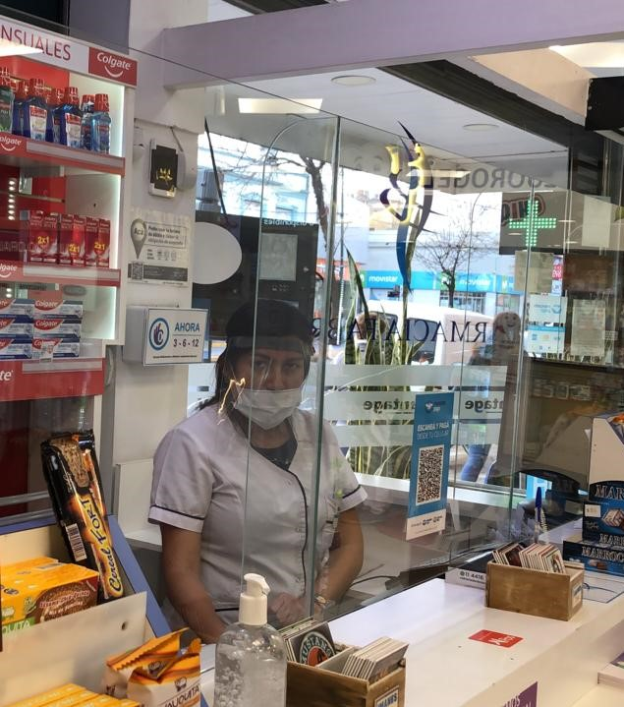
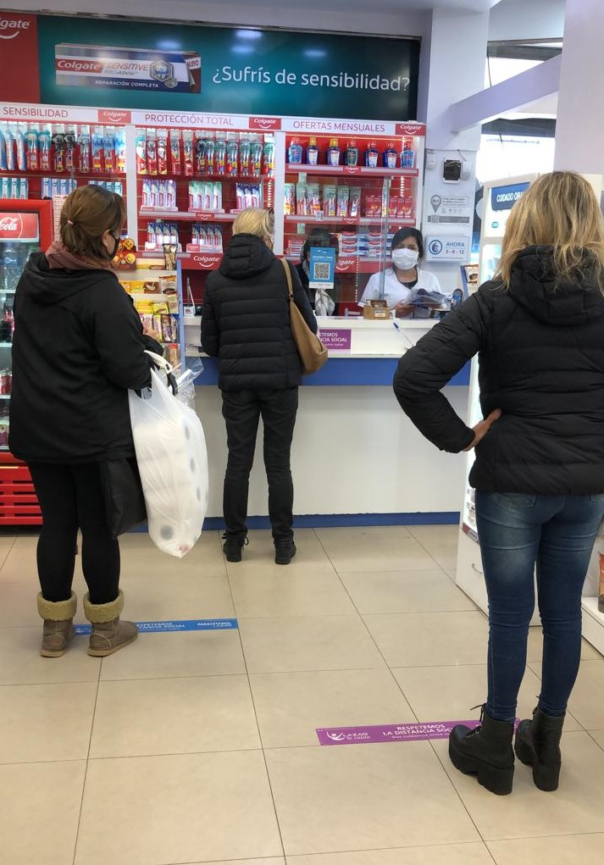

Slide 44
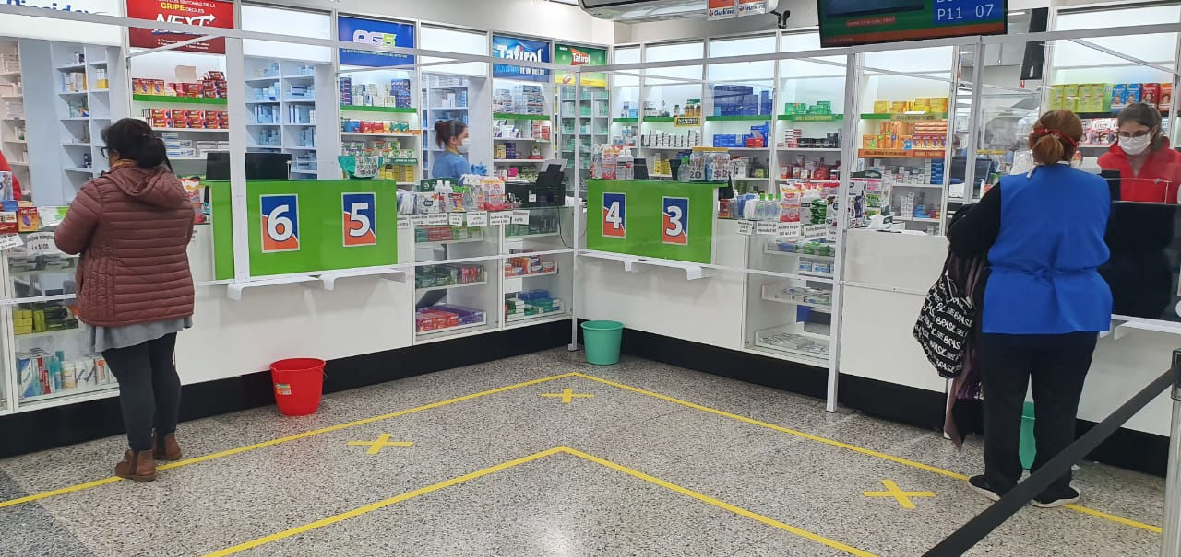
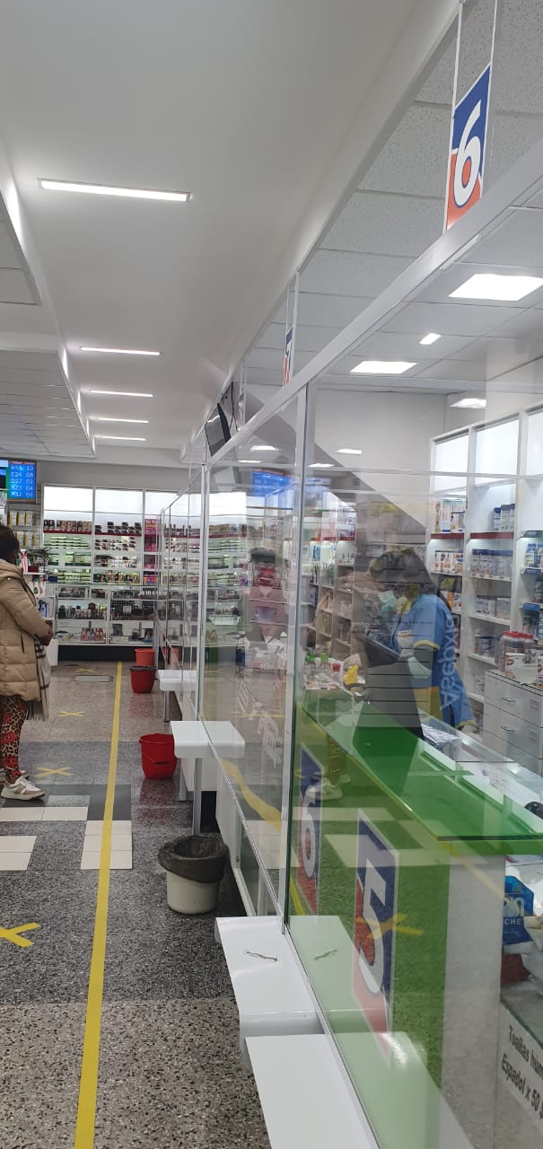
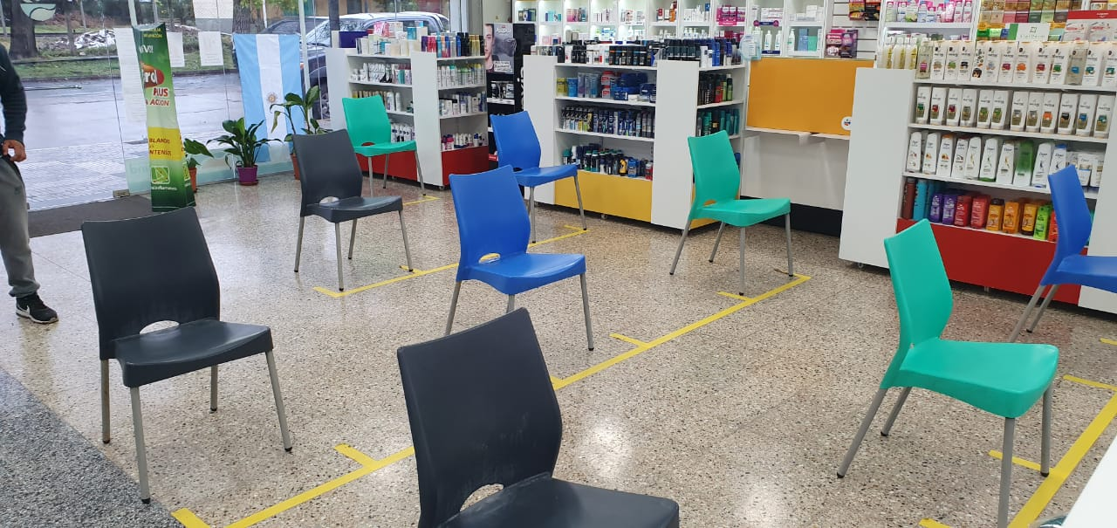

Slide 45
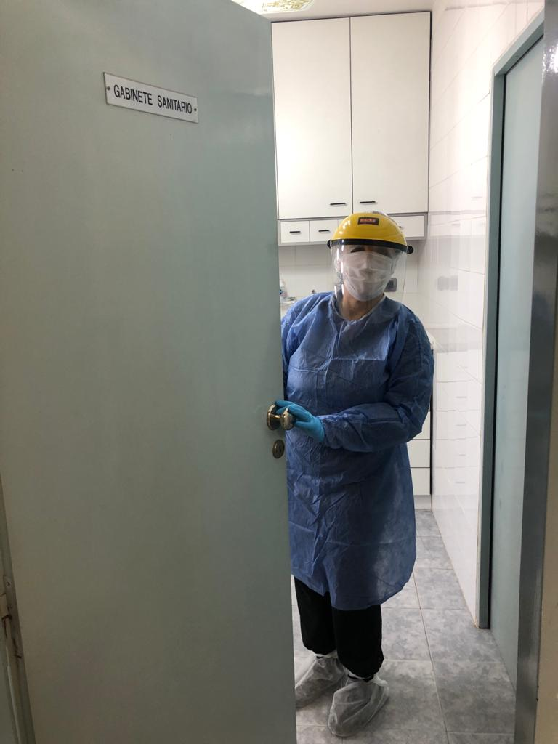
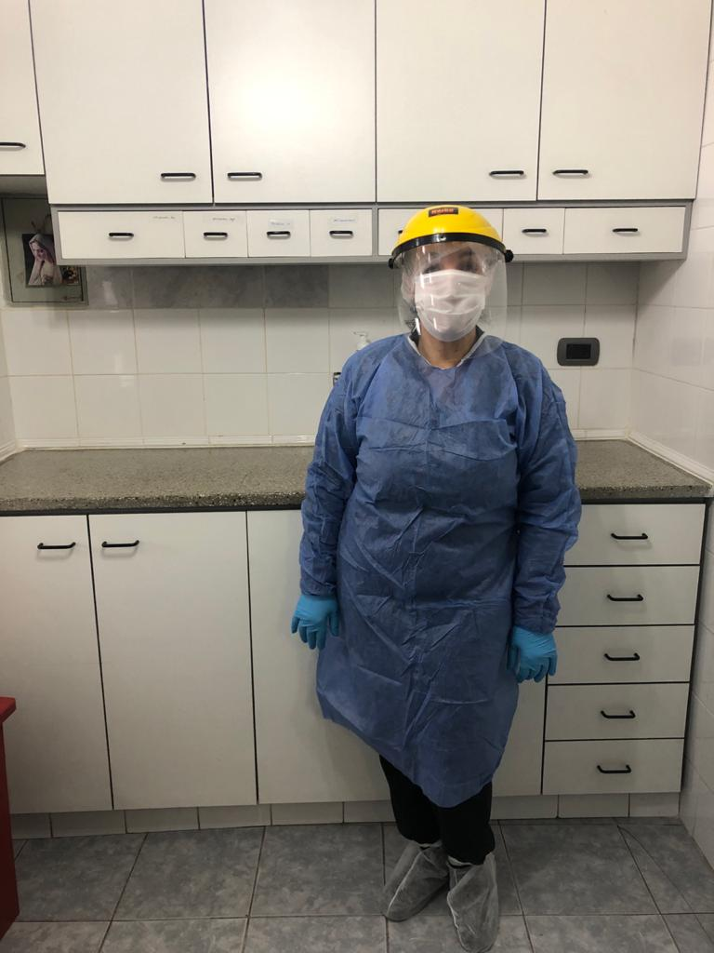
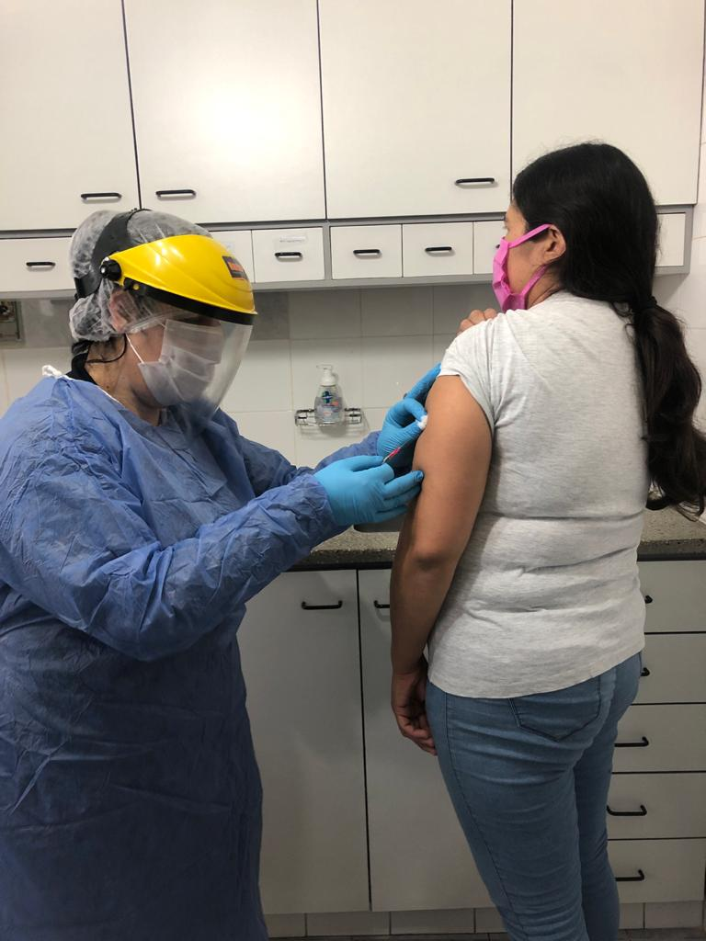

Slide 46
Vaccination campaigns
 | 2019 | 2020
Pharmacies | 6300 | 6700
Influenza doses | 830000 | 850000
Pneumococcal 13 doses | 253000 | 228000
Pneumococcal 23 doses | 218000 | 1500
Daily average doses | 4000 | 7200
ESAVIS | 31 | none
Period of time | Completed campaign | 2 months

Slide 47
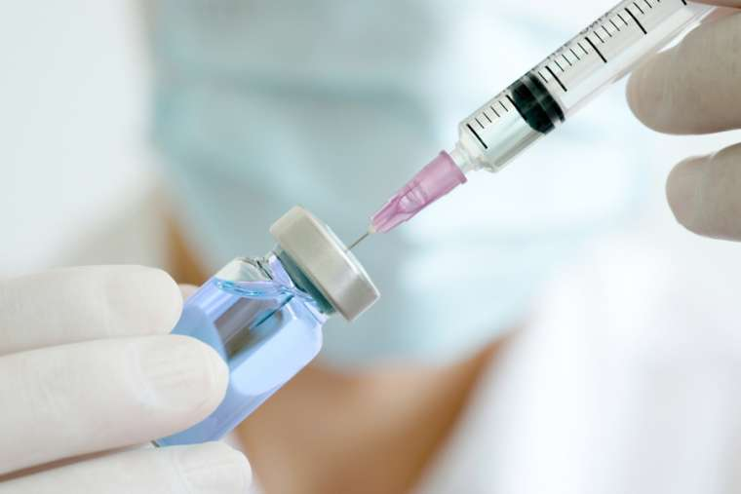
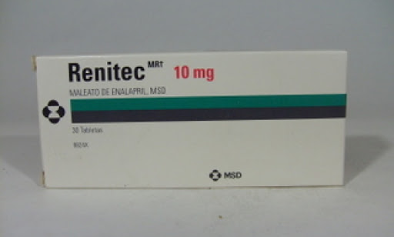
Pharmaceutical fee per vaccination
aprox40%
Aprox: 40%

Slide 48
 | feb-20 | mar-20 | apr-20 | % var
ANTIVIRALS VACCINES | 10.632 | 304.678 | 517.266 | 69,8
ANTIBACTERIANS VACCINES | 27.921 | 109.718 | 123.986 | 13,0
OTHERS | 32.866 | 179.591 | 100.944 | -43,8
Elaboration Farm. Laura Raccagni CoFA

Slide 49
Elaboration Farm. Laura Raccagni CoFA

Slide 50
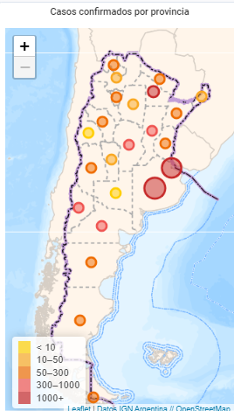
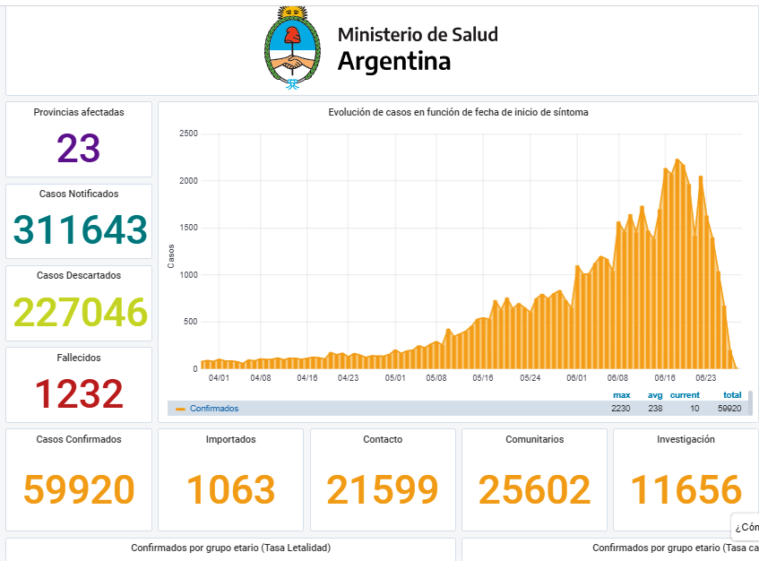
Coronavirus today

Slide 51
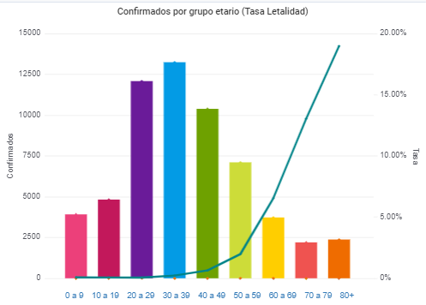
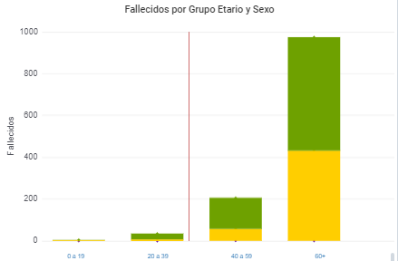
Coronavirus today

Slide 52

PHARMACIST AS ACTIVE MEMBERS OF HEALTH CARE TEAM

Slide 53
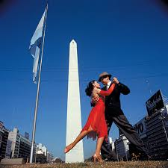
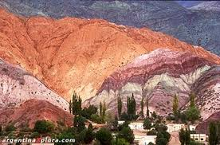




See you soon in ARGENTINA

Slide 54
Thank you for your attention
emailcaponi@yahoo.com.ar

Slide 55
Thanks for your invaluable help:
Farm. Marcela Bonsignore
Farm. Gustavo Dodera
Farm. Isabel Reinoso
Farm. Liliana Nogeras
Farm. Ricardo Pescenti
Farm. Laura Racagni
Farm. Alicia Melo
Farm. Fabian Tirone
Farm. Eugenia Fabris
Farm. Eduardo Gutkind
Matias Aranda

Slide 56
A view from New Zealand
Andi Shirtcliffe

Slide 57
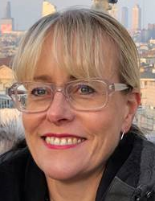
Andi Shirtcliffe
  Clinical Chief Advisor -Quality Use of Medicines, Pharmacy, Allied Health
  Ministry of Health of New Zealand

Slide 58
Any questions?
Please use the questions box

Slide 59
Wrap up
Conclusions

Slide 60
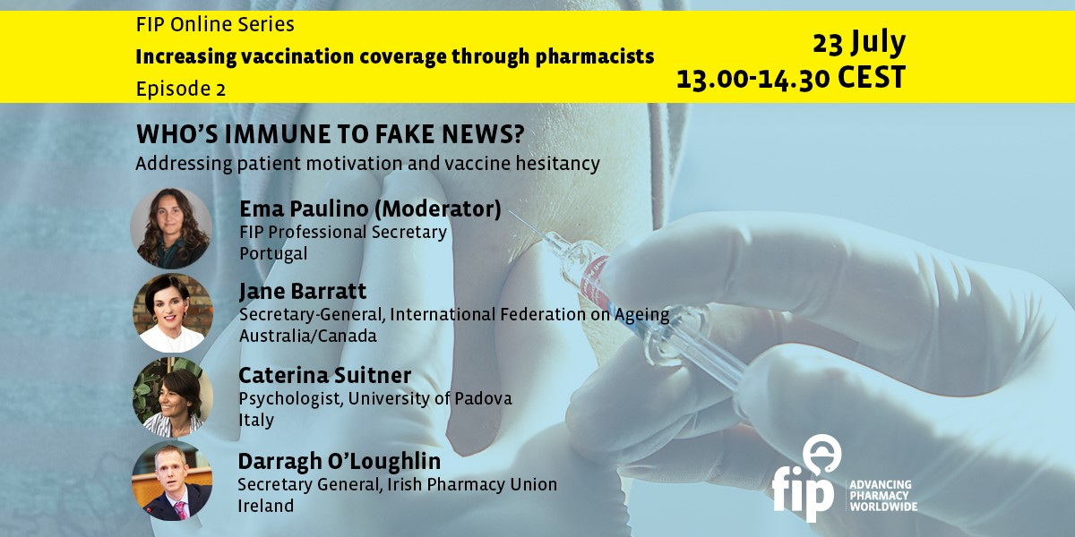

Slide 61
FIP upcoming webinars on the role of pharmacists in vaccination
Date | Title
23 July | Who’s immune to fake news? Addressing patient motivation and vaccine hesitancy
6 August (TBC) | An overview of current pharmacy impact on immunisation – Presentation of key findings from FIP's global report 2020
3 September | Give it a shot: Advocating for pharmacy-based vaccination and achieving legislative changes
15 September | Can the World afford low vaccination coverage rates? Broadening vaccination gateways through pharmacies
16 September | Influenza vaccination: Strategic elements of development, supply and delivery for optimal prevention
18 September | Vaccination in practice - A training course – Part 1. The value of vaccines for society and special populations
19 November | Vaccination in practice - A training course - Part 2. Vaccine safety and confidence
13 January | Vaccination in practice - A training course - Part 3. Vaccination procedures and common errors

Slide 62
Thank you for attending!
Please provide feedback through the survey you will see at the end of the event

