Slide 1
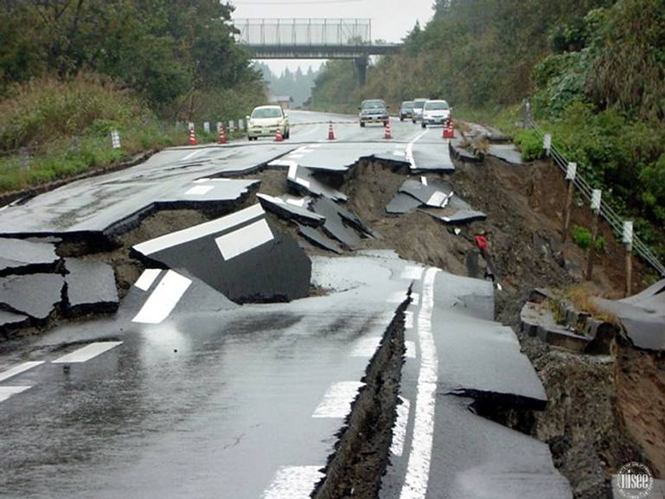
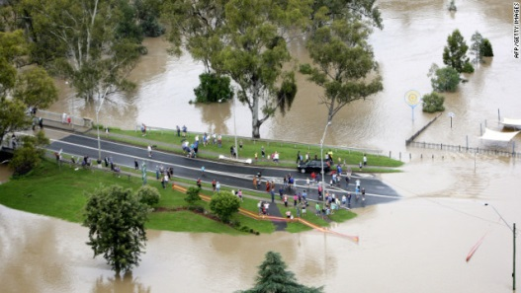
Pharmacy Practice in Response to Natural Disasters:
Legislation, Challenges and Lessons Learned
Parisa Aslani
Tian Xia Chu
Jane Dawson
Carwen Wynne Howells
Zuzana Kusynová
Dr. Maurice Lamontagne
Maula Montagne
Dr. Didier Mouliom
Sven Seißelberg
Dr. Jaqueline Surugue
Dr. Yasuo Takeda
Dr. Régis Vaillancourt (Presenter)

Slide 2
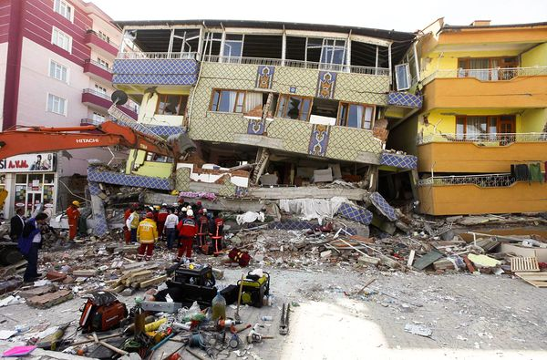
LEARNING OBJECTIVES
Review the legislation supporting the role of pharmacists and pharmacies in natural disaster management
Outline the challenges faced by pharmacists in response to natural disasters
Identify the lessons learned from pharmacists’ involvement in natural disasters
Turkey, Van earthquake, 2011

Slide 3
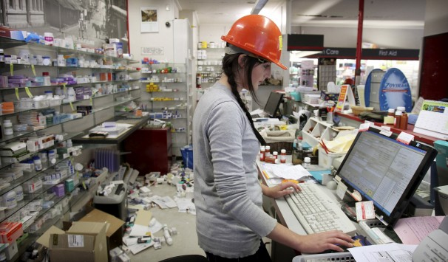
OUTLINE
Introduction
Background
Legislation:
Pharmacists prescribing/dispensing:
Emergency supplies & prescription extensions
Therapeutic substitution
Initiating prescriptions
Administering drugs by injection:
Vaccinations
Other drugs by injection
Monitoring over-the-counter drug sales
Protocols for narcotic drug control and disposal
Human resources:
Pharmacist licensure/registration mobility
Pharmacy licensure/registration mobility
Patient relocation recognition
Delegation to pharmacy technicians
Issues and lessons learned by pharmacists in response to natural disasters
Conclusion
New Zealand, Christchurch earthquake, 2011

Slide 4
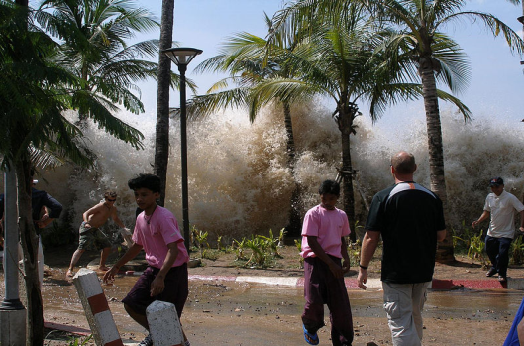
INTRODUCTION
Floods, earthquakes, tsunamis, hurricanes, volcanos, etc. lead to
High cost of damage to infrastructure
Injury and death
⇨ Serious disruption of the functioning of a community
Increases the need for medical and pharmaceutical care
Decreases the ability of the community to provide care
Thailand, Indian Ocean earthquake and tsunami, 2004

Slide 5
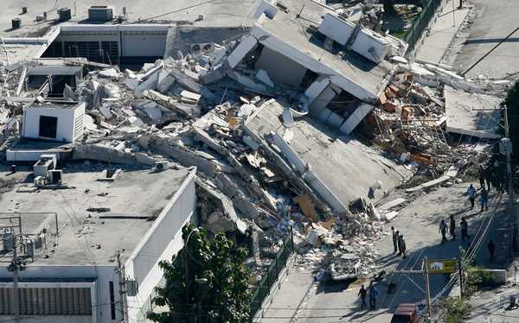
What could we do?
Be prepared for a natural disaster!
Knowledge-transfer by a guidance document
Establish a disaster response plan
Pakistan, Kashmir earthquake, 2005

Slide 6
BACKGROUND
FIP recommendations
High importance of the pharmacy profession:
Filling and refilling prescriptions
Organizing medication donations
Procuring medications
Ensuring security of medications
Managing pharmaceutical stocks
Building emergency kits

Slide 7
Emergency management continuum
(Canada Emergency Management Planning Guide 2010-2011)

Slide 8
1) PHARMACISTS PRESCRIBING & DISPENSING
Emergency/interim supplies & prescription refills/extensions
Based on an existing prescription
Based on a prescription label or receipt
Based on pharmacist’s professional judgement

Slide 9
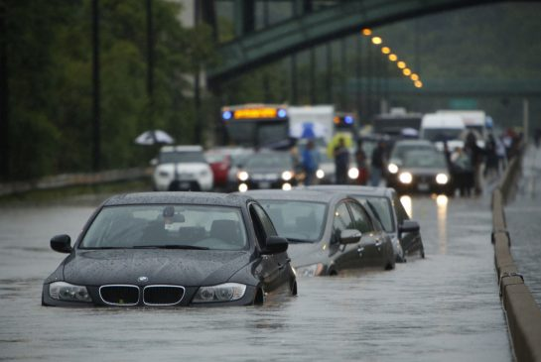
Emergency/Interim Supplies
CANADA:
British Columbia, Alberta, Saskatchewan, Manitoba, Ontario, Québec, Nova Scotia: emergency refills of existing prescriptions.
Newfoundland, New Brunswick: minimum amount needed until next appointment (NFL: pharmacist to notify prescriber within 72 hours).
USA:
Louisiana: 30 days (limited to 72 hours before Hurricane Katrina).
Texas: 30 days; excludes controlled substances.
Maryland: 72 hours, but pharmacist must call a 24/7 telephone number to obtain authorization.
http://blueprintforpharmacy.ca/docs/kt-tools/canada-environmental-scan-of-pharmacy-services---cpha-october-2013---final.pdf
http://www.pharmacists.ca/cpha-ca/assets/File/pharmacy-in-canada/ExpandedScopeChart.pdf
http://www.ncbi.nlm.nih.gov/pmc/articles/PMC2646478/pdf/phr124000217.pdf
http://www.statutes.legis.state.tx.us/Docs/HS/htm/HS.481.htm
http://www.hopkinsmedicine.org/johns_hopkins_healthcare/downloads/PPEmergency_Supply.pdf
Canada, Ontario flood, 2013
Notes:
Canada
-BC, SK, MB, ON, QC, NS: emergency refills of existing prescriptions.
-AB: emergency prescription drug or blood product.
-NFL, NB: dispense minimum amount required until next appointment (NFL must notify prescriber within 72 hours).
USA
Louisiana, USA
-Before Hurricane Katrina in 2005, pharmacists could only provide emergency medication supplies limited to a 72-hour supply.
-This law was later suspended by an order of the governor to extend the emergency supply to 30 days.
Texas, USA
In the event of a natural or manmade disaster, a pharmacist may dispense not more than a 30-day supply of a prescription drug (other than a controlled substance) without the authorization of the prescribing practitioner, if:
-Failure to refill the prescription might result in an interruption of a therapeutic regimen or create patient suffering;
-The natural or manmade disaster prohibits the pharmacist from being able to contact the practitioner;
-The governor has declared a state of disaster under Chapter 418, Government Code and the Texas State Board of Pharmacy, through its executive director, has notified pharmacies in this state that pharmacists may dispense up to a 30-day supply of a prescription drug.
Maryland, USA
-Pharmacist is allowed, in an emergency, to dispense a 72-hour supply.
-However, the pharmacist must call a 24/7 telephone number to obtain authorization for the emergency supply.
-Sprays, inhalers, eye drops, creams, ointments, and antibiotics may be necessary to dispense the entire prescription as an emergency supply due to the way the drug is packaged or administered.

Slide 10
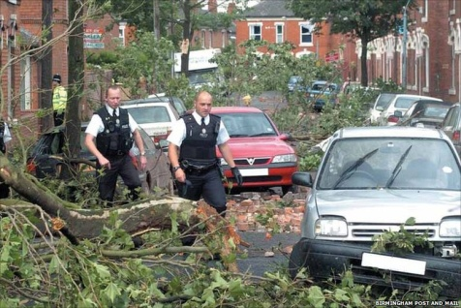
Emergency/Interim Supplies (continued)
AUSTRALIA:
Dispense under the “3-day emergency supply” rule.
GREAT BRITAIN:
Pharmacist must interview the patient (preferably face-to-face).
Patient must have previously had the drug which was prescribed by a registered prescriber in the UK, or an European Economic Area (EEA) or Swiss doctor or dentist.
Excludes controlled drugs; except for phenobarbitone, phenobarbitone sodium for epilepsy, benzodiazepines, and steroids, which are limited to a 5-day supply.
Other drugs limited to 30-day supply.
http://www.pbs.gov.au/info/news/2014/04/cyclone-ita-advice-for-pharmacists/
http://www.rpharms.com/non-member/emergency-supply-qrg.pdf
http://www.release.org.uk/law/schedules
Great Britain, Birmingham tornado, 2005
Notes:
Australia
-Dispense medicines under the “3-day emergency supply” rule without a prescription in accordance with existing emergency supply provisions in Queensland.
-Dispense using the “owing prescription” provision after confirming the prescription details with the prescriber, who must then forward a paper prescription to the pharmacy to cover the emergency supply.
Great Britain
Pharmacists may legally make an emergency supply at the request of a patient who has previously been prescribed the requested prescription only medicines (POM) by:
-An European Economic Area (EEA) or Swiss doctor or dentist
-The following prescribers registered in the UK: doctor, dentist, supplementary prescriber, community practitioner nurse prescriber, nurse independent prescriber, optometrist independent prescriber, pharmacist independent prescriber.
-Pharmacist must interview the patient (preferably face-to-face).
-Patient must have had previous treatment with the POM and was prescribed by one of the prescribers above.
-Pharmacist must be satisfied there is an immediate need for the POM.
-Cannot supply controlled drugs – except for phenobarbitone, phenobarbitone sodium for epilepsy, benzodiazepines, and steroids, which are limited to a 5-day supply.
-Other POMs limited to 30-day supply, except for:
-Insulin, ointment, cream, inhaler for asthma: smallest pack available in pharmacy.
-Oral contraceptives: full treatment cycle supplied.
-Liquid antibiotics for oral administration: smallest quantity that will provide a full course.

Slide 11
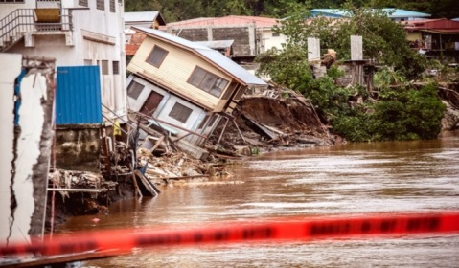
Prescription Refills/Extensions
AUSTRALIA:
Dispense an early repeat of a “4/20 day” drug → record on the prescription “immediate supply required” and sign.
CANADA:
British Columbia: only for stable chronic medications, any length within the prescription expiry date. Psychiatric drug renewal only in multidisciplinary team.
Alberta, Manitoba, New Brunswick, Québec (max 1 year), Saskatchewan (max 100 days), Newfoundland (max 90 days), Nova Scotia (max 90 days), Northwest Territories (max 30 days), Prince Edward Island (amount of 1 refill of original prescription).
Ontario: excludes narcotics and controlled substances. Cannot exceed the lesser of 6 months supply or last fill. Must notify prescriber.
Nova Scotia: excludes previously transferred prescriptions.
http://www.pbs.gov.au/info/general/faq#Whatisthe420dayrule/
http://blueprintforpharmacy.ca/docs/kt-tools/canada-environmental-scan-of-pharmacy-services
---cpha-october-2013---final.pdf
http://www.pharmacists.ca/cpha-ca/assets/File/pharmacy-in-canada/ExpandedScopeChart.pdf
Queensland, Tropical Cyclone Ita, 2014
Notes:
Australia
Medications subject to the 4/20 day rule of Australia’s Pharmaceutical Benefits Scheme (PBS) for prescription drugs:
-If lost, stolen, destroyed, or require medicine without delay for treatment, the pharmacist can dispense a prescription as an early repeat supply → recorded with “immediate supply required” on the prescription and signed by the pharmacist.
-Once received, there is no possibility to get another prescription for the same pharmaceutical benefit dispensed on the same day or within the next :
-20 days if the item is listed in the PBS Schedule with 5 or more repeats allowed.
-4 days for all other items (items listed in the PBS Schedule with less than 5 repeats and eye preparations).
Canada
-BC: only for stable chronic medications, any length within the prescription expiry date. Psychiatric drug renewal only in multidisciplinary team.
-AB, MB, NB, QC (max 1 year), SK (max 100 days), NFL (max 90 days), NS (max 90 days), NWT (max 30 days), PEI (amount of 1 refill of original prescription).
-ON: excludes narcotics and controlled substances. Cannot exceed the lesser of 6 months supply or last fill. Must notify prescriber.
-NS: excludes previously transferred prescriptions.

Slide 12
1) PHARMACISTS PRESCRIBING & DISPENSING
Emergency/interim supplies & prescription refills/extensions
Based on an existing prescription
Based on a prescription label or receipt
Based on pharmacist’s professional judgement

Slide 13
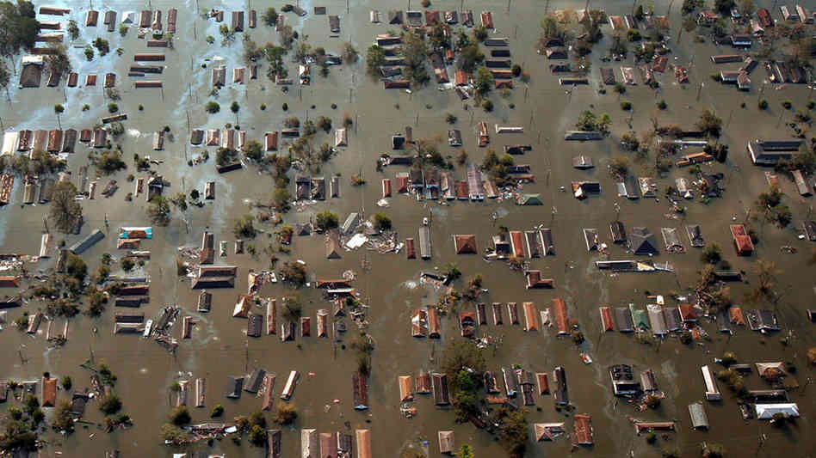
USA:
Illinois’ “Hurricane Katrina Emergency Dispensing Guidelines”
Only for patients relocating from Louisiana, Mississippi, and Alabama.
Narcotics, benzodiazepines, controlled substances: up to 30-day supply.
Narcotics with potential for severe dependence: up to 7-day supply.
Minnesota’s “Hurricane Katrina Emergency Dispensing Policy”
Only for patients relocating from Louisiana, Mississippi, Alabama, and Florida.
Duration evaluated on a case-by-case basis to best meet the patient’s need.
http://idfpr.com/News/NEWSRLS/EmergencyDispensingGuidelines.pdf
http://www.phcybrd.state.mn.us/Katrina.htm
United States, Hurricane Katrina, 2005
Notes:
Illinois, USA: Hurricane Katrina Emergency Dispensing Guidelines
-Applies only to patients who are relocating from Louisiana, Mississippi, and Alabama.
-Can prescribe from a medication vial, label, receipt; or if unavailable, other credible information given by patient.
-Pharmacists may dispense a reasonable amount based on professional judgment on a case-by-case basis.
-Must inform the patient that the refill is being provided without a physician’s authorization.
-Also applies for controlled substances, but for these the pharmacist must also document that a good faith attempt to reach the original prescriber/ pharmacy was made.
-Narcotics, benzodiazepines, controlled substances: up to 30-day supply.
-Narcotics with potential for severe dependence: up to 7-day supply.
Minnesota, USA: Hurricane Katrina Emergency Dispensing Policy
-Applies only to patients who are relocating from Louisiana, Mississippi, Alabama, and Florida.
-Pharmacists can provide emergency supplies for both non-controlled and controlled prescription drugs for a limited and reasonable duration (professional judgment).
-Each patient is evaluated on a case-by-case basis to best meet the patient’s need.

Slide 14
1) PHARMACISTS PRESCRIBING & DISPENSING
Emergency/interim supplies & prescription refills/extensions
Based on an existing prescription
Based on a prescription label or receipt
Based on pharmacist’s professional judgement

Slide 15
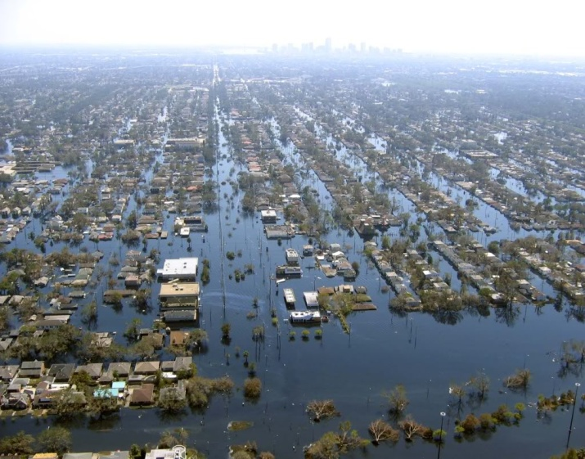
USA:
Illinois’ “Hurricane Katrina Emergency Dispensing Guidelines”
Dispense a reasonable amount based on professional judgment on a case-by-case basis.
Narcotics, benzodiazepines, controlled substances: up to 30-day supply.
Narcotics with potential for severe dependence: up to 7-day supply.
Minnesota’s “Hurricane Katrina Emergency Dispensing Policy”
Both non-controlled and controlled prescription drugs for a limited and reasonable duration based on professional judgment.
http://idfpr.com/News/NEWSRLS/EmergencyDispensingGuidelines.pdf
http://www.phcybrd.state.mn.us/Katrina.htm
United States, Hurricane Katrina, 2005
Notes:
Illinois, USA: Hurricane Katrina Emergency Dispensing Guidelines
-Applies only to patients who are relocating from Louisiana, Mississippi, and Alabama.
-Can prescribe from a medication vial, label, receipt; or if unavailable, other credible information given by patient.
-Pharmacists may dispense a reasonable amount based on professional judgment on a case-by-case basis.
-Must inform the patient that the refill is being provided without a physician’s authorization.
-Also applies for controlled substances, but for these the pharmacist must also document that a good faith attempt to reach the original prescriber/ pharmacy was made.
-Narcotics, benzodiazepines, controlled substances: up to 30-day supply.
-Narcotics with potential for severe dependence: up to 7-day supply.
Minnesota, USA: Hurricane Katrina Emergency Dispensing Policy
-Applies only to patients who are relocating from Louisiana, Mississippi, Alabama, and Florida.
-Pharmacists can provide emergency supplies for both non-controlled and controlled prescription drugs for a limited and reasonable duration (professional judgment).
-Each patient is evaluated on a case-by-case basis to best meet the patient’s need.

Slide 16
1) PHARMACISTS PRESCRIBING & DISPENSING
Therapeutic substitution (drug shortage management)

Slide 17
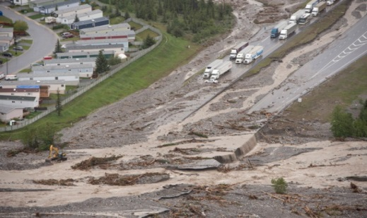
CANADA
All must fax physician after substitution is made:
British Columbia: substitute within 6 classes (H2 blockers, NSAIDs, nitrates, ACE inhibitors, dihydropyridine calcium channel blockers, PPIs).
Saskatchewan: only with prescribers with whom they have a collaborative practice agreement.
Québec: Bill 41 allows substitution from within the same therapeutic class, but the pharmacist must ensure he cannot obtain the medication from 2 pharmacies in the region and from 2 wholesalers. Pharmacist must inform the patient and physician of the substitution, and document the supply and counselling provided to patient.
Alberta, New Brunswick, (Nova Scotia maximum 1 year duration): may substitute for drugs of similar therapeutic effect.
http://http://blueprintforpharmacy.ca/docs/kt-tools/canada-environmental-scan-of-pharmacy-services
---cpha-october-2013---final.pdf
http://www.pharmacists.ca/cpha-ca/assets/File/pharmacy-in-canada/ExpandedScopeChart.pdf
http://www.opq.org/fr-CA/pharmaciens/application-de-la-loi-41/nouvelles-activites/
Canada, Alberta floods, 2013

Slide 18
1) PHARMACISTS PRESCRIBING & DISPENSING
Initiating prescriptions for specific conditions
Independently
In a collaborative setting
Through indirect physician directives & credentialing

Slide 19
Minor Ailments Prescribing
CANADA:
Saskatchewan: mild acne, allergic rhinitis, atopic dermatitis, cold sores, diaper dermatitis, dysmenorrhea, gastroesophageal reflux disease, headache, hemorroids, insect bites, muscoloskeletal strains and sprains, oral aphthous ulcers, oral thrush, superficial bacterial skin infections, tinea corporis, tinea cruris, and tinea pedis.
Québec: labial herpes, allergic rhinitis, urinary infection, allergic conjunctivitis, atopic dermatitis (eczema), dysmenorrhea, diaper rash, hemorrhoids, aphthous ulcers, oral thrush, vaginal yeast infection, minor acne (topical treatments).
Nova Scotia: dyspepsia, gastroesophageal reflux disease, nausea, non-infectious diarrhea, hemorrhoids, allergic rhinitis, cough, nasal congestion, sore throat, mild headache, minor muscle or joint pain, minor sleep disorders, dysmenorrhea, dry eyes, oral ulcers, oral thrush, fungal infections of skin, vaginal candidiasis, threadworms & pinworms, cold sores, contact allergic dermatitis, mild acne, mild-moderate eczema, mild urticaria, impetigo, dandruff, calluses & corns, warts (excluding face & genitalia), smoking cessation.
http://http://blueprintforpharmacy.ca/docs/kt-tools/canada-environmental-scan-of-pharmacy-services-
--cpha-october-2013---final.pdf
http://www.pharmacists.ca/cpha-ca/assets/File/pharmacy-in-canada/ExpandedScopeChart.pdf
http://www.opq.org/cms/Media/1712_38_fr-CA_0_tableau_sommaire_activites.pdf
https://pans.ns.ca/minor-ailment-assessments/
Notes:
Canada
Circumstances for Initiating Prescriptions:
-SK, NS: minor ailments only.
-NS: pharmacists may also prescribe in a collaborative setting (e.g. multidisciplinary clinic) as approved on a case-by-case basis.
-NB: pharmacists must have a collaborative practice agreement.
-AB: pharmacists must have “additional prescribing authority” from Alberta College of Pharmacists.
-ON, QC: pharmacists may prescribe under a physician’s directive (Medical directive / Collective prescription).
http://http://blueprintforpharmacy.ca/docs/kt-tools/canada-environmental-scan-of-pharmacy-services---cpha-october-2013---final.pdf
http://www.pharmacists.ca/cpha-ca/assets/File/pharmacy-in-canada/ExpandedScopeChart.pdf
http://www.nbpharmacists.ca/Portals/9/documents/43/77/List%20of%20pharmacists%20in%20Collaborative%20practice.pdf
http://www.cshp-nb.ca/web/la/en/pa/662839F4B0964253B0288D7C677E2624/it/54EBC13592094DB9854AE7263E79AA75/item.asp

Slide 20
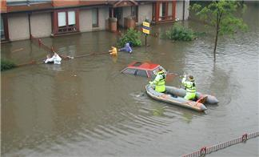
Minor Ailments Prescribing (continued)
SCOTLAND:
Minor Ailment Service (MAS) includes 22 minor ailments: acne, athlete’s foot, back ache, cold sores, constipation, cough, diarrhea, ear ache, eczema & allergies, hemorrhoids (piles), hay fever, headache, head lice, indigestion, mouth ulcers, nasal congestion, pain, period pain, thrush, sore throat, threadworms, warts & verrucae.
http://www.scotland.gov.uk/Publications/2006/06/26102829/1
http://www.communitypharmacy.scot.nhs.uk/core_services/mas.html
Scotland, Glasgow floods, 2002
Notes:
Scotland
-Minor Ailment Service (MAS) allows eligible individuals to register with and use a community pharmacy as the first port of call for common illnesses on the National Health Service (NHS).
-Patient must register with a community pharmacy to use the MAS, and must re-register is they choose to switch pharmacies for this service.
-22 minor ailments: acne, athlete’s foot, back ache, cold sores, constipation, cough, diarrhea, ear ache, eczema & allergies, hemorrhoids (piles), hay fever, headache, head lice, indigestion, mouth ulcers, nasal congestion, pain, period pain, thrush, sore throat, threadworms, warts & verrucae.

Slide 21
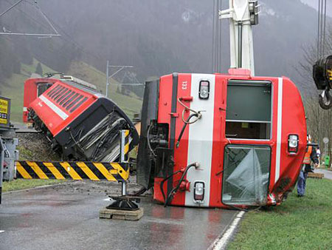
Antibiotics Prescribing
UNITED KINGDOM:
Pharmacist independent prescribers: any medicine for any medical condition within their competence, including some controlled medicines (except diamorphine, cocaine, and dipipanone for the treatment of addiction).
Pharmacist supplementary prescribers: work with the independent prescriber to fulfill a clinical management plan.
http://www.nhs.uk/chq/Pages/1629.aspx?CategoryID=68&
United Kingdom, Storm Kyrill, 2007
Notes:
United Kingdom (Antibiotics prescribing):
-Guidance from the Medicines and Healthcare products Regulatory Agency (MHRA), an executive agency of the Department of Health, states that only ‘appropriate practitioners’ can prescribe medicine in the UK. Appropriate practitioners can be:
-independent prescribers
-supplementary prescribers
-Pharmacist independent prescribers can prescribe any medicine for any medical condition within their competence, including some controlled medicines (except diamorphine, cocaine, and dipipanone for the treatment of addiction).
-Pharmacist supplementary prescribers are responsible for continuing patient care after an assessment by an independent prescriber. They work with the independent prescriber to fulfill a clinical management plan agreed upon between the prescribers and the patient.

Slide 22
1) PHARMACISTS PRESCRIBING & DISPENSING
Initiating prescriptions for specific conditions
Independently
In a collaborative setting
Through indirect physician directives & credentialing

Slide 23
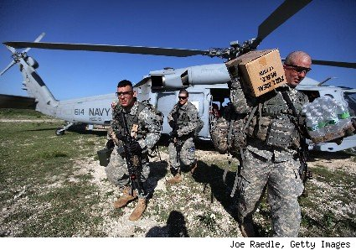
USA:
Collaborative Practice Agreements (CPA)
CPAs define certain patient care functions that a pharmacist can autonomously provide under specified situations and conditions, including:
Collaborative drug therapy management (CDTM)
Pharmaceutical care
Medication therapy management (MTM)
http://www.aphafoundation.org/collaborative-practice-agreements
http://www.cdc.gov/dhdsp/pubs/docs/Translational_Tools_Pharmacists.pdf
http://www.sciencedirect.com/science/article/pii/S1551741105001312#
http://www.cdc.gov/dhdsp/pubs/docs/Pharmacist_State_Law.PDF
United States Military, Haïti earthquake relief, 2010
Notes:
USA: Collaborative Practice Agreements (CPA)
-A formal agreement in which a licensed provider makes a diagnosis, supervises patient care, and refers patients to a pharmacist under a protocol that allows the pharmacist to perform specific patient care functions.
-A 2010 study found that patient health improves significantly when a pharmacist is included on the team.
-CPAs define certain patient care functions that a pharmacist can autonomously provide under specified situations and conditions.
-Includes:
Collaborative drug therapy management (CDTM)
Pharmaceutical care
Medication therapy management (MTM)
Collaborative drug therapy management (CDTM):
Pharmacists work within a defined protocol and assume professional responsibility for performing patient assessments, counseling, and referrals; ordering laboratory tests; administering drugs; and selecting, initiating, monitoring, continuing, and adjusting drug regimens.
36 states authorize physician-pharmacist CDTM in any setting (e.g. hospital, clinic, retail pharmacy) as of Dec. 31, 2012.
Pharmaceutical care:
Care that a patient receives to ensure safe and rational drug use.
Medication therapy management (MTM):
5 core elements: medication therapy review, personal medication record, medication-related action plan, intervention and/or referral, and documentation and follow-up.

Slide 24
1) PHARMACISTS PRESCRIBING & DISPENSING
Initiating prescriptions for specific conditions
Independently
In a collaborative setting
Through indirect physician directives & credentialing

Slide 25
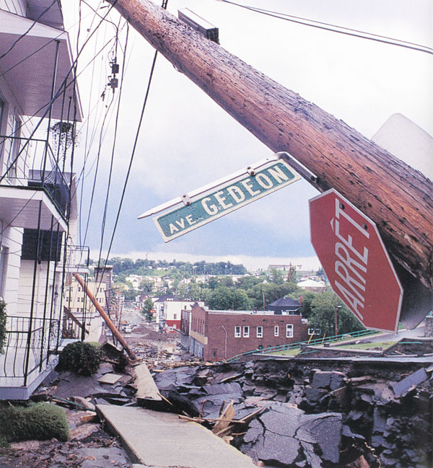
Indirect Physician Directives
CANADA:
Medical Directives (Ontario)
Collective Prescriptions (Québec)
A written order to perform a controlled act for patients who meet the criteria set out in the medical directive.
A medical directive can order a procedure under specific conditions without a direct patient assessment by the authorizer.
e.g. Authorizing a pharmacist to order INR testing for a patient receiving warfarin therapy.
http://www.ocpinfo.com/regulations-standards/policies-guidelines/medical-directives/
Canada, Saguenay Québec flood, 1996
Notes:
CANADA
Medical Directives (Ontario) & Collective Prescriptions (Québec):
-Indirect physician orders to expedite patient care to other competent health professionals.
-Applies to a specific patient population who meet specific criteria.
-Role specific (e.g., RPh, NP, RD, RN), not person specific, and users within the role must possess the necessary knowledge, skill, and judgment before implementing a medical directive.
-Given in advance to enable an implementer to act under specific conditions without a direct assessment by the physician.

Slide 26
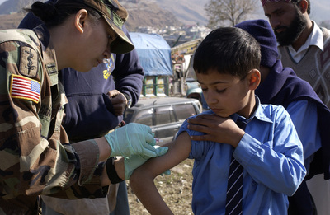
Indirect Physician Directives (continued)
NEW ZEALAND:
Standing Order
A written instruction issued by a medical practitioner or dentist.
USA
Standing Order
Authorize pharmacists (and nurses) to administer vaccinations according to an institution- or physician-approved protocol without a physician's exam.
http://www.health.govt.nz/system/files/documents/publications/standing-order-guidelines-june-2012.pdf
http://www.legislation.govt.nz/regulation/public/2002/0373/10.0/DLM170131.html
http://www.cdc.gov/mmwr/preview/mmwrhtml/rr4901a2.htm
United States Military, Pakistan earthquake, 2013
Notes:
NEW ZEALAND
Medicines Standing Order Regulations 2002:
-A written instruction issued by a medical practitioner or dentist that authorizes a specified person or class of people (including pharmacists) who do not have prescribing rights to administer and/or supply specified medicines and some controlled drugs.
-The issuer must identify the class of persons and the medicine in the standing order.
-Persons permitted to supply and administer medicine under a standing order: must be limited to persons engaged in the delivery of a health service.
USA
“Standing Orders” Program:
-Authorises pharmacists (and nurses) to administer vaccinations according to an institution- or physician-approved protocol without a physician's exam.
-These Standing Order programs have documented improved vaccination rates among adults.
-Can be used in inpatient and outpatient facilities, long-term-care facilities, managed-care organizations, assisted living facilities, correctional facilities, pharmacies, adult workplaces, and home health-care agencies.
-The Advisory Committee on Immunization Practices (ACIP) recommends standing orders for influenza and pneumococcal vaccinations.

Slide 27
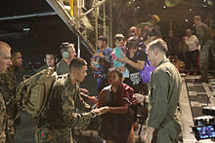
Credentialing
USA:
Council on Credentialing in Pharmacy (CCP)
Credential: Documented evidence of professional qualifications.
Includes professional education, licensure, formal post-licensure training, experience, and certification.
http://www.pharmacycredentialing.org/
http://www.accp.com/docs/positions/misc/Credentialing%20Framework%20for%20Pharmacists%20-%20
Guiding%20Principles.pdf
http://www.aacp.org/resources/education/Pages/CouncilonCredentialinginPharmacy(CCP).aspx
U.S. Marines, Philippines Typhoon Haiyan, 2013
Notes:
USA: Council on Credentialing in Pharmacy (CCP)
-Credential: Documented evidence of professional qualifications.
-Credentials serve to document the knowledge, skills, and experience of pharmacists and are part of a comprehensive framework that includes professional education, licensure, formal post-licensure training, experience, and certification.
-Credentials should be based on demonstrated patient/societal need, sustained demand within the pharmacy profession, and the availability of appropriate education and training programs to support the achievement and maintenance of the credential.
-The Council on Credentialing in Pharmacy (CCP) consists of 12 national pharmacy organizations.
British Columbia, CANADA:
Advanced Practitioner Credentialing
-Credentialing (certification) is a process of qualifying a specialist.
-The National Association of Pharmacy Regulatory Authorities (NAPRA) states that “Certification assures that the pharmacist meets a particular standard in a specific area of practice.”
-The pharmacist licensing authority, the College of Pharmacists of British Columbia (CPBC), established an Advanced Practitioner Credentialing Committee (APCC) in November 2001.
-The APCC develops and maintains standards for credentialing (certifying) pharmacists in BC who possess advanced education, skills, and experience and are qualified to undertake advanced pharmacy practices.

Slide 28
2) ADMINISTERING DRUGS BY INJECTION
Vaccinations
Notes:
http://www.pharmacists.ca/cpha-ca/assets/File/cpha-on-the-issues/DrugShortagesGuide.pdf

Slide 29
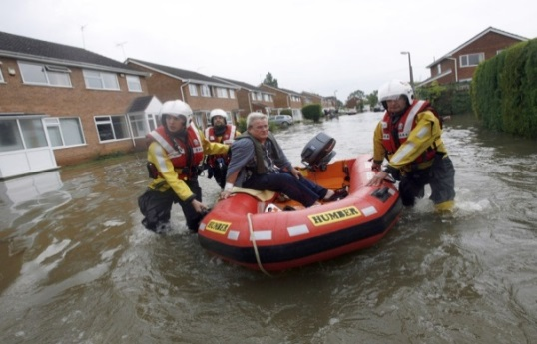
UNITED KINGDOM:
Administer certain vaccines (including influenza vaccine) through a Patient Group Direction (PGD).
IRELAND:
National immunization program (Immunization Guidelines).
AUSTRALIA:
The Pharmaceutical Society of Australia supports vaccination as a public health program.
PORTUGAL:
Change in legislation in 2007 developed a training program on immunization delivery for pharmacists to provide a vaccination service through pharmacies.
http://www.thepsi.ie/Libraries/Pharmacy_Practice/Final_Seasonal_Influenza_Vaccination_Programme_in_Pharmacies_Evidence_Base_and_Framework.sflb.ashx
United Kingdom, floods, 2007
Notes:
UNITED KINGDOM
-UK pharmacists have been authorised since 2002 to administer certain vaccines, including the influenza vaccine, through a Patient Group Direction (PGD) without the requirement for a patient specific prescription written by a medical practitioner.
-Patient Group Directions (PGDs) are written instructions for the supply or administration of medicines to groups of patients who may not be individually identified before presentation for treatment. (Patient Group Directions is the legal term for what were known as group protocols).
http://www.mhra.gov.uk/Howweregulate/Medicines/Availabilityprescribingsellingandsupplyingofmedicines/ExemptionsfromMedicinesActrestrictions/PatientGroupDirectionsintheprivatesector/
-Authorisation of PGDs: The patient group direction must be signed by a senior doctor (or, if appropriate, a dentist) and a pharmacist, both of whom should have been involved in developing the direction. Additionally, the patient group direction must be authorised by the relevant appropriate body as set out in the legislation.
IRELAND
-Trained pharmacists are involved in the national immunisation programme.
http://www.immunisation.ie/en/HealthcareProfessionals/ImmunisationGuidelines/
AUSTRALIA
The Pharmaceutical Society of Australia have stated they support vaccination as a public health program and will lead the development of immunisation administration training, credentialling for pharmacists and accreditation of sites.
PORTUGAL
Following a change in legislation in 2007, a training programme on immunisation delivery was developed for pharmacists to provide a vaccination service through pharmacies.
98% of patients stated that pharmacy was their preferred location for vaccination.

Slide 30
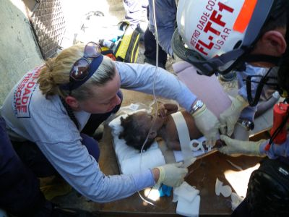
CANADA:
Pharmacists allowed to administer influenza vaccine in: British Columbia, Alberta, Manitoba, Ontario, Québec, New Brunswick, Nova Scotia.
USA:
National Pharmacy Response Teams: Pharmacists immunizing.
New York State (to those 18+): influenza, pneumococcal, meningococcal, acute herpes zoster, tetanus toxoid-containing vaccines (including those also containing diphtheria and pertussis vaccines).
North Carolina (to those 18+): influenza, pneumococcal, and zoster vaccines.
Ohio, as of 2014 (to those 18+): measles, mumps, and rubella (MMR) vaccine; Zostavax (herpes zoster vaccine) without a prescription. Must have the required credentials and work under a physician-established protocol.
http://www.pharmacists.ca/cpha-ca/assets/File/education-practice-resources/Flu2013-InfluenzaGuideEN.pdf
http://mpha.in1touch.org/uploaded/web/New%20Pharmaceutical%20Act/Immunization%20Info%20for%20Pharmacists%20Feb%202014%20FINAL%20(2).pdf
https://www.phe.gov/Preparedness/responders/ndms/teams/Pages/nprt.aspx
http://www.op.nysed.gov/prof/pharm/part63.htm#immunization
http://www.ncbop.org/LawsRules/rules.2500.pdf
http://www.ohiopharmacists.org/aws/OPA/pt/sd/news_article/1604/_PARENT/layout_interior_details/true
Haïti earthquake, United States USAID disaster relief, 2010
Notes:
CANADA: Influenza Vaccine
-8 influenza vaccines are authorized for use in Canada:
Fluviral, Vaxigrip, Agriflu, Influvac, Intanza, Fluad, Fluzone, FluMist.
-Provinces in which pharmacists are allowed to administer the influenza vaccine:
BC, AB, MB, ON, QC, NB, NS.
USA
American Pharmacists Association: Guideline 3 – Quality: Pharmacists must achieve and maintain competency to administer immunizations
-Pharmacists should administer vaccines only after being properly trained in emergency responses to adverse events and should provide this service only in settings equipped with epinephrine and related supplies.
-Pharmacists should receive additional education and training on current immunization recommendations, schedules, and technique at least annually.
https://www.pharmacist.com/sites/.../HOD_APhA_Policy_Manual_0.pdf
National Pharmacy Response Teams:
-Pharmacists immunizing for the chemoprophylaxis of Americans.
-Located in 3 geographical areas of the United States: Eastern, Central and Western areas.
-When activated as Federal employees, their licensure and certification are recognized in all States (talked about later in Human Resources Management: Pharmacist Licensure/Registration Mobility)
New York State Education Department, Regulations of the Commissioner, Part 63, Pharmacy, 2009:
A certified pharmacist may administer the following authorized immunization agents to persons 18 years or older:
Immunizing agents to prevent influenza, pneumococcal disease, or meningococcal disease pursuant to a patient-specific order or a non-patient specific order.
Immunizing agents to prevent acute herpes zoster, pursuant to a patient specific order.
Allows pharmacists to administer tetanus toxoid-containing vaccines, including those also containing diphtheria and pertussis vaccines, to persons 18 years of age or older within the federally declared counties.
Rule 21 NCAC 46.2502 – North Carolina Board of Pharmacy:
Pharmacists must:
Follow a written protocol for administration of influenza, pneumococcal, and zoster vaccines and for the treatment of severe adverse events following administration.
Maintain written policies and procedures for handling and disposal of used or contaminated equipment and supplies.
Give the appropriate, most current vaccine information.
Report adverse events.
Not administer vaccines to patients under 18 years of age or have no primary care provider.
Report all vaccines administered.
Ohio State Board of Pharmacy:
As of June 9, 2014, licensed pharmacists are permitted to administer the measles, mumps, and rubella (MMR) vaccine to individuals 18 years and older pursuant Amended Emergency Rule 4729-5-38.
As of May 22, 2014, trained Ohio pharmacists may administer Zostavax (herpes zoster vaccine) without a prescription. The patient receiving the vaccine must meet the age criteria listed in the FDA-approved labeling.
Pharmacists administer these vaccines must meet the training requirements of Ohio Board of Pharmacy Rule 4729-5-36, and work under a physician-established protocol.
http://www.ohiopharmacists.org/aws/OPA/pt/sd/news_article/1604/_PARENT/layout_interior_details/true
http://pharmacy.ohio.gov/Documents/Pubs/Special/Pharmacists%20Can%20Now%20Administer%20the%20Measles,%20Mumps,%20and%20Rubella%20%28MMR%29%20Vaccine.pdf
http://pharmacy.ohio.gov/Documents/LawsRules/RuleChanges/Guidance%20Document%20for%20Pharmacist%20Administration%20of%20Zostavax%20%28Herpes%20Zoster%20Vaccine%29.pdf

Slide 31
2) ADMINISTERING DRUGS BY INJECTION
Other drugs by injection

Slide 32
CANADA:
British Columbia: intramuscular (IM), subcutaneous (SC), or intradermal (ID) injections for immunizing or for treating anaphylaxis. Only patients > 5 years.
Alberta: IM or SC vaccinations or parenteral nutrition. Only patients > 5 years and non-pregnant.
Manitoba: only patients > 5 years and non-family members.
Ontario: pharmacists may administer drugs by injection for demonstration purposes, and influenza vaccine by injection or inhalation for patients > 5 years.
Québec: for demonstration purposes only, excluding intravenous (IV) injections.
New Brunswick: pharmacists need advanced drug administration requirements and may administer drugs IM, SC, ID, or IV for flu shots, shingles vaccines, travel vaccines and birth control.
Nova Scotia: pharmacists may provide vaccinations and injections after a training program.
http://http://blueprintforpharmacy.ca/docs/kt-tools/canada-environmental-scan-of-pharmacy-services---cpha-october-2013---final.pdf
http://www.pharmacists.ca/cpha-ca/assets/File/pharmacy-in-canada/ExpandedScopeChart.pdf
http://www.opq.org/fr-CA/pharmaciens/application-de-la-loi-41/nouvelles-activites/
http://nbpharma.ca/

Slide 33
3) AGENCIES TO MONITOR OVER-THE-COUNTER DRUG SALES: OUTBREAK CONTROL

Slide 34
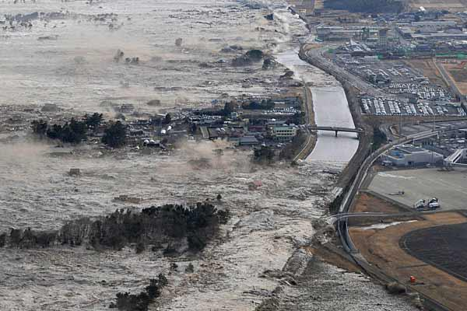
CANADA: Walkerton, Ontario Outbreak:
Over-the-counter (OTC) anti-nauseant and anti-diarrheal sales could detect gastrointestinal illness outbreaks related to water contamination.
Local weekly pharmacy OTC sales were comparable to outbreak epidemic curves.
JAPAN:
Correlation between common cold OTC sales and concurrent influenza activity.
USA: New York
Cough and influenza medication sales correlate strongly with annual influenza epidemics.
OTC medication sales can be considered a syndromic surveillance system.
http://www.attorneygeneral.jus.gov.on.ca/english/about/pubs/walkerton/part1/WI_Summary.pdf
http://www.ncbi.nlm.nih.gov/pubmed/15622795
http://www.ncbi.nlm.nih.gov/pubmed/16177693
http://www.cdc.gov/mmwr/preview/mmwrhtml/su5301a47.htm
http://www.ncbi.nlm.nih.gov/pubmed/16177692
Japan, earthquake/tsunami, 2011
Notes:
CANADA
Walkerton, Ontario Outbreak:
-Rain washed cattle manure into a town well and subsequently contaminated the drinking water with E. coli.
-Monitoring over-the-counter (OTC) drug (such as anti-nausea and anti-diarrhea) sales could provide a timely syndromic surveillance method of detecting outbreaks of gastrointestinal illness related to Canadian water contamination cases by Cryptosporidium, E.coli O157:H7 and Campylobacter.
-Local weekly pharmacy sales of OTC products were comparable to the outbreak epidemic curves. Statistical control tests on the sales data indicated the start of the outbreak periods.
JAPAN
-Using data on sales of over-the- counter (OTC) medications as part of a routine syndromic surveillance system aimed at early detection of infections of public health concern.
-Cold & flu medicines are always on demand and account for a significant share of the OTC segment.
-There is a correlation between OTC medication sales used to treat the common cold and concurrent influenza activity.
-But analysis of OTC medication sales data alone is not sufficient to determine influenza activity.
New York, USA
-New York City Department of Health and Mental Hygiene (DOHMH) has tracked OTC sales from New York City pharmacies to enhance the detection of natural and intentional infectious disease outbreaks.
-Influenza-like illness drug category includes cough and influenza medications whose sales correlate strongly with annual influenza epidemics.
-Antidiarrheal medication sales were more sensitive to increases in GI illnesses caused by norovirus and influenza than by rotavirus.
-OTC medication sales can be considered as an adjunct syndromic surveillance system.

Slide 35
4) PROTOCOLS FOR NARCOTIC DRUG CONTROL AND DISPOSAL

Slide 36
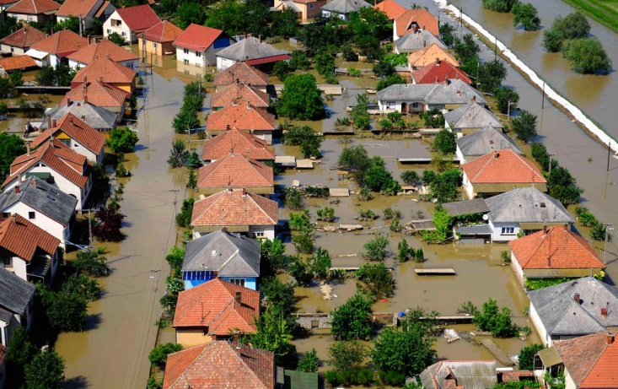
GERMANY:
World Health Organization (WHO) has compiled guidelines for a simplified procedure for exporting narcotic drugs in emergencies.
Germany has reacted to these guidelines by amending Section 15 sub-section 3 of the “Ordinance concerning the Foreign Trade in Narcotics” accordingly.
Such simplified procedures only take effect if the competent authority of the recipient country cannot be reached or is no longer functioning due to the events.
This procedure, as opposed to the normal export process, places the controls exclusively within the responsibility of the exporting country.
Therefore, the authority of the exporting country must place high demands regarding the reliability of the potential suppliers of such aid shipments.
http://www.bfarm.de/EN/FederalOpiumAgency/narcoticDrugs/Ein-Ausfuhr/hinweis-ausfuhr.html
Central Europe, floods, 2010

Slide 37
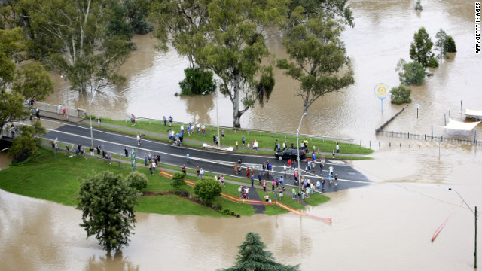
AUSTRALIA:
Missing prescriptions/paperwork: pharmacist can submit a Statutory Declaration to the Department of Human Services (DHS), including a statement about loss of paperwork as a result of natural disaster/emergency, and an undertaking such that if the paperwork is found it will be forwarded to the DHS and that an insurance claim has not been made.
http://www.pbs.gov.au/info/news/2014/04/cyclone-ita-advice-for-pharmacists/
Australia, Queensland floods, 2010-2011

Slide 38
5) HUMAN RESOURCES
Pharmacist licensure/registration mobility

Slide 39
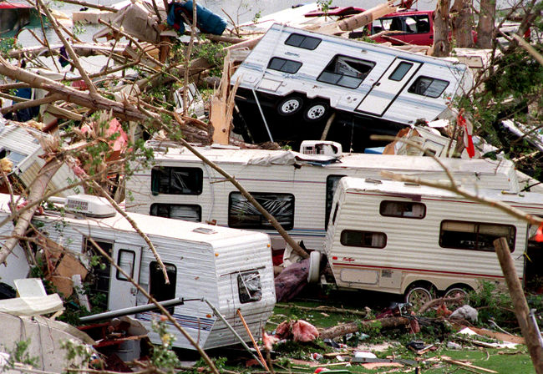
USA and CANADA:
When activated as Federal employees, their licensure and certification are recognized in all States/Provinces.
https://www.phe.gov/Preparedness/responders/ndms/teams/Pages/nprt.aspx
Canada, Alberta Pine Lake tornado, 2000
Notes:
Recognition of Non-Resident Pharmacist Licensure
CANADA:
-July 6th, 2009: 12 Canadian pharmacy regulatory authorities (excluding Nunavut) approved and signed the Mobility Agreement for Canadian Pharmacists (MACP) under NAPRA (National Association of Pharmacy Regulatory Authorities).
-Facilitates the movement of pharmacists across Canada without imposing unreasonable or discriminatory requirements.
USA:
National Pharmacy Response Teams:
-Pharmacists immunizing for the chemoprophylaxis of Americans.
-Located in 3 geographical areas of the United States: Eastern, Central and Western areas.
-When activated as Federal employees, their licensure and certification are recognized in all States.

Slide 40
5) HUMAN RESOURCES
Pharmacy licensure/registration mobility
Temporary pharmacy facilities
Telepharmacies

Slide 41
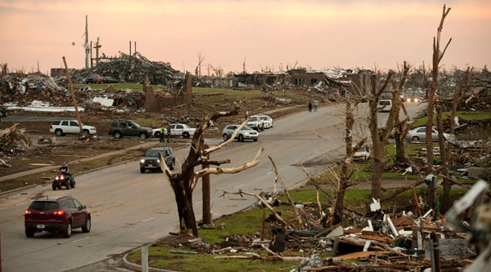
AUSTRALIA:
Emergency temporary relocation of a pharmacy due to damage: Pharmacist to email the Department of Human Services (DHS), with name of affected pharmacy, PBS approval number, addresses of current and temporary premises, and expected timeframe for return to the approved premises.
http://www.pbs.gov.au/info/news/2014/04/cyclone-ita-advice-for-pharmacists/
United States, Missouri tornado, 2011
Notes:
AUSTRALIA
Emergency relocation of a pharmacy:
-Pharmacists seeking to temporarily relocate their approved pharmacy due to damage should send an email to the Department of Human Services (DHS), quoting the name of the affected pharmacy, its current PBS approval number, addresses of the current and temporary premises, and expected timeframe for return to the approved premises.
USA:
Recognition of Non-Resident Pharmacy Licensure
Iowa, U.S.:
A nonresident pharmacy shall apply for and obtain a nonresident pharmacy license from the Board prior to providing prescription drugs, devices, or pharmacy services to ultimate users in this State.
Nonresident pharmacy licenses shall be renewed by December 31 of each year.
Delaware, U.S.:
A pharmacy located outside Delaware must hold a Delaware Non-Resident Pharmacy permit (by filling out an application form) in order to ship, mail, or deliver, in any manner, any controlled substance or prescription drug to a patient in Delaware.

Slide 42
5) HUMAN RESOURCES
Pharmacy licensure/registration mobility
Temporary pharmacy facilities
Telepharmacies

Slide 43
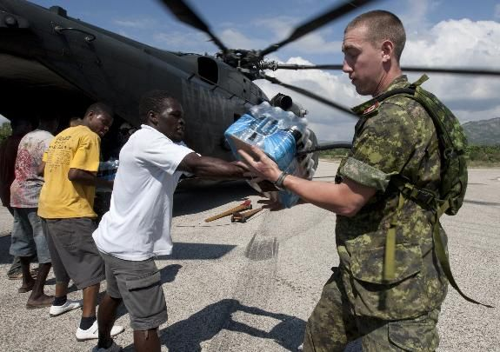
NEED FOR TELEPHARMACIES
Pharmacies and pharmacists inaccessible due to damage and relocation – technology aids communication with pharmacists located in other areas.
There should also be 24-hour telephone lines for medication-related questions to be answered by a pharmacist.
http://www.northwesttelepharmacy.ca/about_us.shtml
Canadian Military, Haïti, 2010
Notes:
Telepharmacies were initially developed to address pharmacist shortages in rural areas. However, they can also play a big role in natural disasters where pharmacies and pharmacists may be inaccessible due to damage and relocation, via the use of technology to communicate with pharmacists in other areas. This indicates the need for legislations to be in place in all areas to allow pharmacists located in other jurisdictions to provide their services remotely to the jurisdiction in need. These telepharmacies have been implemented in parts of Canada as well as in some rural areas of the USA (see Appendix 5b). Some even have 24-hour telephone lines for callers to speak with a nurse regarding their medication-related questions; however, this service should be expanded for all medication-related questions to be posed to a pharmacist.
CANADA
North West Telepharmacy Solutions (NWTS):
Formed to address the significant shortage of pharmacists for hospitals in remote communities within Canada.
Provides remote pharmacy services to over 40 facilities, ranging in size from outpatient family health teams to hospitals exceeding 400 beds and employs over 60 hospital trained pharmacists.
Currently working with HealthLinkBC by providing pharmacist access to BC and Yukon residents for answering medication related questions by calling 8-1-1 to speak with a nurse 24 hours a day.
USA
TelePharmacy (North Dakota State University):
Provides pharmacy services for many remote rural communities throughout North Dakota state.
Through the use of state-of-the-art telecommunications technology, pharmacists are able to provide pharmaceutical care to patients at a distance.
Telepharmacy expands access to quality health care to communities nationwide, primarily in rural, medically-underserved areas.
A licensed pharmacist at a central pharmacy site supervises a registered pharmacy technician at a remote telepharmacy site through the use of video conferencing technology.
Telepharmacy sites in North Dakota are full service pharmacies that have complete drug inventories, including over-the-counter and prescription drugs.

Slide 44
5) HUMAN RESOURCES
Patient relocation recognition

Slide 45
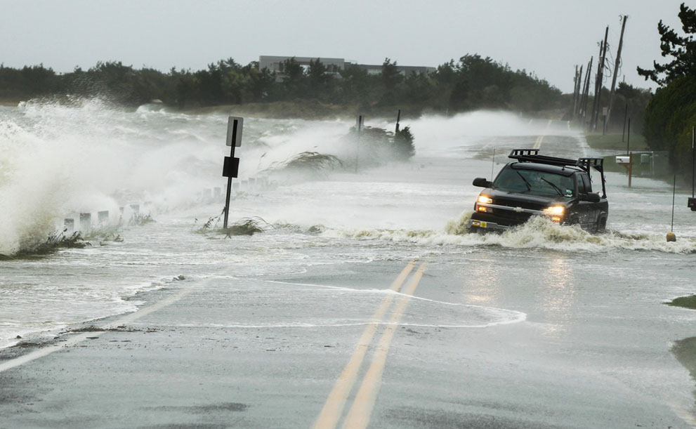
USA:
Illinois Emergency Dispensing Guidelines recognize only patients relocating from Louisiana, Mississippi, and Alabama as a result of natural disaster.
Minnesota Emergency Dispensing Policy recognizes only patients relocating from Louisiana, Mississippi, Alabama, and Florida as a result of natural disaster.
http://idfpr.com/News/NEWSRLS/EmergencyDispensingGuidelines.pdf
http://www.phcybrd.state.mn.us/Katrina.htm
United States, Hurricane Sandy, 2012
Notes:
Recognition of Residents relocating from other jurisdictions
Illinois Emergency Dispensing Guidelines recognize only patients relocating from Louisiana, Mississippi, and Alabama as a result of natural disaster.
Minnesota Emergency Dispensing Policy recognizes only patients relocating from Louisiana, Mississippi, Alabama, and Florida as a result of natural disaster.

Slide 46
5) HUMAN RESOURCES
Delegation of responsibilities to regulated pharmacy technicians

Slide 47
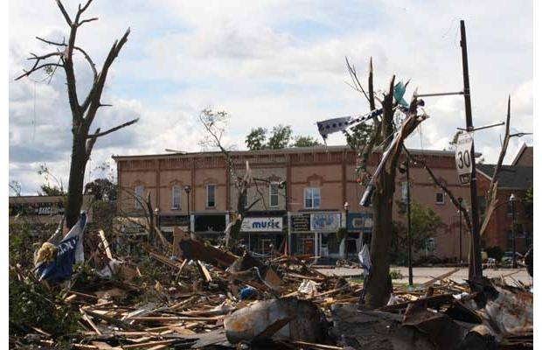
NEED FOR DELEGATION TO TECHNICIANS
Technicians are responsible for dispensing processes and free up pharmacists’ time for clinical patient care roles (e.g. prescribing, vaccinating, counselling).
CANADA:
“Tech-check-tech” program: regulated technicians perform final verification of prescriptions – having at least 2 technicians (rather than a pharmacist) check order-entry accuracy.
Receive and transcribe verbal prescriptions from physicians.
Licensure mobility across all provinces.
http://napra.ca/Content_Files/Files/Model_Standards_of_Prac_for_Cdn_PharmTechs_Nov11.pdf
http://www.medscape.com/viewarticle/750654
http://blueprintforpharmacy.ca/docs/kt-tools/pharmacists'-expanded-scope_summary-chart-
--cpha---october-2013.pdf
Canada, Goderich Ontario tornado, 2011
Notes:
CANADA:
-Technicians interpret and input prescriptions, bill insurance plans, calculate dosages, select and count the appropriate medications, compound sterile and non-sterile products, maintain inventory.
-5 Canadian provinces (BC, AB, ON , NB, NS) currently have Regulated Technicians.
-“Tech-check-tech” program: Regulated technicians perform the final verification of prescriptions – having at least two technicians (rather than a pharmacist) check the order-entry accuracy.
-Receive and transcribe verbal prescriptions from physicians.
-Licensure mobility across all provinces.
http://napra.ca/Content_Files/Files/Model_Standards_of_Prac_for_Cdn_PharmTechs_Nov11.pdf
http://www.jcfswinnipeg.org/documents/Pharmacy-RolesandResponsibilities.pdf
http://www.medscape.com/viewarticle/750654
http://blueprintforpharmacy.ca/docs/kt-tools/pharmacists'-expanded-scope_summary-chart---cpha---october-2013.pdf
http://www.bcpharmacists.org/about_us/key_initiatives/index/articles/27.php
http://napra.ca/pages/pharmacytechnicians/default.aspx

Slide 48
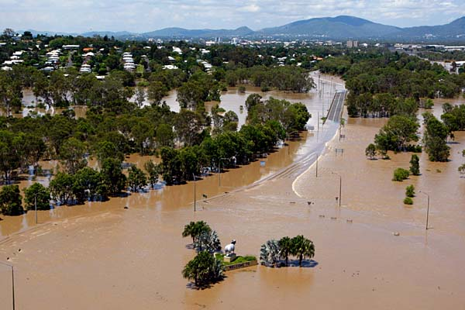
Pharmacy Practice Response to Natural Disasters-
A qualitative study of issues and challenges encountered
by pharmacy organizations during natural disasters
Dr. Régis Vaillancourt, B Pharm, Pharm D; Dr. Annie Pouliot, PhD ; Dr. Sylvain Grenier, Pharm D;
Jane Dawson, FPS; Sherwin Fernandes, BSc Pharm Candidate; Laure Breton, Pharm D Candidate
Australia, Queensland flood, 2010-2011

Slide 49
OBJECTIVES OF THE STUDY
Synthesize the issues/challenges faced by pharmacists who have responded to a natural disaster
Analyze lessons learned from past natural disaster from a pharmacy standpoint
Turkey, earthquake, 2011

Slide 50
STUDY DESIGN
A qualitative, retrospective, descriptive, participatory study
⇨ Including semi-structured interviews and informative documents from participants
Participants: members or contacts of the Military and Emergency Pharmacy Section of the FIP
Canadian, Australian, New Zealand and American military
Japan Red Cross
Chinese People’s Liberation Army
New Zealand, earthquake, 2011

Slide 51
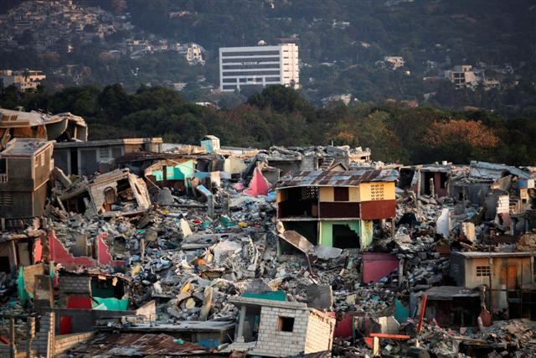
Natural Disasters Participants Were Involved In
Australia, flood, 2010-2011
Australia, floods, 2011
New Zealand, Christchurch, earthquake, 2011
Japan, earthquake, 2004
Japan, earthquake/ tsunami, 2011
China, earthquake, 2006
Turkey, earthquake, 1999
Turkey, earthquake, 2011
Pakistan, earthquake, 2005
United States, hurricane, 2005
Haiti, earthquake, 2010
Haïti, earthquake, 2010

Slide 52
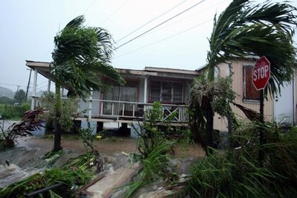
DATA ANALYSIS
Interviewed 6 participants
Data coded and analyzed using Microsoft Excel
Issues/challenges were grouped together in common themes
⇨ 6 major themes
⇨ 22 issues/challenges
United States, hurricane, 2005

Slide 53
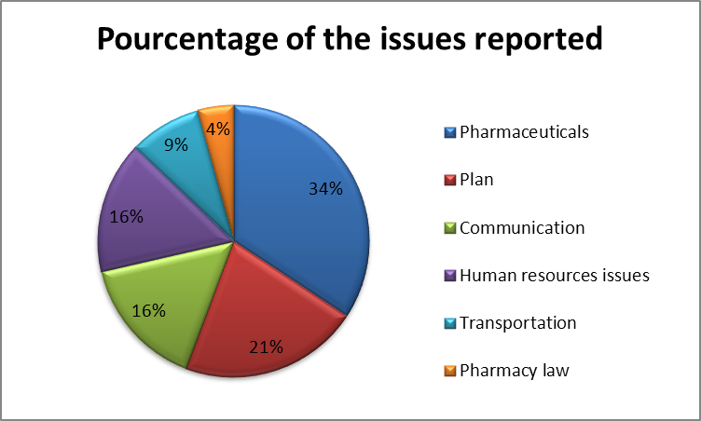
RESULTS
Issues Reported by Percentage

Slide 54
Pharmaceuticals
Frequency Mentioned | Issues/Challenges | Frequency Mentioned
24 | Supply shortage (rationing, no stock pills) | 8
 | Destruction of infrastructures, warehouses | 6
 | Issue with medical supply chain (storage, quality, expiry date, backorders) | 4
 | Type of medications needed (pediatric, chronic treatment, 1st line therapy) | 3
 | Tourist lost medication | 2
 | Seeking behaviour for narcotics | 1

Slide 55
Plan
Frequency Mentioned | Issues/challenges | Frequency Mentioned
15 | Need of Standard Operating Procedures and formularies for each section deployed | 7
 | No plan in place for natural disaster or working on an emergency management framework | 4
 | Need of a flexible plan, flexible kit of medications | 3
 | Multi-days delay before the start of the relief plan | 1

Slide 56
Communication
Frequency Mentioned | Issues/Challenges | Frequency Mentioned
11 | Communication tools missing (telephone, electronic record) | 5
 | Language barriers with patients | 3
 | Communication issues within the relief team (pharmacist, physician) and between different sites | 3

Slide 57
Human Resources Issues
Frequency Mentioned | Issues/Challenges | Frequency Mentioned
11 | Insufficient staff (pharmacists, physicians, pharmacy technicians) | 5
 | No experience, uneducated staff deployed | 3
 | Local pharmacists did not know what help they needed | 2
 | Difficulties determining credentials of locally hired staff | 1

Slide 58
Transportation
Frequency Mentioned | Issues/Challenges | Frequency Mentioned
6 | Blocked transportation routes, roads, airports | 3
 | Unorganized airports caused delay in receiving supplies and finding medical supplies | 2
 | Limited or inadequate room on plane for medical supplies | 1

Slide 59
Pharmacy Law
Frequency Mentioned | Issues/Challenges | Frequency Mentioned
3 | Pharmacists prescribing on own cognizance (refills, etc.) | 2
 | Emergency provisions to relocate and open new pharmacies | 1

Slide 60
LESSONS LEARNED
Appropriate medication is not always available in a timely manner.
Standard Operating Procedures and formularies are needed to increase the efficiency and effectiveness of the response effort.
Natural disasters are not predictable, meaning that pharmacy organizations need to be perpetually prepared.

Slide 61
LESSONS LEARNED (CONTINUED)
Communication allows for a coordinated effort and needs to be improved
Between different sites
Between each section nurses/pharmacists/technicians/physicians
With the organization units and supply depots in the home country
In some countries, language barriers exist and/or the rates of illiteracy are high, and pictograms or interpreters are needed to communicate with patients about medication instructions.
Organizations responding to natural disasters often lack pharmacy human resources to handle the workload during a natural disaster.
Transport logistics for medications is lacking.

Slide 62
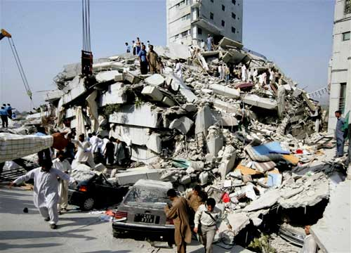
LESSONS LEARNED (CONTINUED)
Pharmacy laws in natural disasters can impede medical aid.
Legislative changes have to be temporary set up:
allow pharmacists to provide prescription medications during the emergency out of their own cognizance
dispense new medications and refills
allow the relocation of and setting up of pharmacies in places that would not have met regular pharmacy requirements.
Pakistan, earthquake, 2005

Slide 63
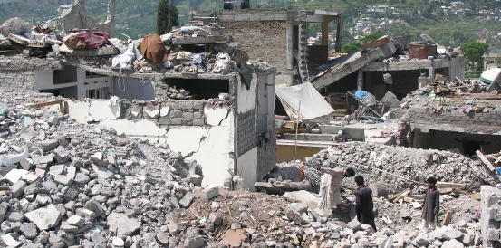
CONCLUSION
Legislation exists to support the role of pharmacists in natural disasters, including:
Dispensing emergency supplies, making therapeutic substitutions, and initiating prescriptions
Administering vaccinations and other drugs by injection
Monitoring over-the-counter drug sales to prevent outbreaks
Having protocols on narcotic drug control and disposal
Managing human resources to allow licensure and registration mobility for pharmacists and pharmacies, recognizing relocated patients, and delegating to pharmacy technicians
Pakistan, Kashmir earthquake, 2005

Slide 64
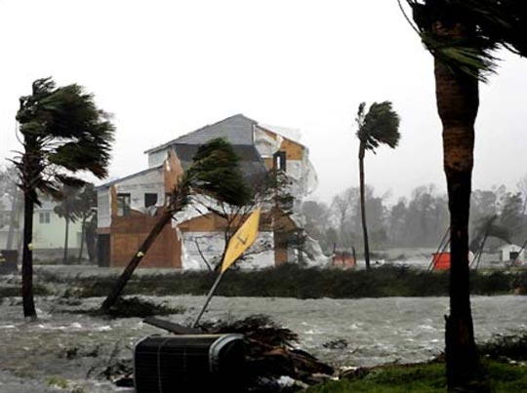
CONCLUSION (CONTINUED)
Pharmacy teams hold a unique and crucial position in natural disaster relief.
6 main themes (Medicines, Planning, Communication, Human Resources, Transportation and Law) emerged from the semi-structured interviews highlighting key challenges to pharmacists’ involvement in responses to natural disasters
Next Step: Draft recommendations for pharmacy organizations responding to future natural disasters
United States, Hurricane, 2005

Slide 65
REFERENCES
^{[1]} International Pharmaceutical Federation. (2006). The Role of The Pharmacist in Crisis Management: Including Manmade and Natural Disasters and Pandemics. Amsterdam, North Holland: FIP Press.
^{[2]} Monteiro, S., M. Shannon, T. J. Sandora, and S. Chung."Pediatric Aspects of Hospital Preparedness."Clinical Pediatric Emergency Medicine 10 (2009): 216-28.
^{[3]} VanVactor, J. D. "Health Care Logistics Response in a Disaster." Journal of Homeland Security and Emergency Management 7 (2010): n. pag.
^{[4]} Currier, M., D. S. King, M. R. Wofford, B. J. Daniel, and R. DeShazo. "A Katrina Experience: Lessons Learned." The American Journal of Medicine 119 (2006): 986-92.

