Slide 1


THE LATEST ON TRANSMISSION & THE CURRENT GLOBAL SITUATION
LAST UPDATE: 22 July 2020
CORONAVIRUS UPDATE
32
What do we know about
COVID-19 transmission?

Slide 2








Current global situation
22 July 2020
> 14,7 million cases
> 600,000 deaths
5 countries with highest cumulative number of cases
5 countries with highest cumulative number of deaths
United States of America
Brazil
India
Russian Federation
South Africa
United States of America
Brazil
The United Kingdom
Mexico
Italy

Slide 3
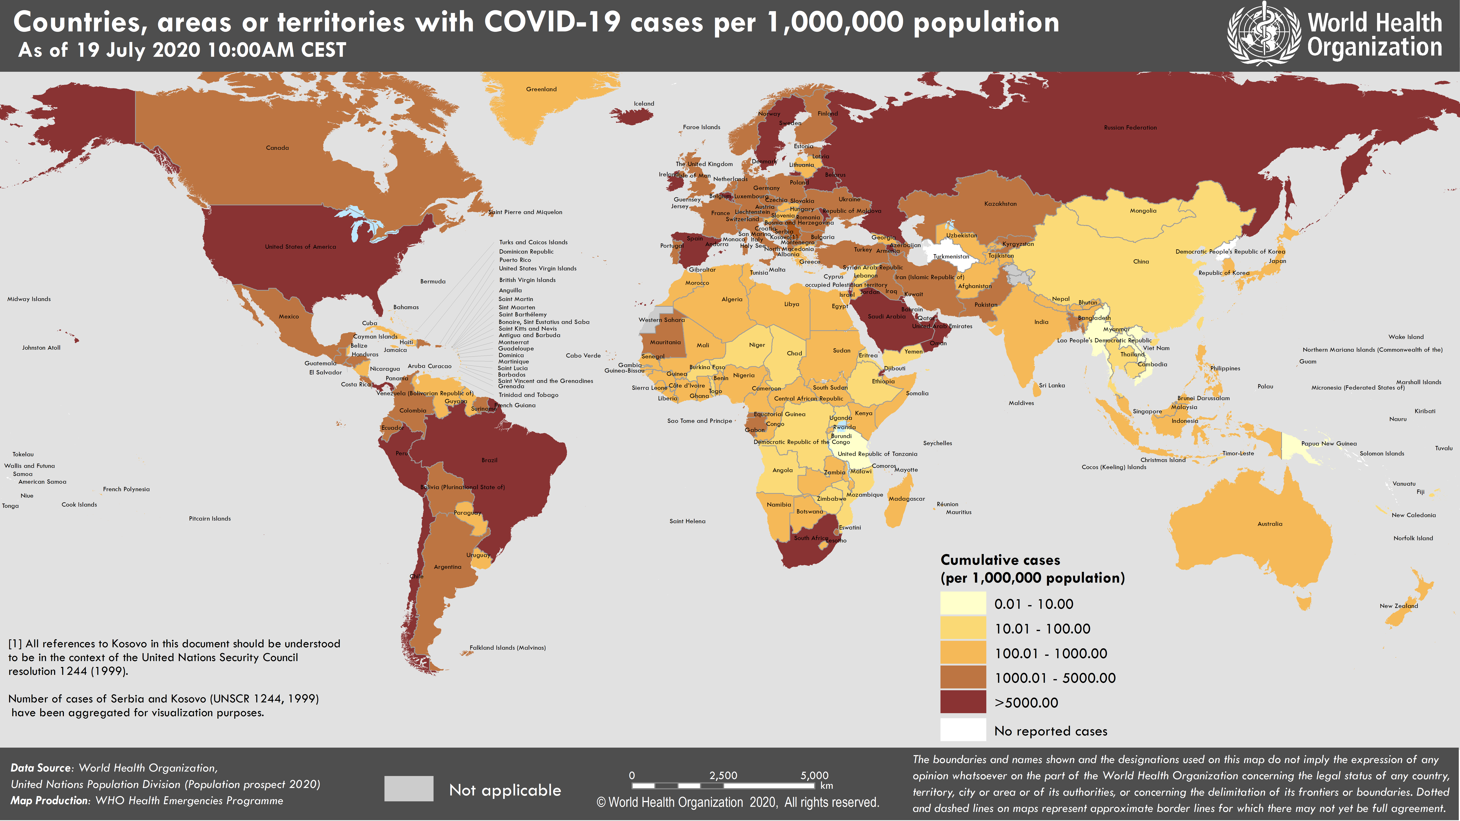
Countries, areas or territories with COVID-19
Cases per 1,000,000 population
(AS OF 19 JULY 2020 10:00AM CEST)

Slide 4
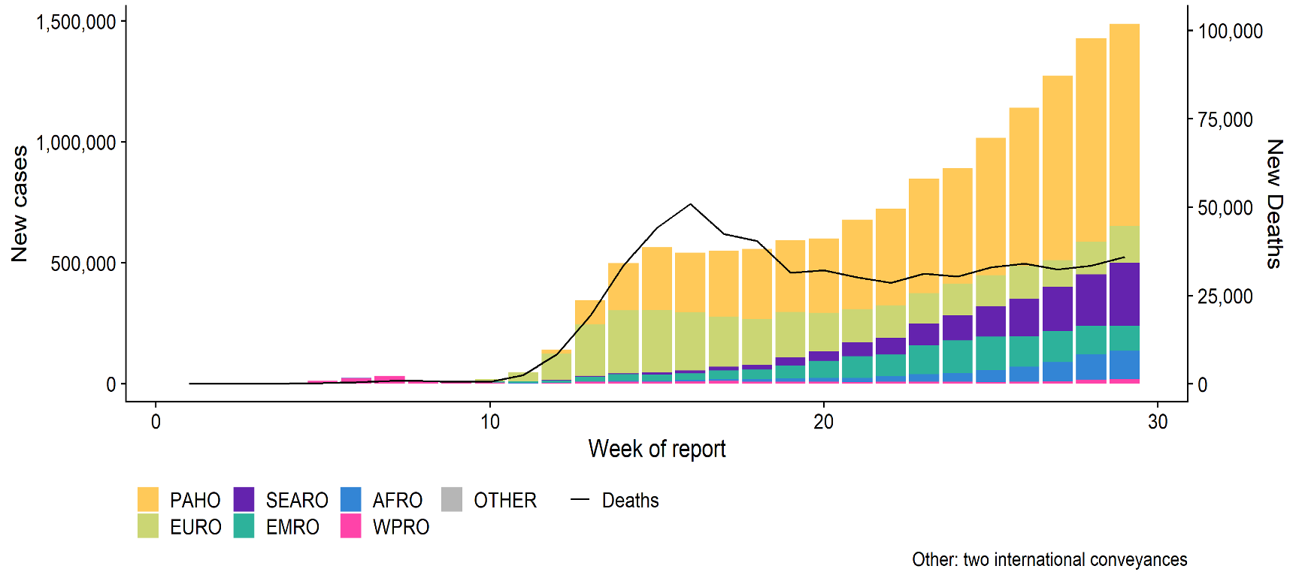
Global epidemic curve by region
(cases reported to WHO, 19 July 2020)
NUMBER OF NEW CONFIRMED COVID-19 CASES & DEATHS BY WEEK
19 JULY: 14,043,176 CASES & 597,583 DEATHS

Slide 5
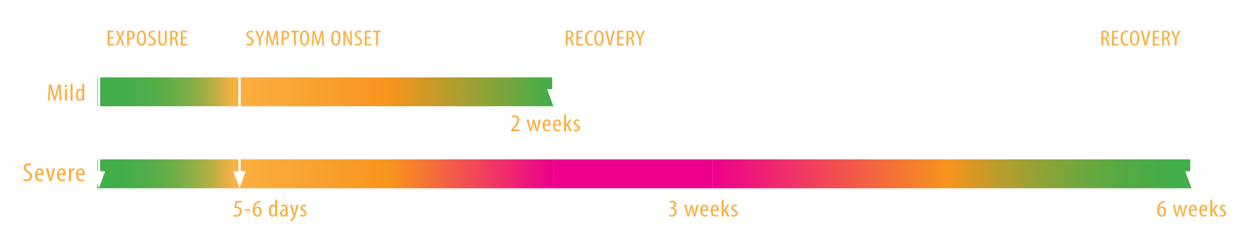
Clinical insights
Average time from infection to onset of symptom is 5-6 days
Most people with COVID-19 experience mild symptoms or moderate illness
Approximately 10-15% of cases progress to severe disease, and about 5% become critically ill
Some report that symptoms may linger for weeks, including extreme fatigue, shortness of breath, cough
COVID-19 is reported much less frequently in children than in adults
Children tend to have mild disease. Rarely, a few may develop serious illness

Slide 6

What do we know about COVID-19 transmission?
COVID-19 is spread primarily through droplets and direct contact.
The upcoming slides will address when, where and how COVID-19 spreads.
There are still many unanswered questions and more studies are urgently needed to investigate and assess the importance of the different modes of transmission in different settings.

Slide 7


How does COVID-19 spread?
The spread of COVID-19 from person to person is mainly by droplet and contact transmission
Virus from the nose and throat is carried in droplets from the mouth or nose when an infected person speaks, coughs, sings or sneezes.
In the days following exposure, infected persons can transmit the virus to others before symptoms appear (1-3 days before symptom onset) and early in the course of illness.
A person who touches a surface or object that has the virus on it, then touches their eyes, nose or mouth before they clean their hands can also become infected.

Slide 8
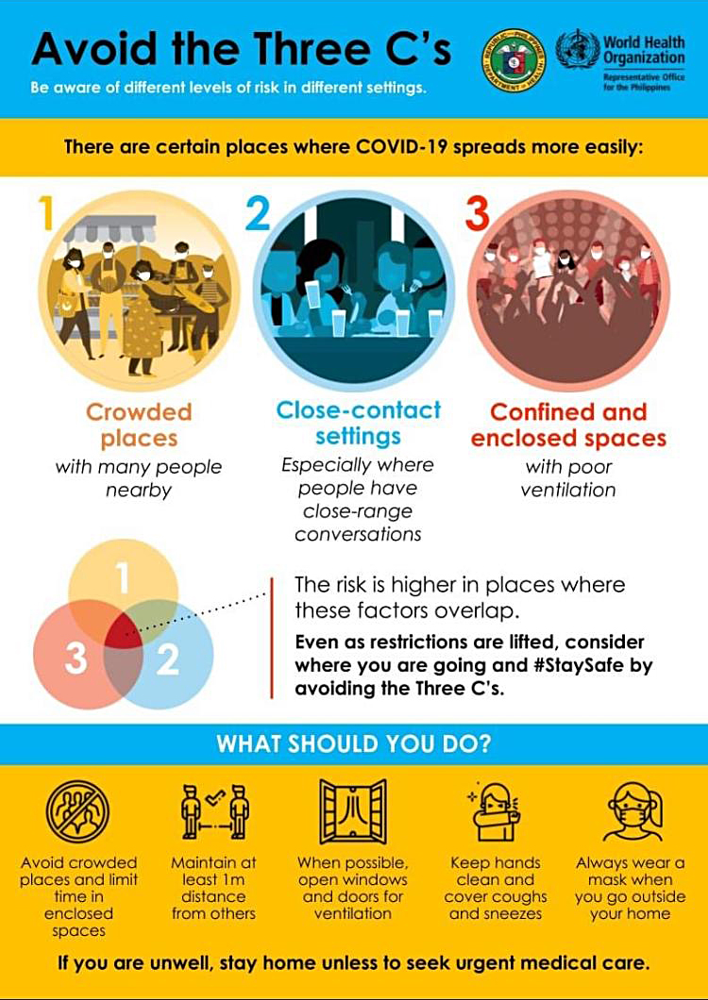
Where does COVID-19 spread most easily ?
COVID-19 tends to spread readily in:
Closed settings – such as long-term living homes, correctional facilities (prisons)
Crowded settings without distancing – gatherings, parties, sports events, restaurants & public transportation
Confined and crowded indoor settings without good ventilation – such as nightclubs, bars, private gatherings
Specific workplace settings - dormitories for migrant workers, meat processing plants, etc.

Slide 9


When does COVID-19 spread?
Can someone with no symptoms spread COVID-19?
YES. An infected person without symptoms can transmit the virus
  Someone exposed and infected can transmit the virus by producing respiratory droplets in the pre-symptomatic period, up to three days before the onset of symptoms.
  For someone who is infected and remains symptom-free, onward transmission can occur. The extent of transmission from people who remain well is unknown and likely depends on the setting.
  Wear a face covering to protect others
An infected person with symptoms can also transmit the virus
  Transmission is highest at the beginning of illness, when symptoms
  may still be mild. This is why it is so important to stay home, even with the mildest symptoms.

Slide 10
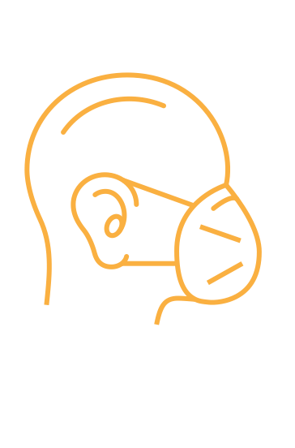
Does aerosol (airborne) transmission of COVID-19 occur?
Aerosol transmission occurs when certain medical procedures are performed
  Health workers performing these procedures must wear personal protective equipment, including specifically designed masks
  (e.g. N95, FFP2).
In crowded poorly ventilated indoor spaces, where people are talking, shouting or singing, aerosol transmission may also be occurring.
  Aerosol transmission may play a role in COVID-19 outbreaks reported in closed settings such as nightclubs, restaurants, some places of work and places of worship.
  Fabric masks can reduce transmission where physical distancing cannot be achieved.
  To date, there is insufficient data to determine the contribution of aerosol transmission in community settings.

Slide 11



Transmission from contaminated surfaces and objects
People with the virus in their nose and throat may leave traces of virus-laden droplets on objects and surfaces (also called ‘fomites’). For example, when they sneeze, cough on, or touch surfaces such as tables, doorknobs and handrails.)
Other people may become infected by touching these objects or surfaces, then touching their eyes, nose or mouth.
Therefore, it is essential to thoroughly clean hands regularly with soap and water or an alcohol-based hand rub product, and to clean surfaces regularly.

Slide 12
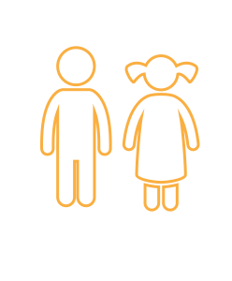
What is the role of children and adolescents in the transmission of COVID-19?
Children and adolescents can be infected and spread COVID-19
COVID-19 is reported much less frequently in children than in adults
Children tend to have milder disease than adults. Rarely, a few may develop serious illness.
Studies to date show minimal spread among children under ten years
Infection occurs more often in teenagers than in younger children
Children and adults should follow the same guidance on self-isolation if there is a risk they have been exposed or are showing symptoms.

Slide 13
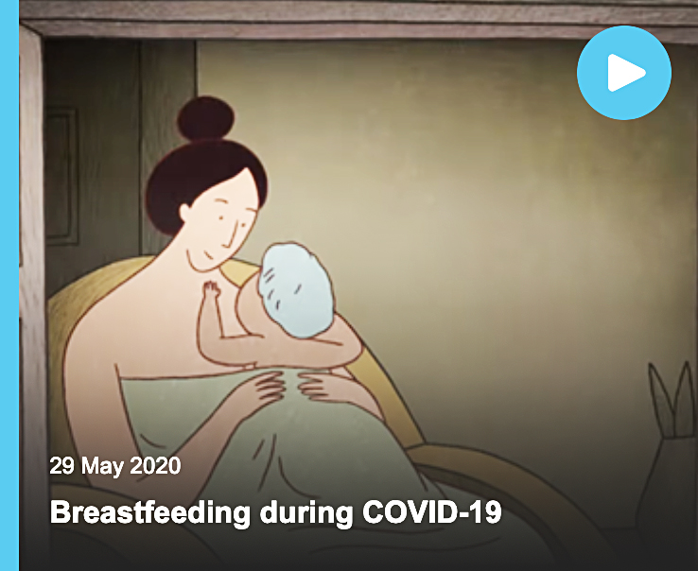
What is known about mother-to-child transmission of COVID-19?
There has to date been no viable virus found in breastmilk of mothers with COVID-19.
  A mother with suspected or confirmed COVID-19 should be supported to breastfeed safely, hold her new-born skin-to-skin and share a room with her baby.
  When breastfeeding with COVID-19, wear a mask, wash hands before and after touching baby, and routinely clean and disinfect surfaces.
The placenta does not appear to contain receptors used by the SARS-CoV-2 virus to gain entry into cells. There has been one report of an infant infected through intrauterine transmission.
Information on mother-to-child transmission remains limited and requires further study.
VIDEO:
Breastfeeding during COVID-19

Slide 14
What is known about the transmission of COVID-19 via the faecal-oral route?
There are no reports or evidence of faecal-oral spread of COVID-19
  Some studies have detected viral RNA in faeces or shown viral RNA contamination of toilets.
  Viable virus has been found in stool in a very small number of individuals. The significance of this finding is not yet known. More research is needed.
There is no evidence to date of survival of the SARS-CoV-2 virus in water or sewage
  Environmental surveillance studies are underway in many countries. These have so far detected viral RNA, but not viable virus.
  Some countries are exploring the use of detection of viral RNA fragments in waste water to provide early warning of resurgence of infection

Slide 15
How can we protect ourselves and others?
Stay home and self-isolate if you feel unwell, even with mild symptoms
Clean hands frequently with soap and water for 40 seconds or with alcohol-based hand rub for 20 seconds
Cover your nose and mouth with a disposable tissue or flexed elbow when you cough or sneeze
Avoid touching your eyes, nose and mouth
Maintain a minimum physical distance of at least 1 metre from others
Stay away from crowds and stay away from poorly ventilated indoor spaces
Use a fabric mask where physical distancing of at least 1 metre is not possible
Use a medical / surgical mask if you may be at higher risk (age, medical conditions)
Regularly clean and disinfect frequently-touched surfaces
VIDEOS:
Transmission
How to break the chains of transmission
Protecting ourselves
How to protect yourself against COVID-19
Seven steps to prevent the spread of the virus
Masks
Medical and fabric masks: who wears what when?
How to wear a fabric mask safely
How to wear a fabric mask
How to wear a medical mask

Slide 16
Stopping transmission with contact-tracing
should be:
tested
isolated if positive, and
receive medical care, if needed
Anyone who is exposed to COVID-19 or develops symptoms even in the absence of known exposure
must be:
identified (from 2 days before until
14 days after symptoms or test result)
contacted by public health authorities, and
placed in quarantine or asked to self-quarantine for 14 days
For every person who tests positive, all persons with whom they have been in contact
FACT: some countries successfully trace
and quarantine contacts of contacts to suppress transmission

Slide 17
WHO guidance on COVID-19 transmission
Additional resources
SCIENCE BRIEF ON TRANSMISSION
https://www.who.int/publications/i/item/modes-of-transmission-of-virus-causing-covid-19-implications-for-ipc-precaution-recommendations
INTERIM GUIDANCE ON MASKS
https://www.who.int/publications/i/item/advice-on-the-use-of-masks-in-the-community-during-home-care-and-in-healthcare-settings-in-the-context-of-the-novel-coronavirus-(2019-ncov)-outbreak
Q&A ON TRANSMISSION
https://www.who.int/emergencies/diseases/novel-coronavirus-2019/question-and-answers-hub/q-a-detail/q-a-how-is-covid-19-transmitted
Q&A: SCHOOLS AND COVID-19
https://www.who.int/emergencies/diseases/novel-coronavirus-2019/question-and-answers-hub/q-a-detail/q-a-schools-and-covid-19
BREASTFEEDING AND COVID-19
https://www.who.int/publications/i/item/10665332639

Slide 18
Recent studies
Transmission of COVID-19
SARS-COV-2 REVERSE GENETICS REVEALS A VARIABLE INFECTION GRADIENT IN THE RESPIRATORY TRACT; Cell 2020
  This paper supports the understanding that SARS-CoV-2 replicates in the upper airways and helps explain why virus is present in large quantities even before, and around the time, that symptoms begin to appear.
PHYSICAL DISTANCING INTERVENTIONS AND INCIDENCE OF COVID-19: NATURAL EXPERIMENT IN 149 COUNTRIES; BMJ; July 15, 2020
  This study showed that physical distancing was associated with a 13% lower incidence of COVID-19. Early movement restrictions were associated with lower COVID-19 incidence compared with later implementation.
ABSENCE OF APPARENT TRANSMISSION OF SARS-COV-2 FROM TWO STYLISTS AFTER EXPOSURE AT A HAIR SALON WITH A UNIVERSAL FACE COVERING POLICY; CDC MMWR; July 17, 2020
  139 clients were in contact with two hair stylists with confirmed COVID-19 and symptoms. There were no secondary cases reported. The 67 clients tested all had negative test results.
  Both the stylists and the clients wore face masks, which likely prevented spread of COVID-19.
Cell 2020 https://www.cell.com/cell/pdf/S0092-8674(20)30675-9.pdf
BMJ; July 15, 2020 https://www.bmj.com/content/bmj/370/bmj.m2743.full.pdf
CDC MMWR; July 17, 2020 https://www.cdc.gov/mmwr/volumes/69/wr/pdfs/mm6928e2-H.pdf

Slide 19
What information is needed to better understand COVID-19 transmission?
WHO and partners are working to better understand:
transmission routes, including via droplets of different sizes, physical contact, surfaces and objects, and the role of aerosol transmission in the community;
dose of virus required for infection to occur;
characteristics of people, settings and situations in which superspreading events are observed (e.g. in some closed settings);
proportion of infected persons who remain asymptomatic throughout the course of their infection; the proportion of these who transmit the virus to others;
specific factors that drive asymptomatic and pre-symptomatic transmission and the proportion of infections arising from asymptomatic individuals.

Slide 20
www.who.int/epi-win

